Slide 1
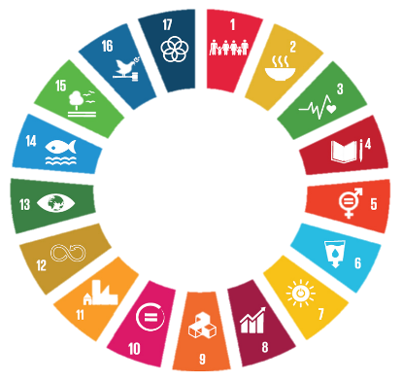




Transforming tourism for a resilient and sustainable post-COVID world
OECD Global Forum on Tourism Statistics, Knowledge and Policies
Thursday 4 November, 2021
Helena Rey, Programme Officer
Consumer and Production Unit
Notes:
Today I’d like to present key findings of UNEP research on transforming tourism in the pan European region, for a resilient and sustainable post-COVID world to give the context of our discussion on how we can transform tourism for a resilient and sustainable post-COVID world.

Slide 2
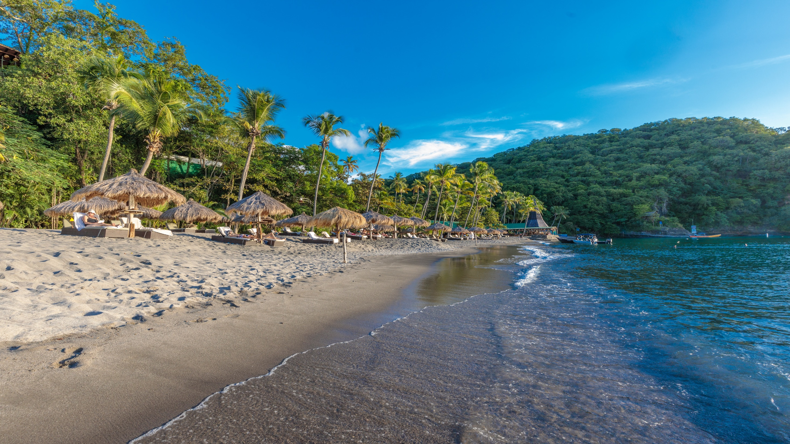



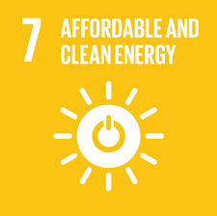
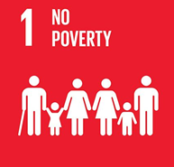
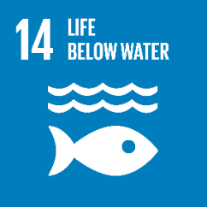


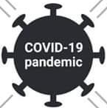



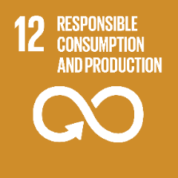
Impacts on tourism environment in Pan-Europe
Drop in oil prices makes transition to renewable and sustainable energy investments less attractive
Jobs accommodation and food services make 20% of all vulnerable
positions.
11.5 m travel and tourism jobs have been impacted in the region
Increase of plastic pollution and use of single use plastic products including PPE in transport, accommodation & restaurants
Sanitization and hygiene standards, increasing the use of chemical products in tourism destinations and pollution in waste water
Reduced air emissions of GHG, including due to major international travel arrivals decrease.
Waste management challenges including disposal of single use plastic products
Trust and health concerns driving consumer demands for social distancing and hygiene
Surge in domestic nature-based tourism in protected and conserved areas post-lockdown, leading to overcrowding & waste management challenges
UNEP (forthcoming report) Transforming tourism in the Pan European region for a resilient and sustainable post-COVID word
Notes:
UNEP conducted a survey to understand the environmental impacts of COVID-19 on the tourism sector in the pan-European Region in June 2021. The online survey received 135 responses from people representing government, NGOs, tourism businesses, associations, and research institutions in 35 countries, although focused on a specific region. Key impacts identified and the relation with SDGs are highlighted in this slide, they range from increase challenges with waste management, including increase use of single use plastics, overcrowding in natural areas due to tourists behavioural changes. I will not enter in details on the each of the environmental impacts identified, the report will be launched in the next weeks. Next slide

Slide 3
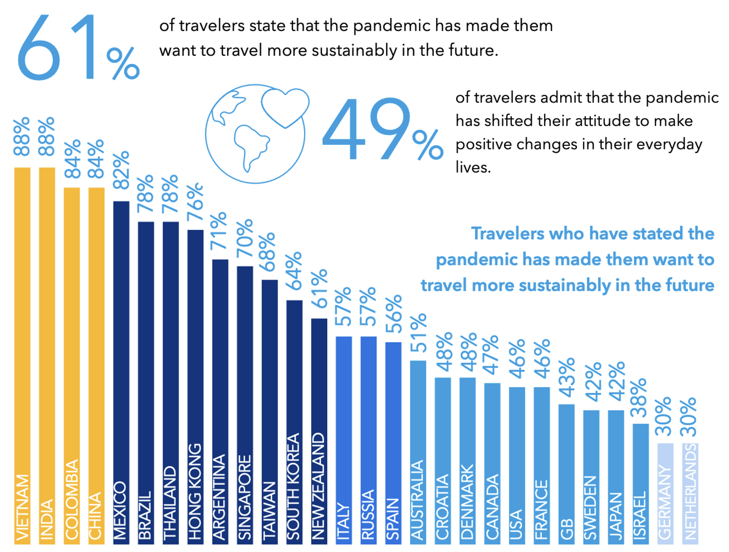
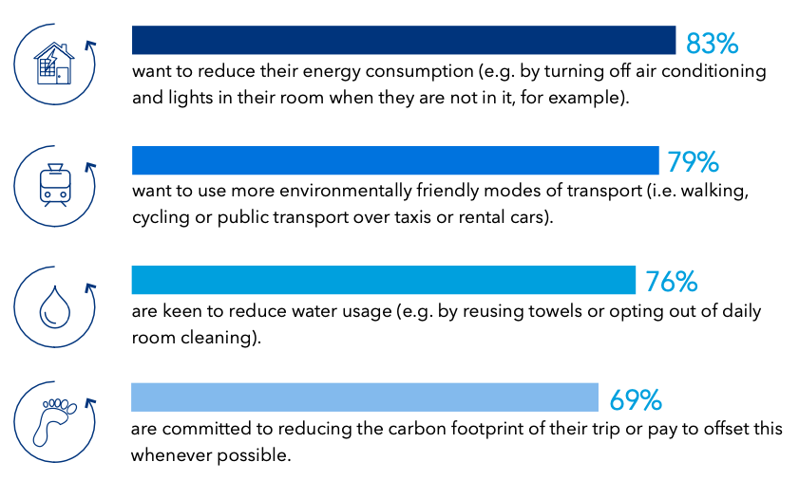
Implications for sustainable tourism
https://globalnews.booking.com/bookingcoms-2021-sustainable-travel-report-affirms-potential-watershed-moment-for-industry-and-consumers/
Notes:
But I will highlight the implication for sustainable tourism , as consumer research amid the pandemic suggests that we are in a watershed moment where the majority of travellers say that the pandemic has made them want to travel more sustainably in the future.­ Travellers are particularly concerned about excess waste, threats to local wildlife and natural habitats, overcrowding at popular sights and destinations, and greenhouse gas emissions.­
This suggests we are at a critical tipping point to drive sustainable tourism in destinations and across the industry, and capitalise on the sustainability trend, and that we should take advantage of this pivotal moment to drive it into the mainstream. This switch to more sustainable tourism offers will require finance and technical support from governments and private sector.

Slide 4
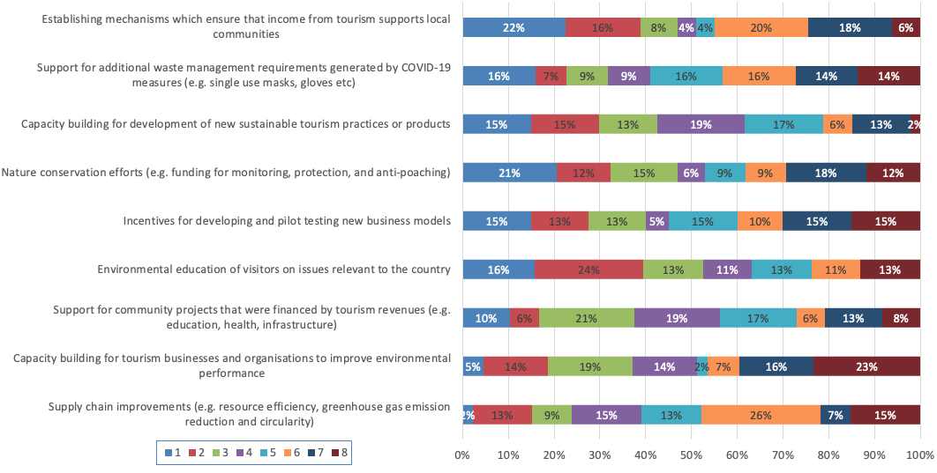
- Financial & technical resources
Where is financial support most required to enhance the sustainability of the tourism sector in the post-pandemic period? Ranked importance: 1 most important, 8 least important
Notes:
Across Europe, millions of Euros have been made available by governments and destination management organisations (DMO), in order to address sustainable tourism challenges. We know by now the opportunity for using COVID-19 fiscal rescue and recovery spending to stimulate the economy while fostering a low-carbon transformation has been missed in most countries so far. Only 17-19 per cent of total recovery investments to May 2021 are likely to reduce greenhouse gas emissions (USD 438 billion out of a total USD 2.28 trillion in recovery spending according to the Global Recovery Observatory). Βυτ συρϖεψ ρεσπονδεντσ ηιγηλιγητεδ φινανχιαλ συππορτ ισ νεεδεδ for capacity building for development new sustainable tourism practices and products; and establishing mechanisms that ensure nature protection. Increasing sustainable finance and investment is needed to boost innovation, strengthen skills and support new initiatives across the tourism value chain. Investment support in training programmes and other business development is a necessary condition to the green transformation of micro, small and medium -sized enterprises.

Slide 5
Policy measures
1. Strengthen policy, regulatory and institutional frameworks to prevent future crises
2. Stimulate supportive fiscal measures and disable harmful ones
3. Support investment and finance for sustainable tourism practices
4. Accelerate sustainable infrastructure and retrofitting towards Net Zero, and resource efficient operations
8. Establish Measurement, Reporting and Verification (MVR) systems
7. Engage with tourism stakeholders and partners, and build their capacity to participate effectively
6. Adopt digital, circular and technology solutions
5. Adopt sustainable procurement and consumer information tools, including sustainability standards and voluntary certification schemes
9. Support vulnerable groups, including women, youth and migrants
10. Invest in research to support science-based decision making in tourism
11. Develop partnerships for collaboration across the tourism value chain
Notes:
Eleven policy measures have been formulated from the literature and survey responses suggest the following proposals to support sustainable tourism in the future, and address increasing risks of natural disasters, climate change, and pandemics.
These address
Policy, regulatory and institutional frameworks
Supportive fiscal measures
Investment and finance for sustainable tourism practice
sustainable infrastructure and retrofitting towards Net Zero
Establish Measurement, Reporting and Verification (MVR) system
Stakeholder engagement and capacity building
digital, circular and technology solutions
sustainable procurement
Supporting vulnerable groups
Investment in research and
Development of partnerships
Alignment of policies and investment, public-private partnerships and cooperation across the tourism value chains are key to sustainable recovery. Therefore, improving the dialogue and strengthening cooperation among businesses, local authorities, civil society and vulnerable groups is essential. Governments need to facilitate, measure and report policy coherence, key indicators (environmental, social, economic) and consistency of actions across the tourism value chain and related sectors.

Slide 6


Thank you!
Contact us:
Helena Rey De Assis
www.unenvironment.org
Notes:
This analysis will be used to prepare background and participant information papers for the forthcoming EfE Ministerial Conference conference, in October 2022, and to promote green solutions that help Europe to build back better from the pandemic and other crises.
Thank you for your kind attention

