Slide 1
projects:
MSK(art)
Velzeke(history)
Zwin(nature)

Slide 2
projects:
MSK (art)
Velzeke (history)
Zwin (nature)

Slide 3
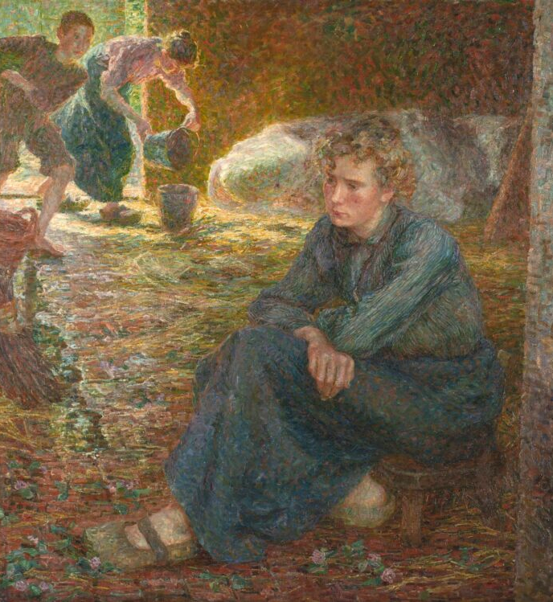
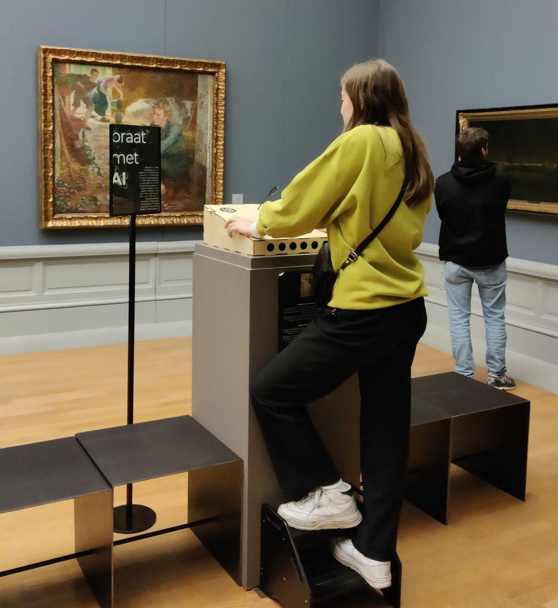

pilot
winter ‘23
anonymous vrouw
Jenny Montigny’s ‘The Cattle Shed’

Slide 4
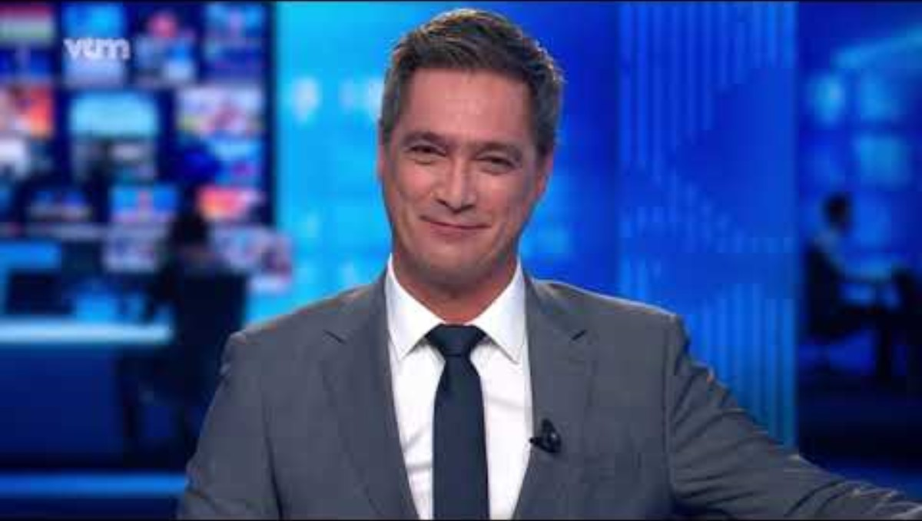
4

Slide 5
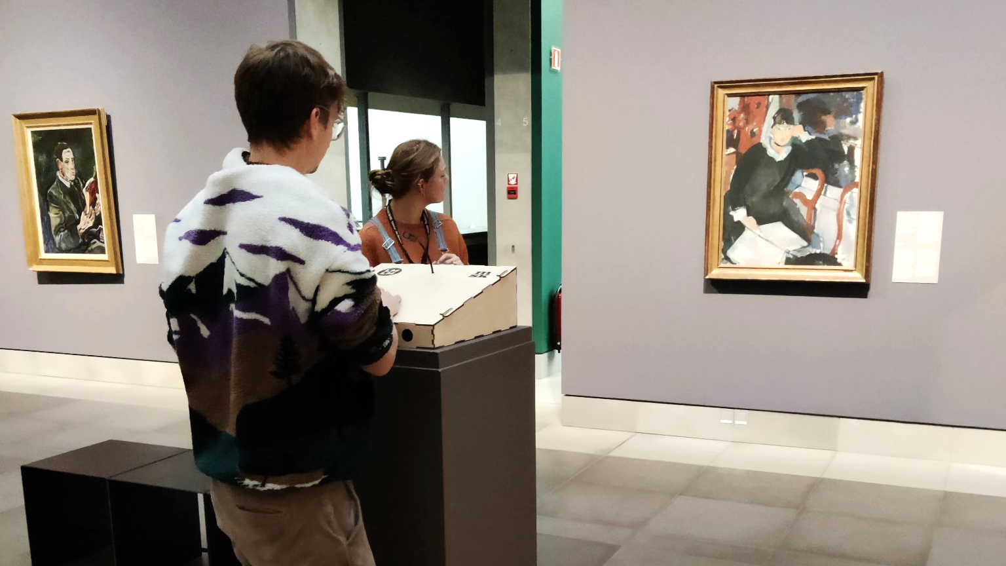
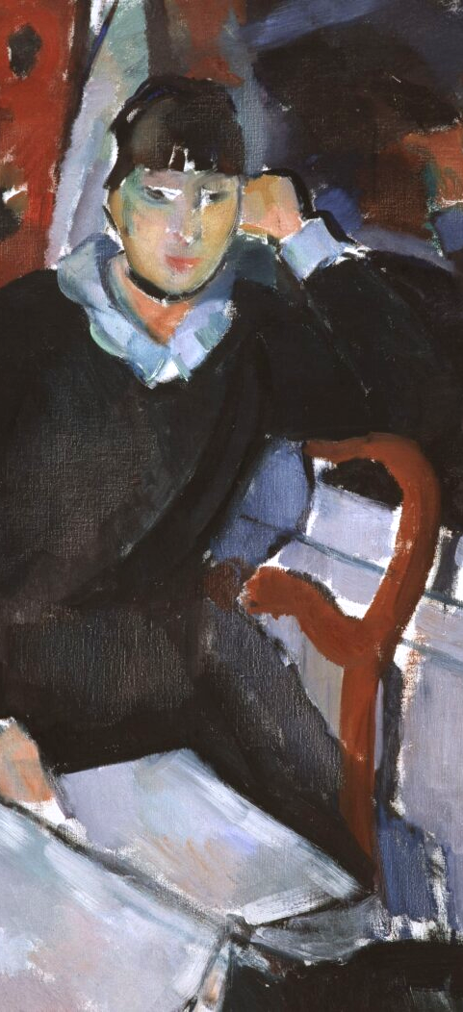
spring ‘24
Multilingual NL/FR/EN
Headphones
Nel Deurinckx
Wife and muse of Rik Wouters

Slide 6
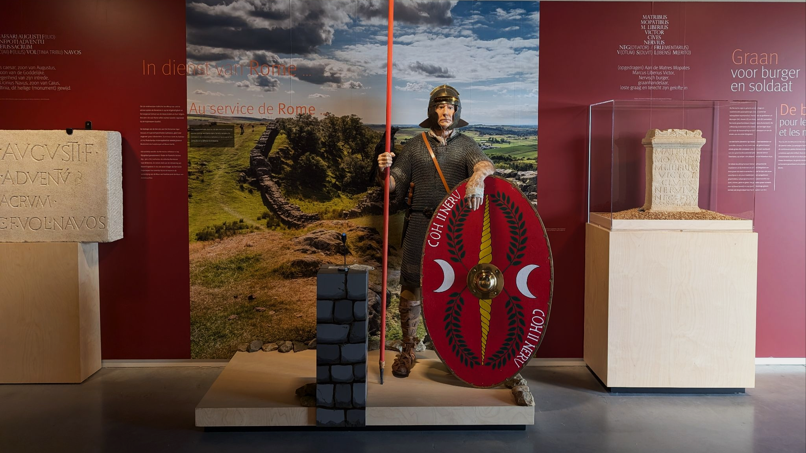
Archeocentrum Velzeke
summer ‘24
Quintus Barbius Velinus,
Roman legionair

Slide 7
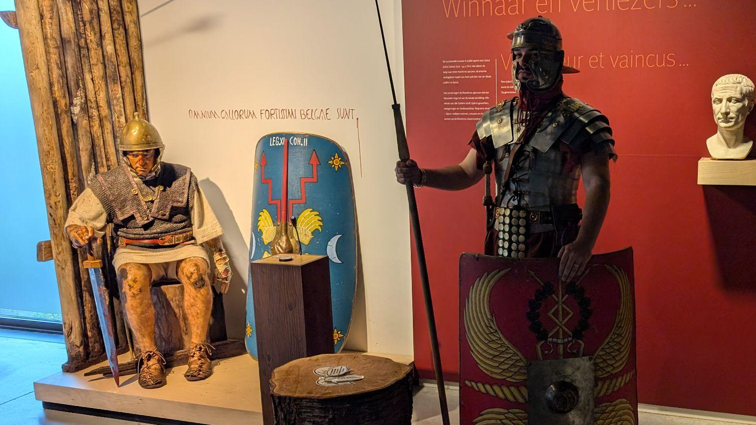
Archeocentrum Velzeke
Julius Felix,
Nervian soldier

Slide 8
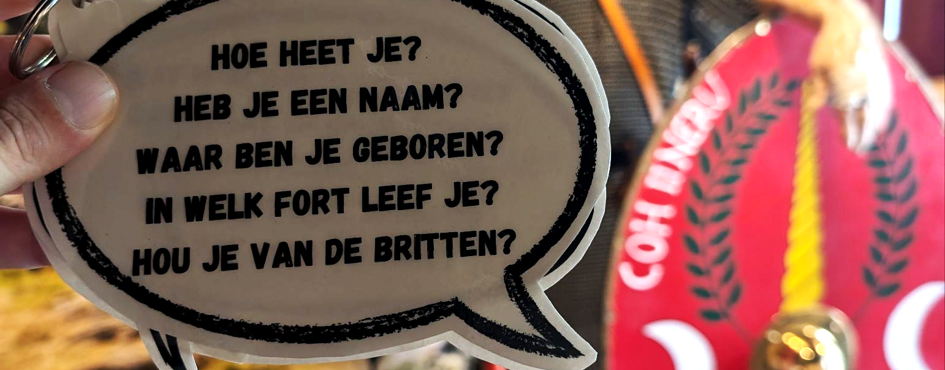
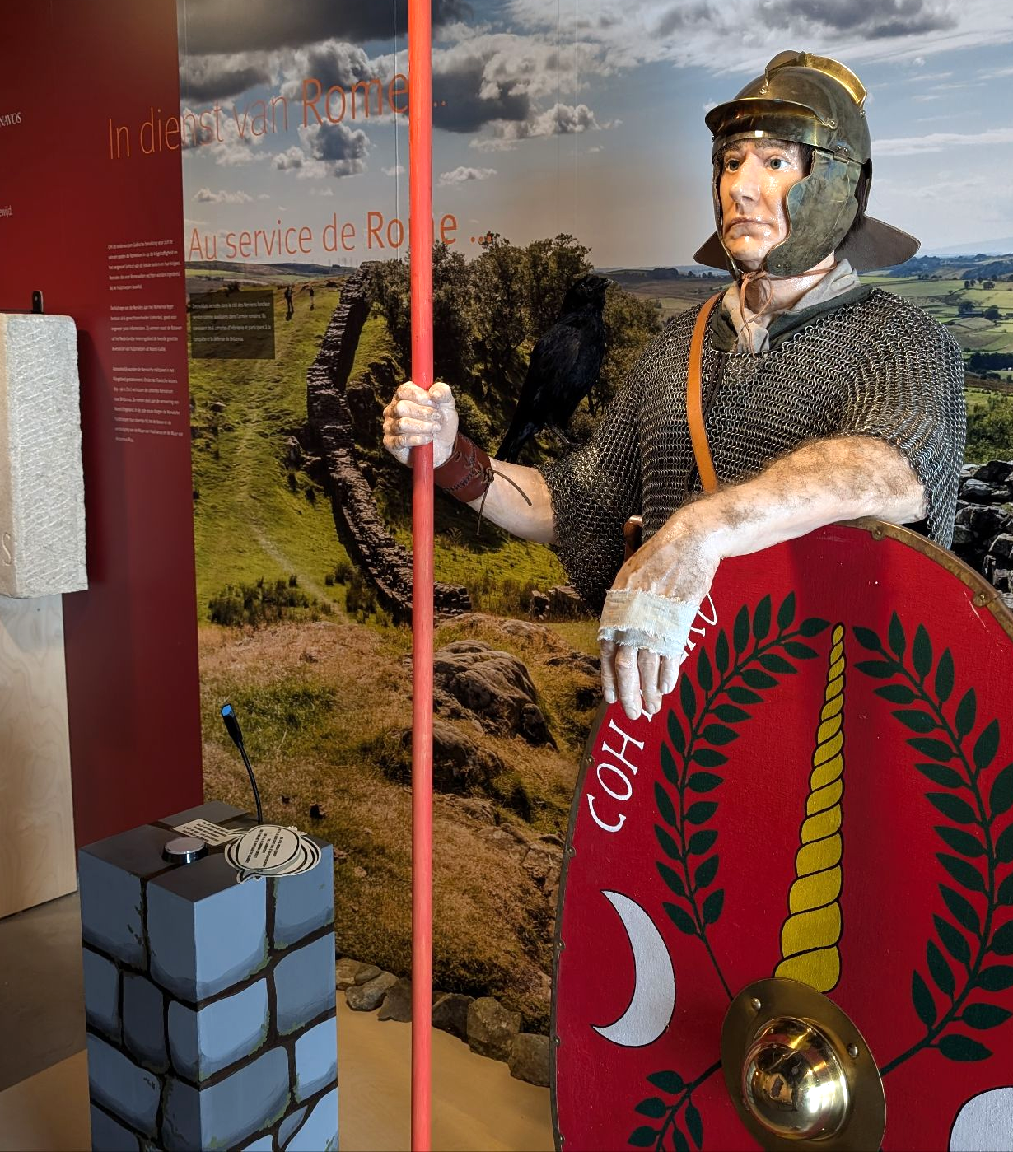
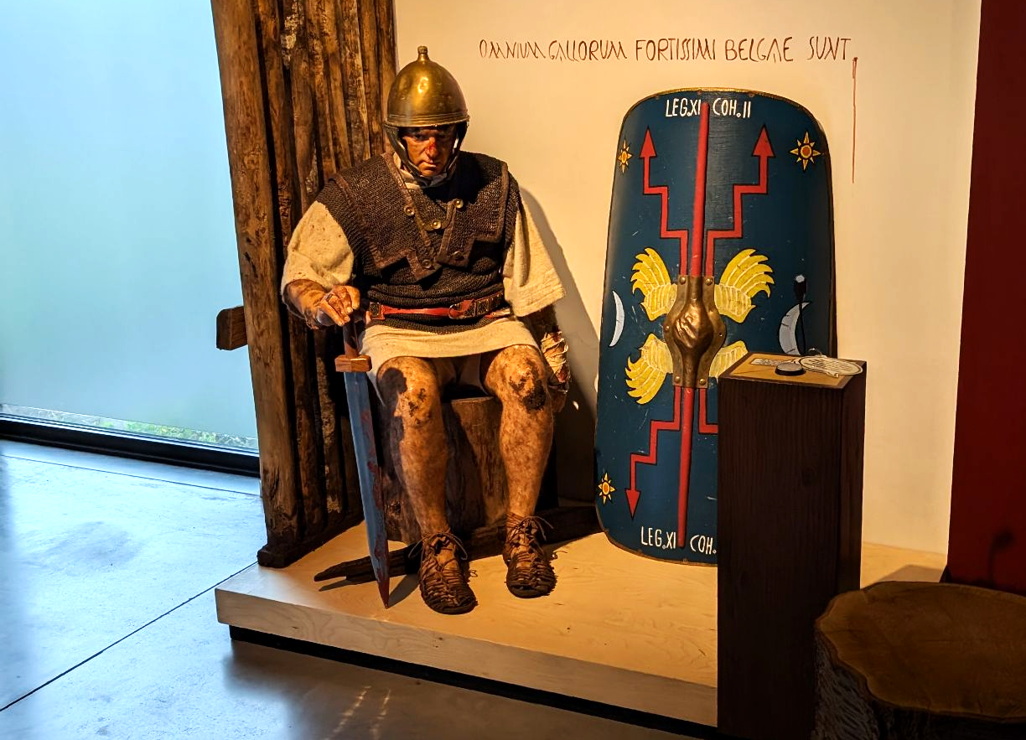
Example Questions
Custom integration

Slide 9
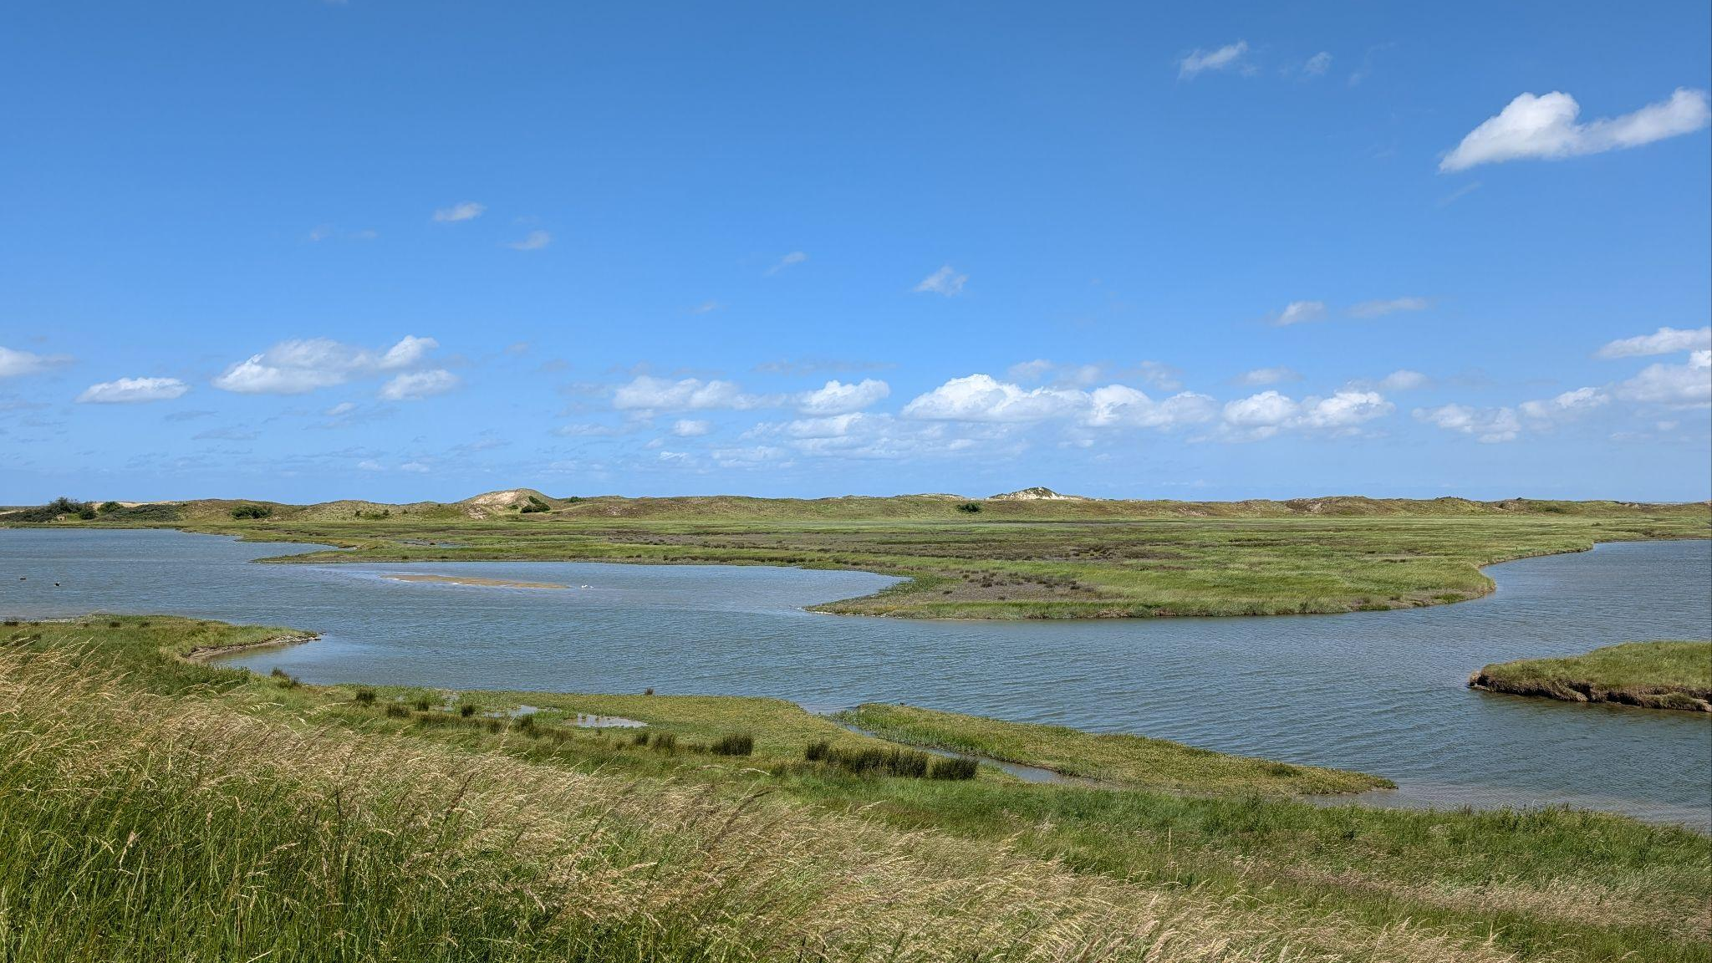
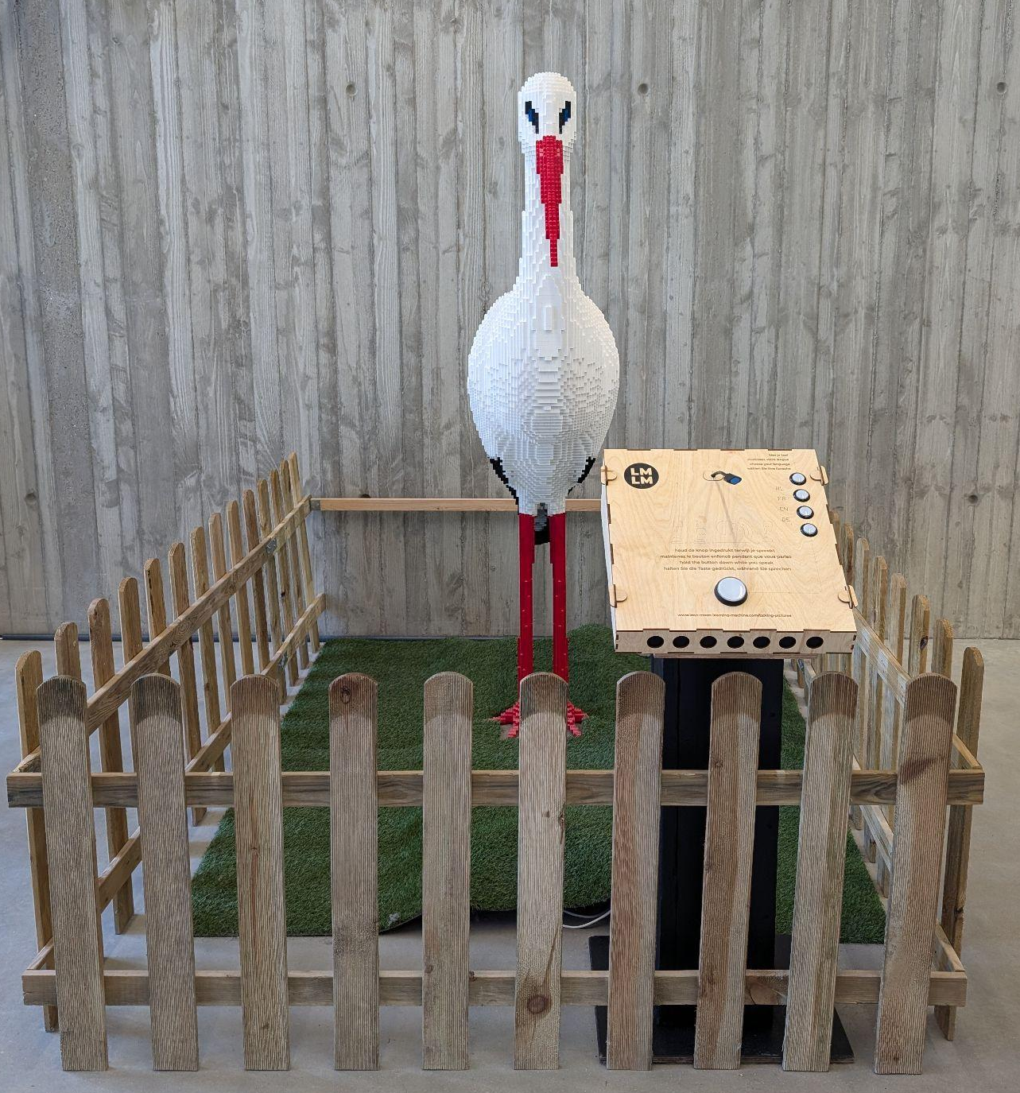

ZWIN Natuurpark
summer ‘24
Visitor Interviews
by LEGO stork
& automatic reporting
www.lean-mean-learning-machine.com

Slide 10
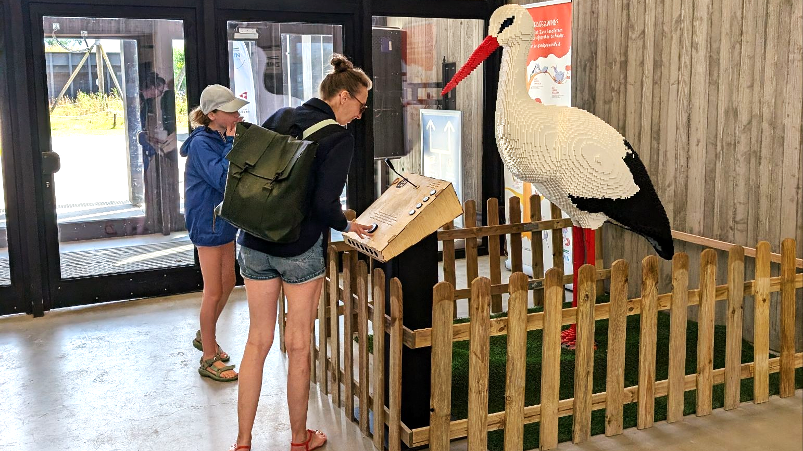
ZWIN Natuurpark
What did you think about your visit to the museum?
I really enjoyed it!
www.lean-mean-learning-machine.com

Slide 11
OUR MISSION
OUR VISION
revolutionize museum visits
artworks respond directly to visitors' questions
personalized and interactive learning experience
enhanced connection between the visitor and the exhibition
Curators provide information, AI rephrases that information
AI will not replace people (experts, curators, museum staff, guides, etc). However, it will spectacularly and positively change the museum experience.
www.lean-mean-learning-machine.com

Slide 12
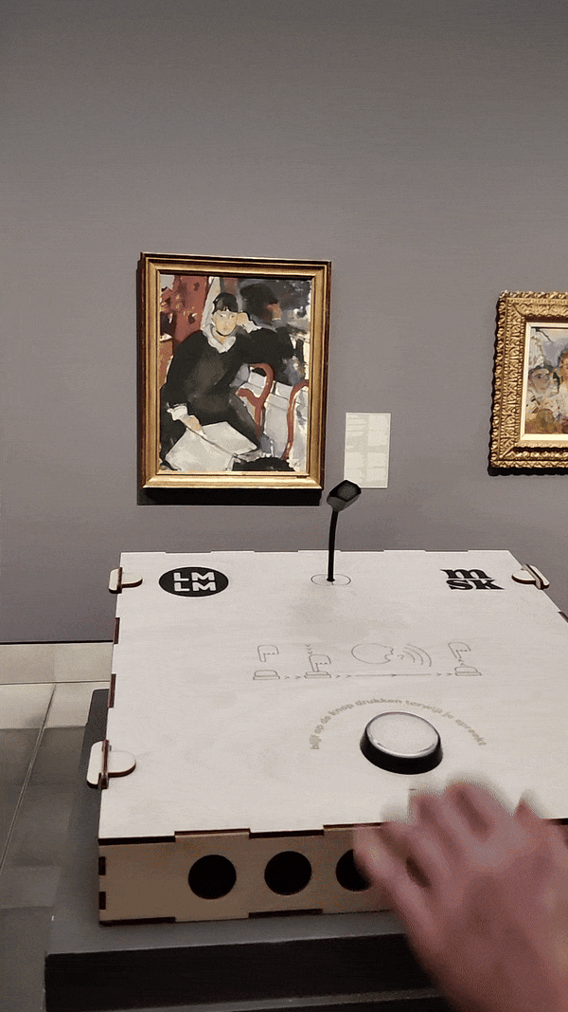
How does it work?
Press a button
Ask a question
Get an answer
Start a conversation!
with the help of AI!

Slide 13
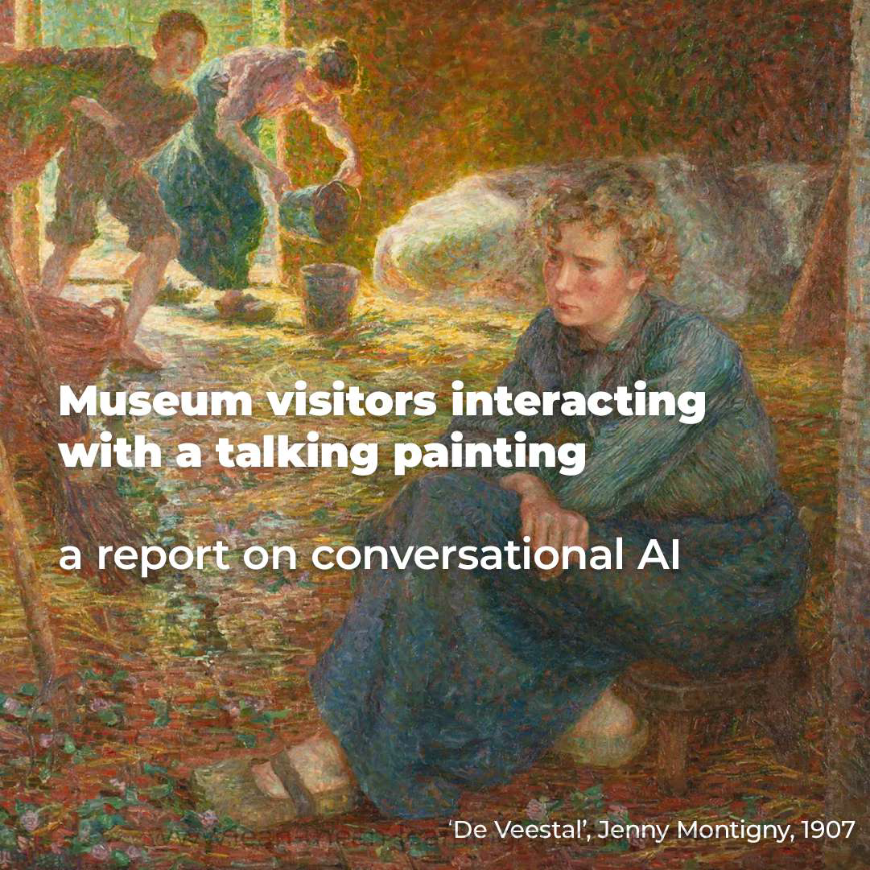
Case study
The MSK (Museum of Fine Arts)
in Ghent, Belgium, wants to
improve visitor engagement
Innovate with advanced technology
Have a highlight for 'Museum Night': an event where all museums in the city are open until midnight.

Slide 14
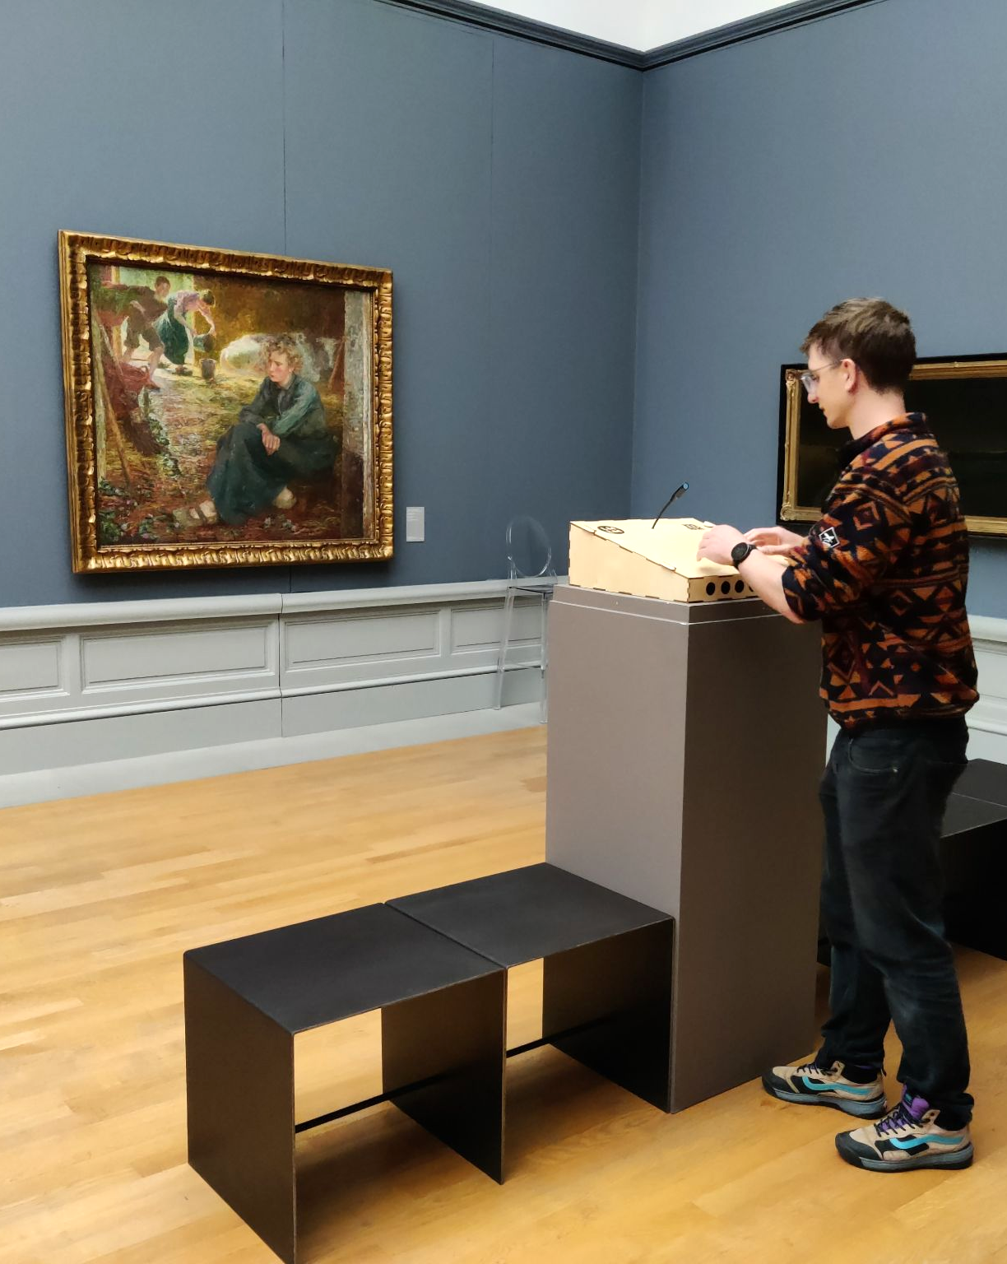

Case study: results
installed on location
2600 interactions in 30 days
new insights about visitors
95% positive reviews
national news
+500 interactions during Museum Night

Slide 15
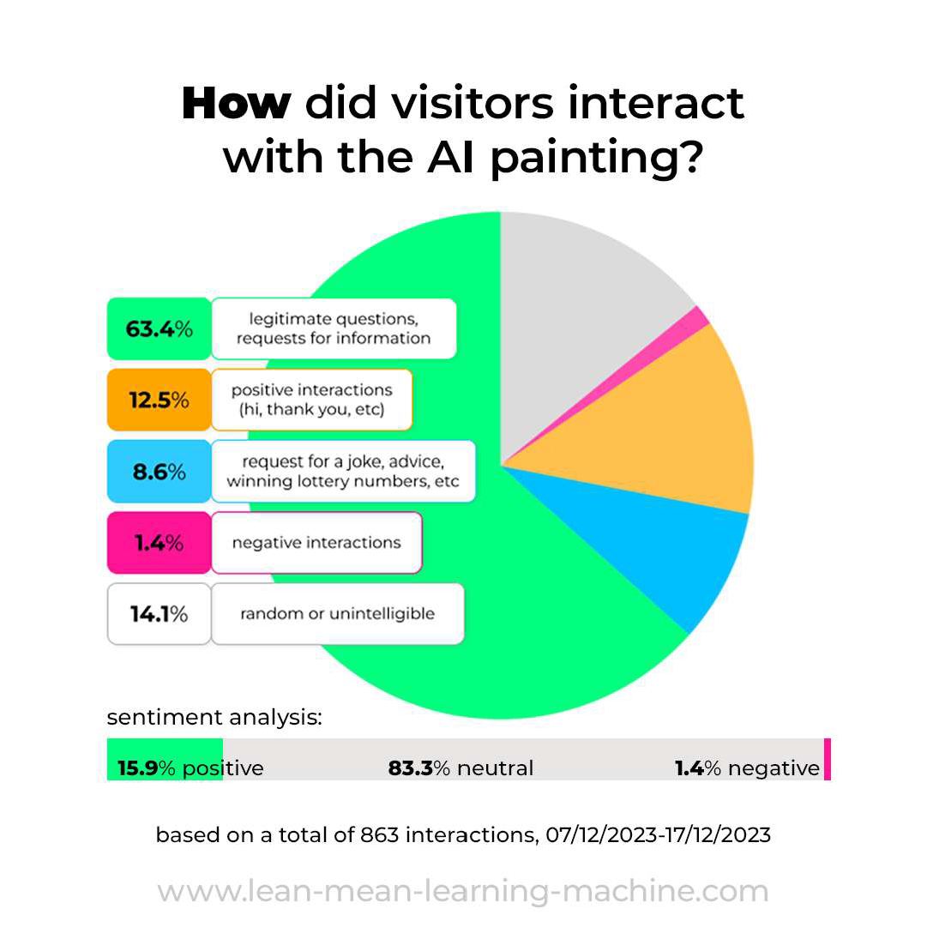
Case study
The analysis of the log files revealed many surprising insights.
The museum now has a better understanding of what visitors want, and which type of information they seek.

Slide 16
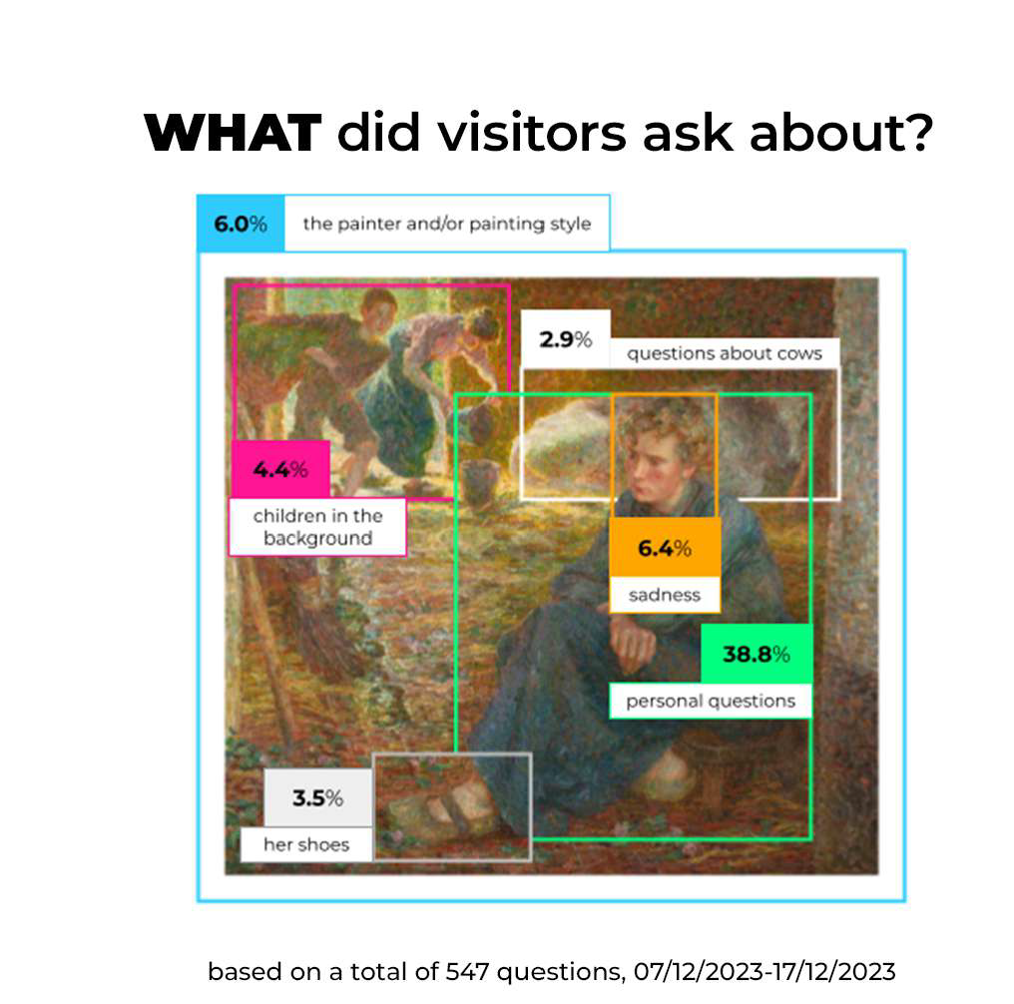
Case study
Insights
Visitors ask about what is depicted, rather than technical aspects such as painting style, for example.
Most questions are asked to the girl in the painting, and not in the third person, e.g., 'what shoes are you wearing' instead of 'what shoes is she wearing'.
Our research shows that in more than 2000 interactions, the AI in 99% of the cases the correct information provided. When the AI didn't know the answer, it communicated this as well.
The information that the AI possesses was compiled by curators

Slide 17
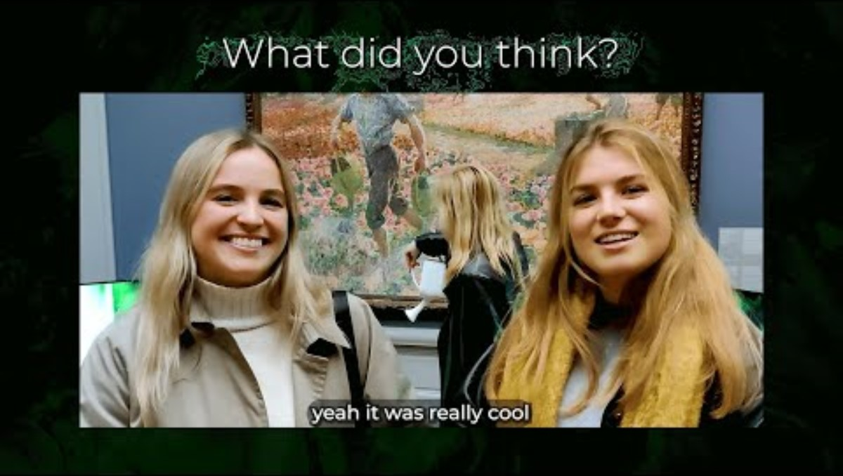
Case study

Slide 18
What languages does the AI speak?
List with available languages
Arabic 🇸🇦
Basque 🇪🇸
Bengali 🇧🇩
Bulgarian 🇧🇬
Catalan 🇪🇸
Chinese 🇨🇳
Czech 🇨🇿
Danish 🇩🇰
Dutch 🇳🇱
English 🇬🇧
Finnish 🇫🇮
French 🇫🇷
Galician 🇪🇸
German 🇩🇪
Greek 🇬🇷
Gujarati 🇮🇳
Hindi 🇮🇳
Hungarian 🇭🇺
Indonesian 🇮🇩
Italian 🇮🇹
Japanese 🇯🇵
Kannada 🇮🇳
Korean 🇰🇷
Latvian 🇱🇻
Lithuanian 🇱🇹
Malay 🇲🇾
Marathi 🇮🇳
Polish 🇵🇱
Portuguese 🇵🇹
Punjabi 🇮🇳
Romanian 🇷🇴
Russian 🇷🇺
Serbian 🇷🇸
Slovak 🇸🇰
Ukrainian 🇺🇦
Vietnamese 🇻🇳

Slide 19
Features | Basic | Advanced | AI interviewer
AI performance | high | very high | very high
Prompt finetuning | v | v | v
Conversational AI | v | v | v
Languages* | 1 | up to 4 | up to 4
Single-board computer | v | v | v
Audio (headset or speaker) | v | v | v
Microphone | v | v | v
Outer casing |  | v | v
Reporting |  | v | v
Monthly interactions | up to 10K | up to 15K | up to 30K**
One time fee | €3,975 | €4,975 | €4,975
Monthly fee | €75 / month | €100 / month | €200 / month

Slide 20
Procedure – Steps in the process
concept
more testing
training
install
on-site
launch
follow-up
development
testing

Slide 21
Procedure – What YOU do
decide who/what/where
expert info*
access to WiFi or Ethernet
test installation
communication & marketing
concept
testing
1
2
4
training
3
install
on-site
launch
follow-up
development
5
*We work together with curators and experts to guarantee that all information is 100% correct.
testing
Notes:
*We closely work together with your curators and subject matter experts to ensure all information is 100% correct.

Slide 22
Procedure – what WE do
train the AI
software and hardware deployment
create casing (optional)
internal testing
installation
create log files & reporting
concept
testing
training
install
on-site
launch
follow-up
development
5
6
1
2
3
testing
4

Slide 23
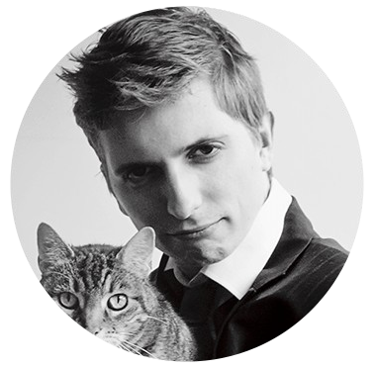
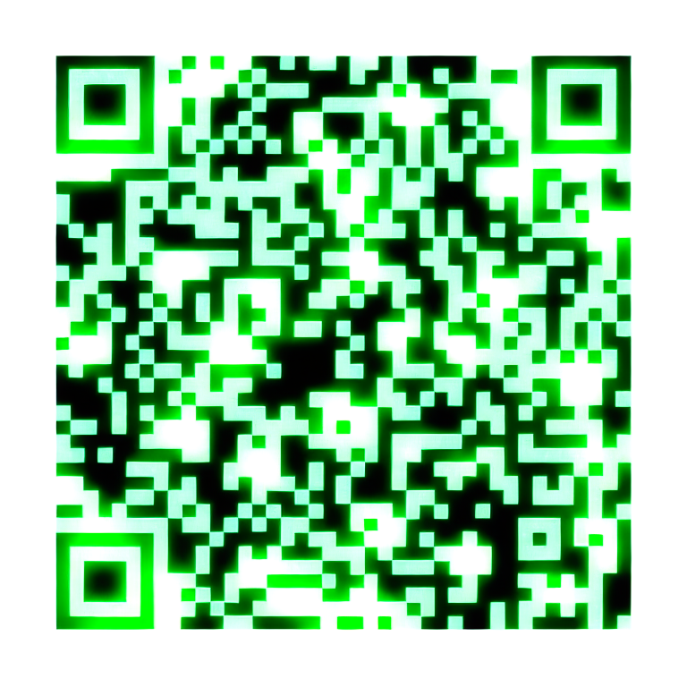
Contact
Dennis Lippens
(+32 ) 484 97 22 57
dennis@Lean-Mean-Learning-Machine.com

