Slide 1


X
Next-Gen AI Driven Contextual Solution

Slide 2
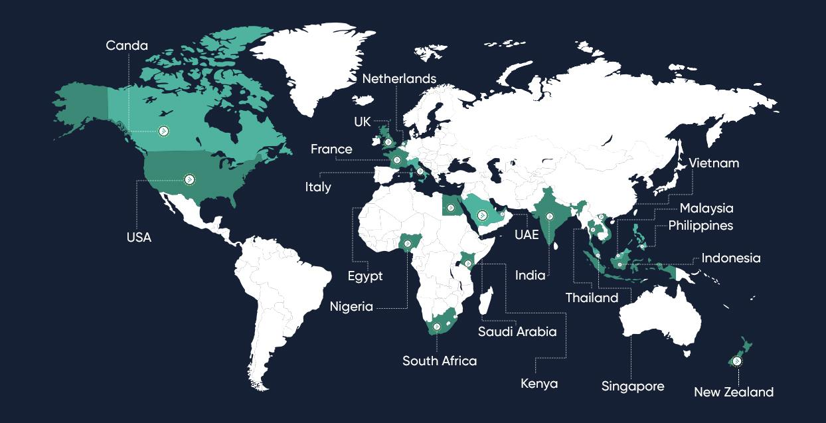






















Global Footprint: Expanding in North America & LATAM
Canada
2012
Company founded
18+
Countries
200+
Employees
7+
Global Awards
SOME OF OUR CLIENTS THAT TRUST US
Notes:
Silverpush was founded in 2012 with an ambition to grow and create a technology that can revolutionize the advertising industry. Within the last few years, especially 2022, Silverpush has expanded its global footprint across 18+ countries and more in the near future.
2

Slide 3







Brands that have leveraged Mirrors to achieve their goals

Slide 4
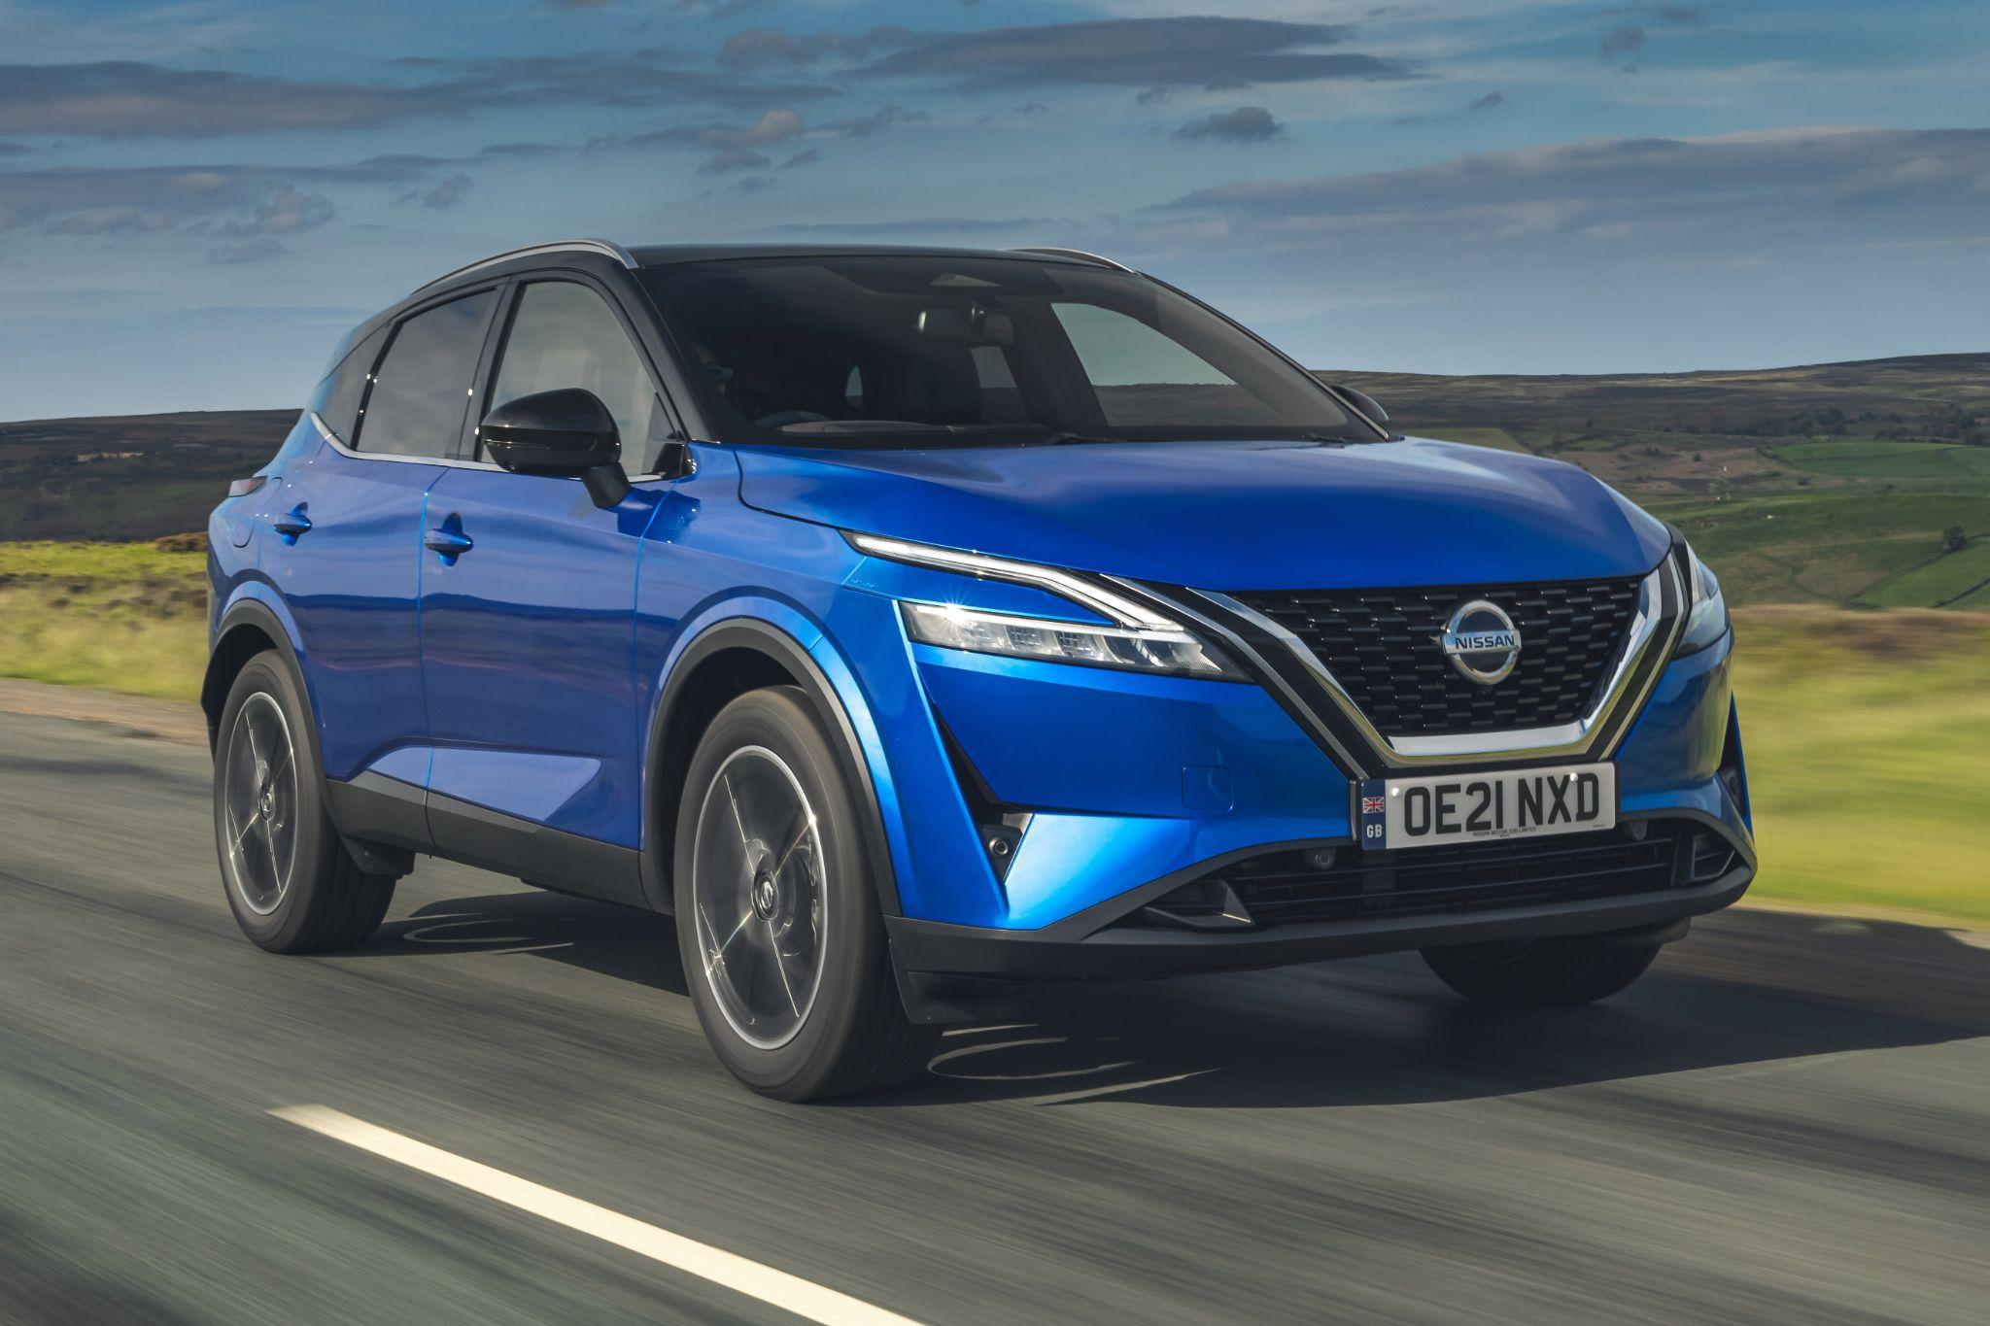
Build brand relevance by tapping into automotive consumers’ state of mind with our next gen AI technology.
Notes:
Optimize a car buyer's journey by leveraging the power of key moments, using in-video visual context triggers for precise targeting and a seamless path to purchase.

Slide 5
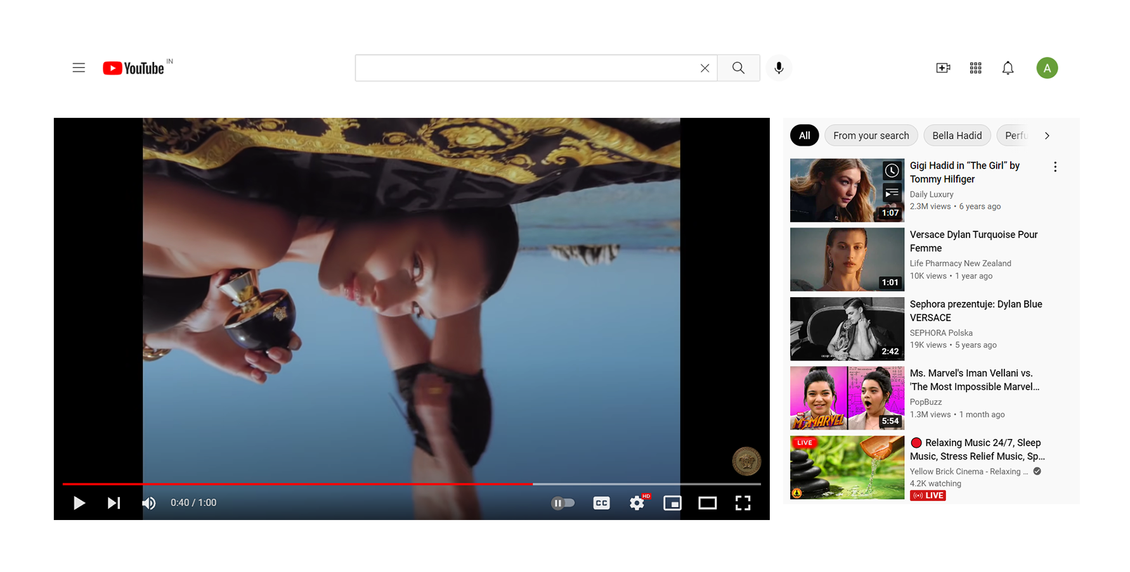
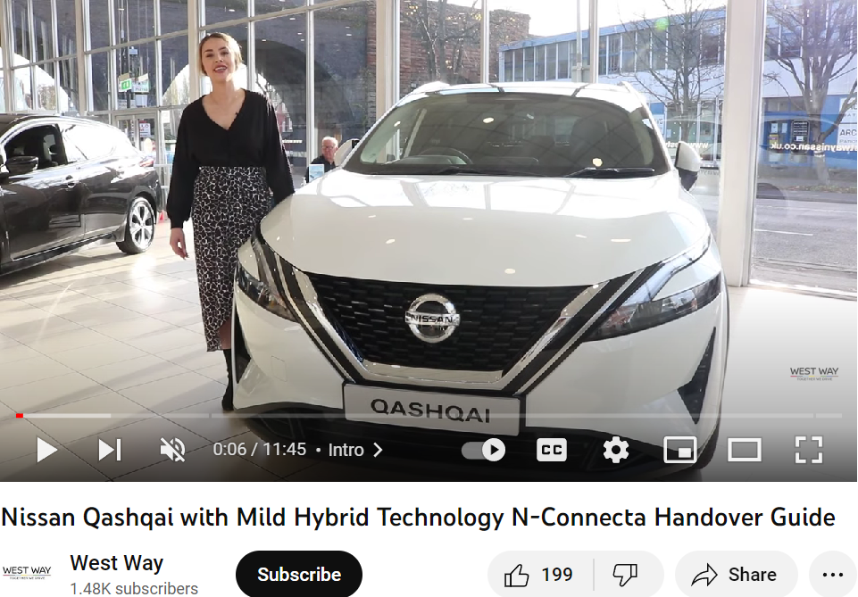
Watch time of car videos on YouTube has grown by more than 65% in the past two years.
When looking to buy a new car, consumers often turn to video research. Auto marketers can use this opportunity to reach potential buyers who are actively considering a purchase, even if they are not familiar with their product.
https://www.thinkwithgoogle.com/marketing-strategies/video/automotive-marketing-videos/

Slide 6

Over 75% of auto shoppers say that online video has influenced their shopping habits or purchases.
https://www.thinkwithgoogle.com/marketing-strategies/video/auto-video-shopping-statistics/

Slide 7
YouTube Standard Targeting is Too Broad
and Can Lead to Media Waste
% of Consumers negatively impact the view of a brand
Standard YouTube can misidentify your audience and place your ads on irrelevant content.
Youtube employs third-party or user-provided data targeting.
The targeting is based on keywords, affinity, and audience targeting.
Limited focus on brand safety.
Only keyword-level customisation.
Reaches a broader audience without creating emotional resonance.
37%
31%
20%
15%
Ads without diversity/inclusivity
Ads that are too targeted
Ads next to inappropriate content
Ads not relevant
Notes:
7

Slide 8
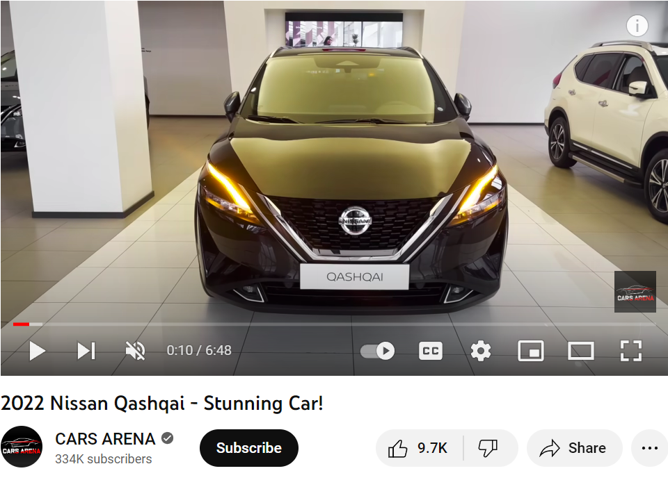
Leveraging
Contextual Targeting: Nissan's strategy for steering car buyers towards purchase.
Object Detected
Logo Detected
Nissan would benefit from our next-gen hyper-granular visual context targeting powered by AI and computer vision to leverage what auto consumers are watching on YouTube and drive trust and personal connection with a captive audience.

Slide 9

Mirrors for
Silverpush’s Next Gen AI powered solution, introduces hyper contextual technology called MIRRORS. It watches (frame by frame), listens (word by word), allowing you to target audiences with both precision and scale-ultimately driving better brand outcomes.

Slide 10
Silverpush’s AI Strategy Framework For Nissan
Strategy: By targeting high networth individuals with a spending of 300K+ a year, Nissan can connect with potential customers.
Tactic: To detect competitor/ self logos, luxury object, action, audio, in-video text.
Tactic: Example: Logo of Nissan, Audi, action like Off-roading, object like luxury cars, watches, audio or in-video text explaining features of car.
Rationale: MIRRORS will detect Nissan and competitor luxury car logos, scenes of luxury places, activities like offroading, audio explaining technical feature of the car, and will place the AD wherever the relevant trigger is detected reaching broader audience at once.
Strategy: Flash movie Fans Conquesting
Tactic: Detecting face, logo, audio and action of Flash movie.
Tactic: Example: Ezra Miller, Grant Gustin, Ben Affleck, Flash, warner bros logo, action like celebrity interviews, etc
Rationale: MIRRORS will be detecting faces of Flash movie actors like Ezra Miller, logo of Flash and Warner bros, action like speed running by Flash, etc, and will then place an AD which can help convert Warner Bros or Flash movie fans to the target audience directly.

Slide 11

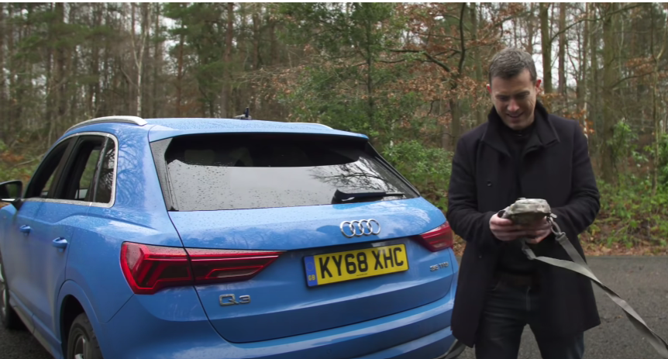

Brand Conquesting
Rationale: Targeting the audience interested in luxury and high-tech automobiles by leveraging Nissan as a brand through trigger detection based on the logo of luxury vehicle brands like Land Rover, Citroën, top luxury brands watches, perfumes, popular faces (influencers, celebrities, brand ambassador), events (vehicle unveils, car reviews) etc.
MIRRORS AI technology can detect specific visual triggers, allowing the ad to be strategically placed at the appropriate moment and time to effectively target the intended audience.
Faces | Logos | Objects | Action/ Scene
Laure Boulleau | Nissan | Luxury watch | Going off roading
Doug DeMuro | Land Rover | Perfume | Driving luxury cars
Mat Watson | Armani | Luxury cars | Luxury places
Bernard Arnault | Gucci
Helping brands target the granular level content, to reduce ad waste, enhance user experience and improve brand safety.

Slide 12
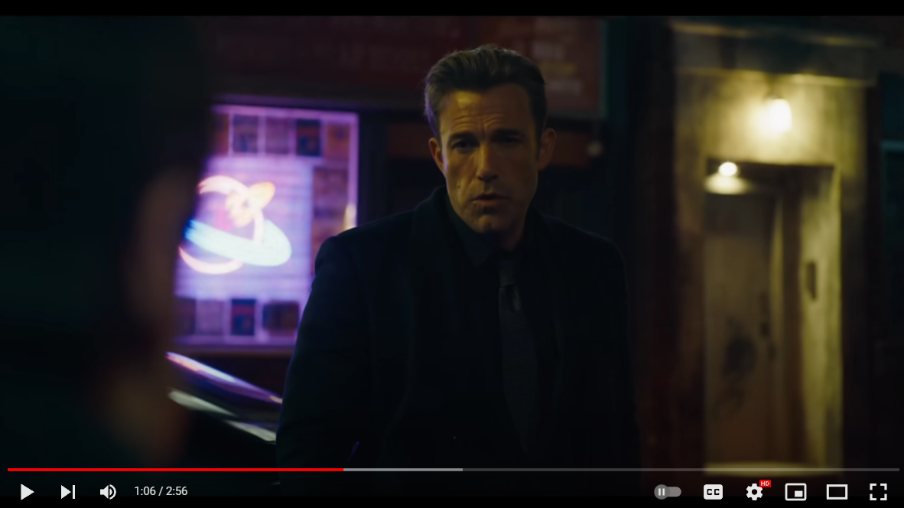

Flash Movie Conquesting
Rationale: Targeting the audience who loves DC movies and are huge fan of Flash. This can be done by detecting movie stars in Flash movie, logo of DC, Warner Bros, Flash, actions like flash character running, videos related to Flash movie stars interview & more.
MIRRORS AI technology identifies these visual triggers, placing the ad at the right place at the right moment to target the audience.
Faces | Logos | Action/ Scene
Ben Affleck | Flash | Car chase
Grant Gustin | DC | Superheroes entry in movie
Sasha Calle | Warner Bros | Flash running
Helping brands target the granular level content, to reduce ad waste, enhance user experience and improve brand safety.

Slide 13
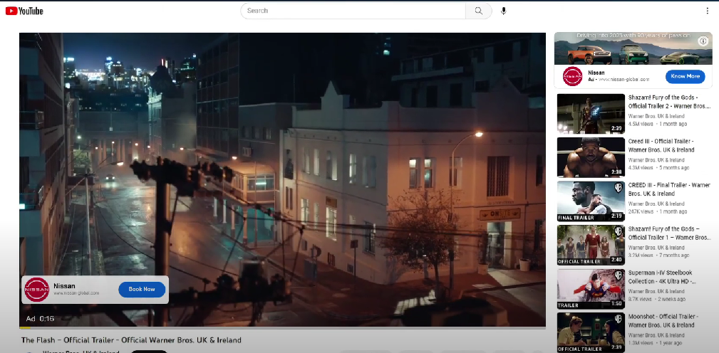
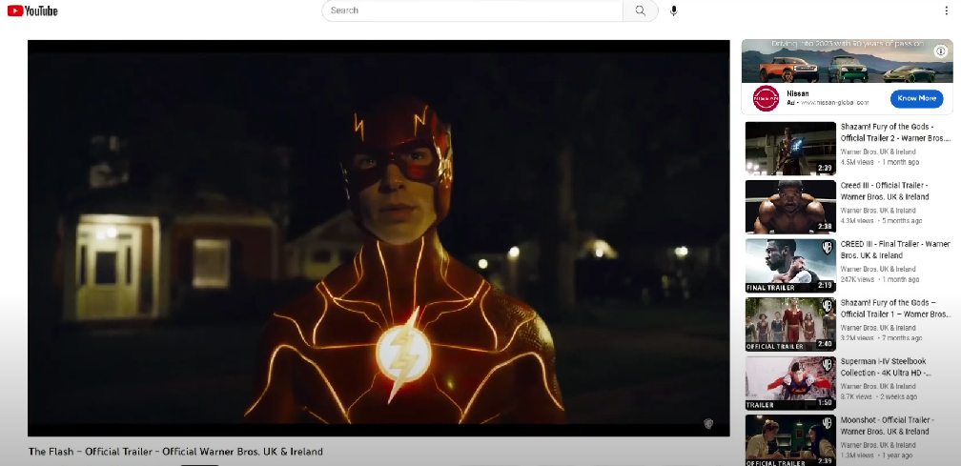




NIssan x Flash: Pre-Roll Ad Creative
1
2
Deliver Ads Before the video begins
Original video begins
Our AI technology filters out video IDs by utilizing frame-by-frame analysis to detect visual context triggers such as faces/emotions, logos, objects and scenes/places. The ad is then placed with companion banners and CTA’s in line with key moments.
Upon video completion, the main video begins and companion banner stays.
PROPOSED VISUAL TRIGGERS
defining the exact moment you want to trigger your ad
Faces
Ben Affleck
Grant Gustin
Sasha Calle
Logo
Flash
DC
Warner Bros
Actions/ Scene
Car chase
Superheroes entry in movie
Flash running
Watch Ad Experience Video

Slide 14
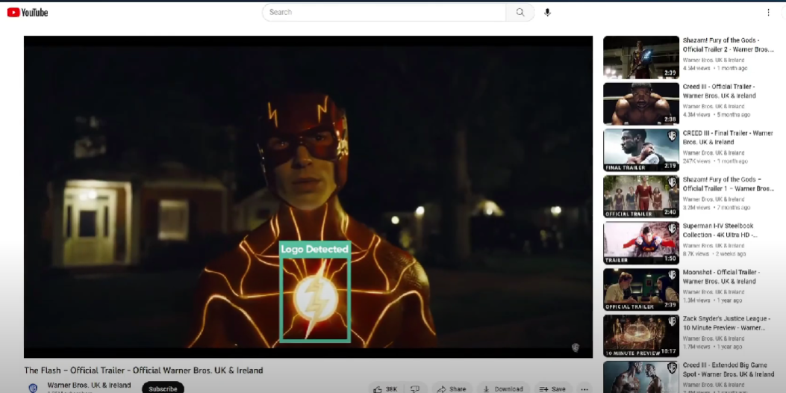
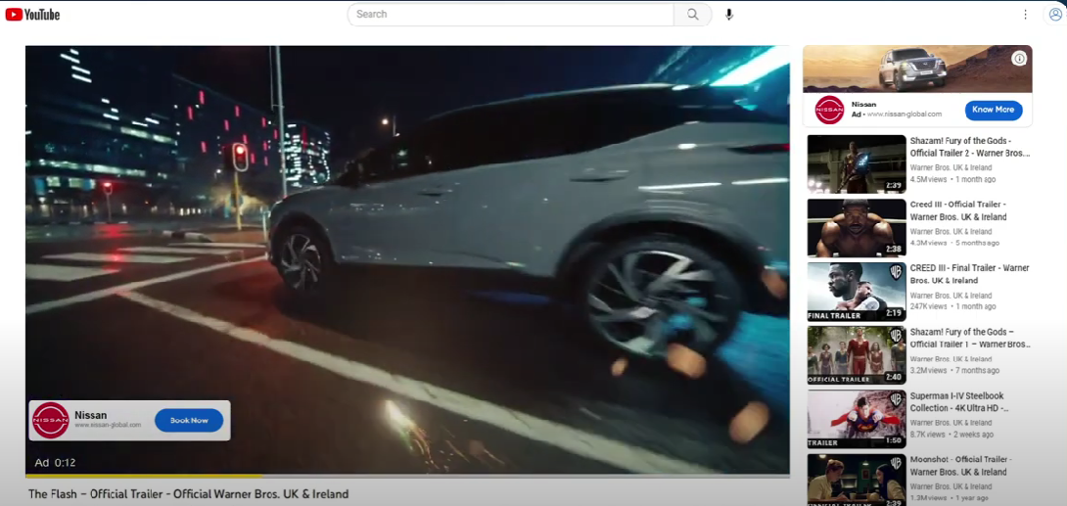
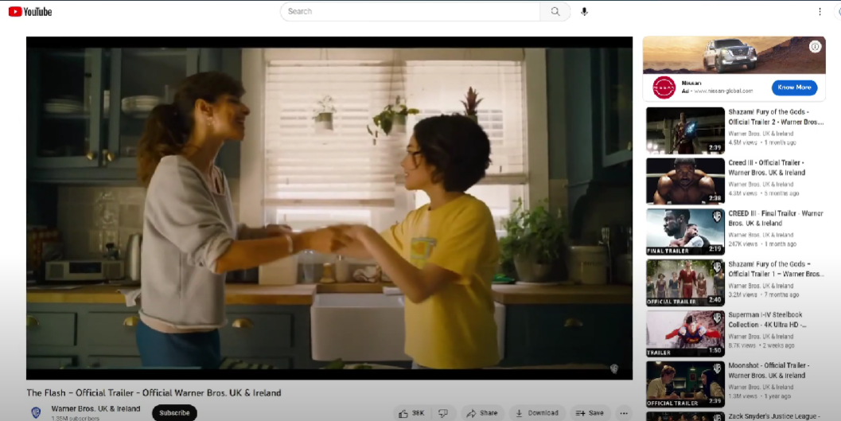
NIssan x Flash: Mid-Roll Ad Creative
1
2
3
Detect Triggers and Discover Content
Deliver Ads in Contextual Moments
Resume Content
Mirrors uses AI and computer vision to scan YouTube video to detect visual context triggers such as faces/emotions, logos, objects and scenes/places.
When videos with pre-defined visual contexts are detected,
Mirrors places a video ad with companion banners and CTA’s in line with key moments.
Upon ad completion, the content is resumes and companion banner stays.
PROPOSED VISUAL TRIGGERS
defining the exact moment you want to trigger your ad
Faces
Ben Affleck
Grant Gustin
Sasha Calle
Logo
Flash
DC
Warner Bros
Actions/ Scene
Car chase
Superheroes entry in movie
Flash running
Watch Ad Experience Video
Notes:
Boolean logic - Slide 15

Slide 15
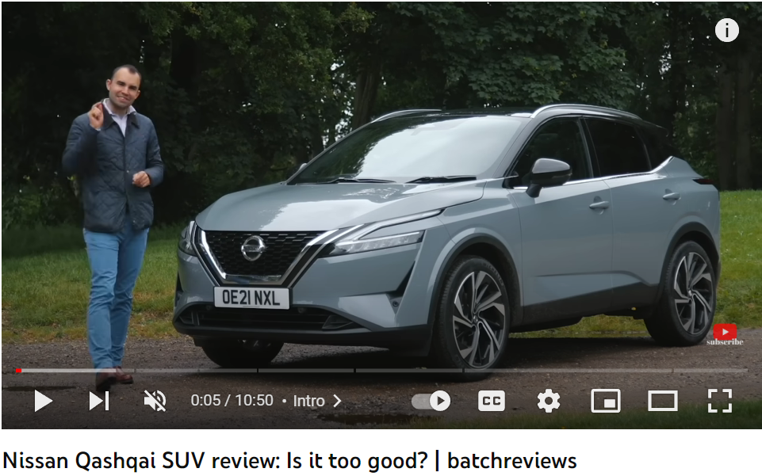











Visual Context Triggers You Can Target = Brand Suitability + Engagement
Faces
Logo
Emotions
Audio
Detects celebrities influencers and more to help you tap/extend the full potential of your celebrity brand endorsement.
Increase the visibility of your own trademark or capture competitor’s screen time wit Mirrors logo detection.
Let your ad-placements hit the right measure on the emotional scale. Target videos featuring desired emotions.
Sentiment & contextual analysis of audio transcribes to further enrich the contextual profile of a video.
Object
Scenes & Places
On-screen text
Identifies thousands of objects of all sizes to help you serve contextually rich ads synced with allied product categories.
Detects popular landmarks and background settings. Align your communication to places and scenes featured in a video.
Detects on-screen text that helps in providing more in-depth contextual intelligence.

Slide 16
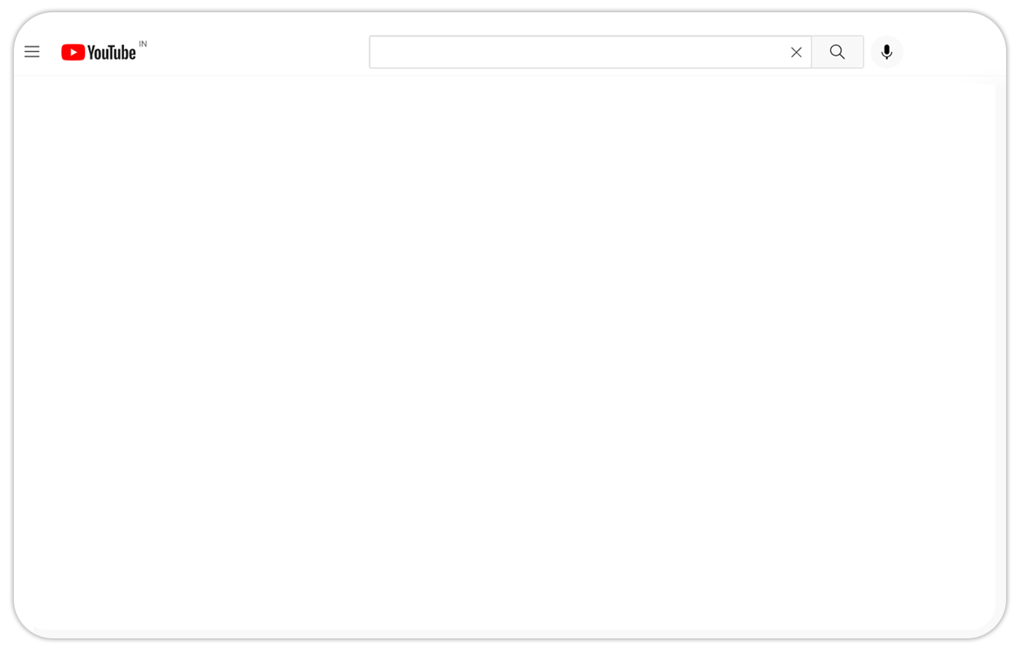
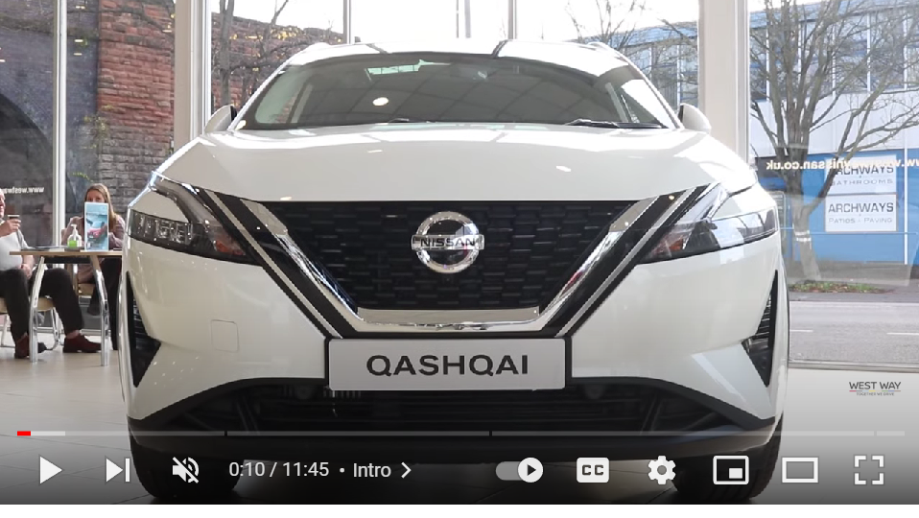
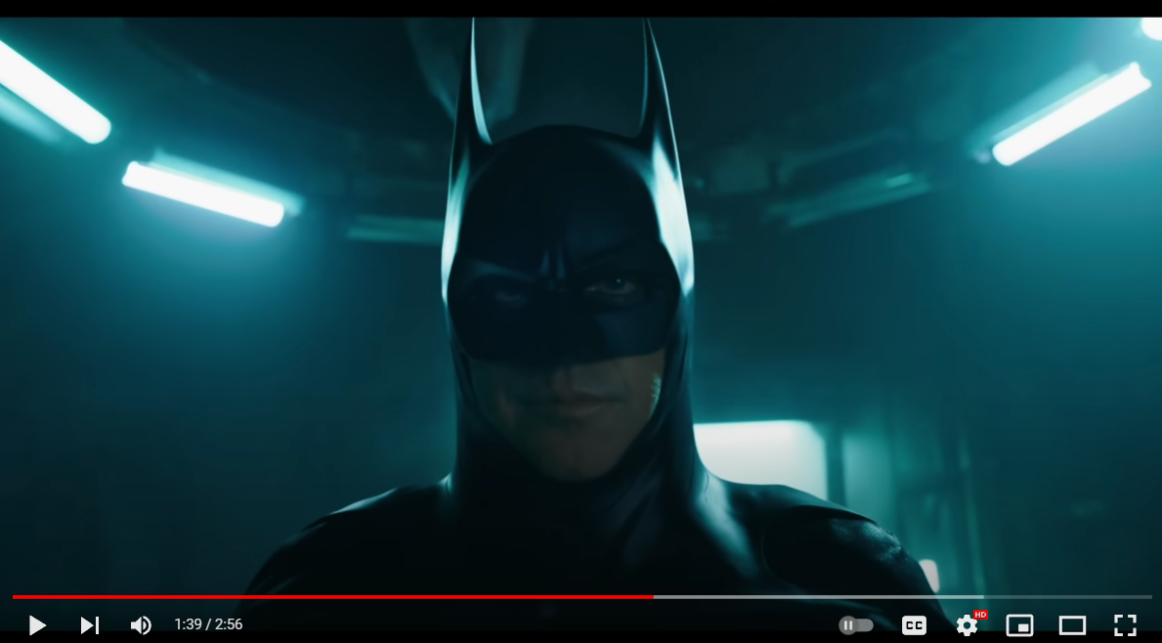
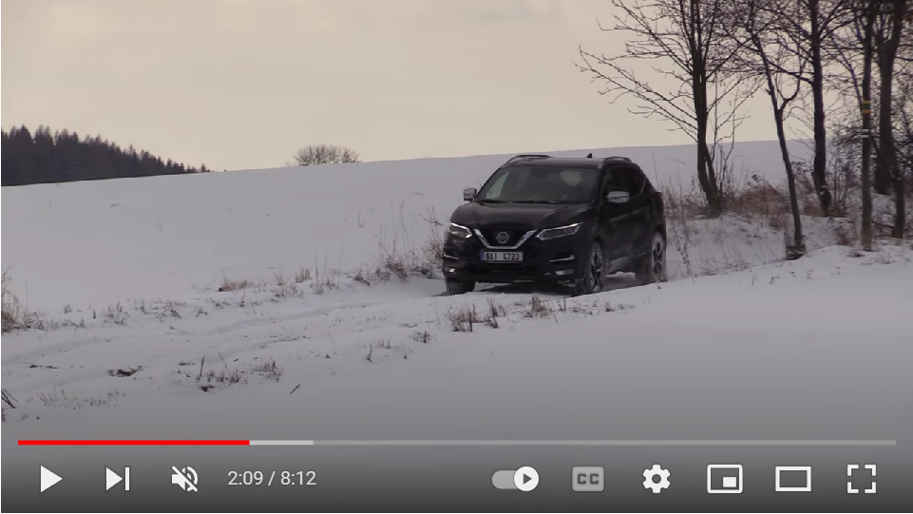
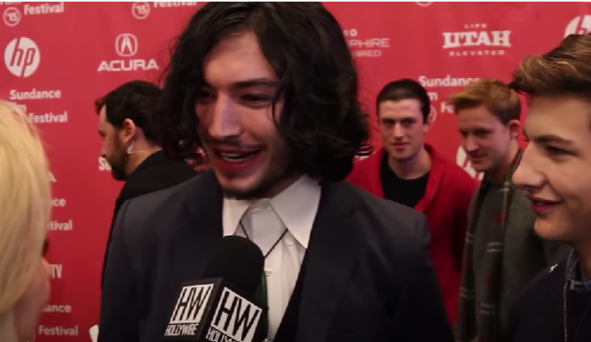
Brand Targeting and Brand Conquesting
Logo detected
Face detected
Action detected
Nissan Logo
Michael Keaton
..
Offroading with Nissan Qashqai
Audi Logo
Ezra Miller Interview
Flash movie scene

Slide 17

Case Studies

Slide 18



Nissan NMEF Patrol Y-62 Achieves 2X better VTR with Mirrors AI technology
Objective
To capitalize on content of YT videos most relevant for the brand using contextual targeting of Mirrors
Target Audience
35 to 55 Men in Abu Dhabi, Dubai, Kuwait, Qatar, Oman and Bahrain
Platforms
YouTube
Amazing campaign results!
Planned
Achieved
Exceeded
VTR - 25%
VTR - 43%
2x

Slide 19
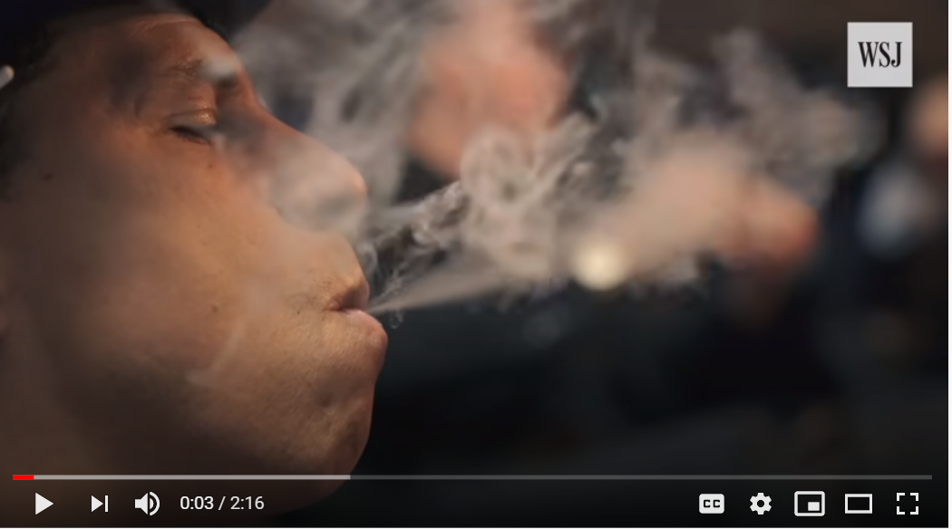
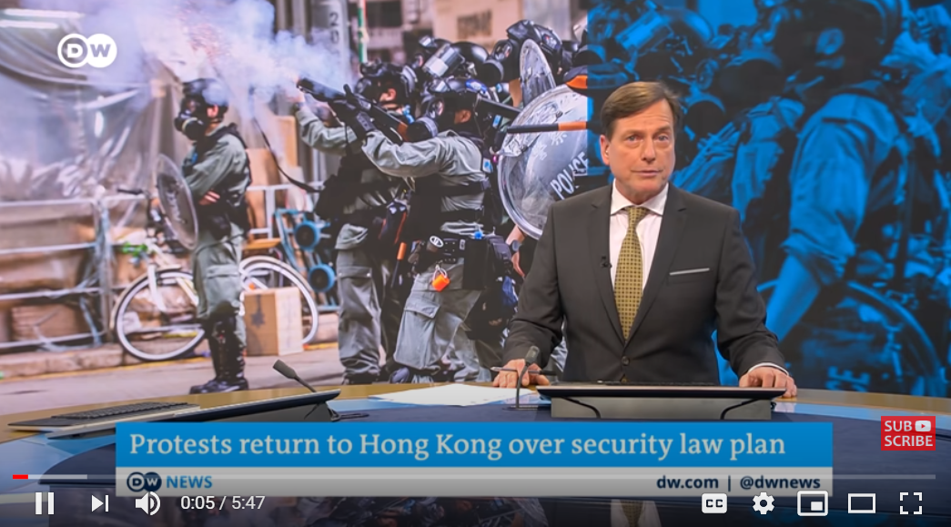

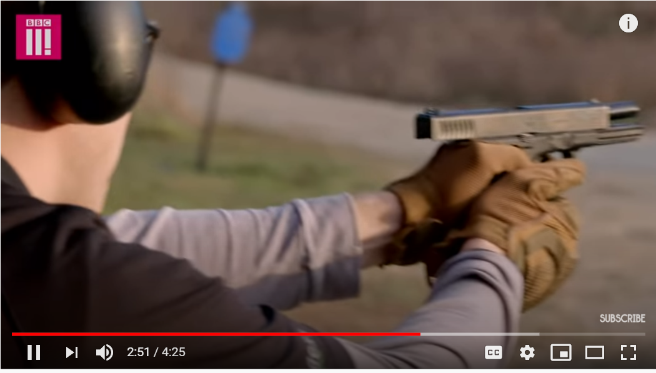


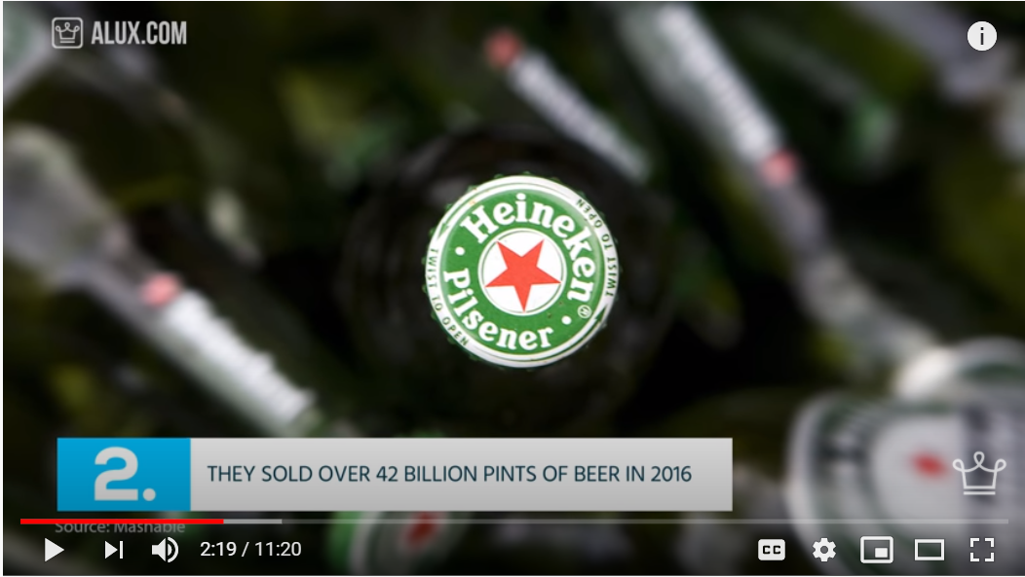
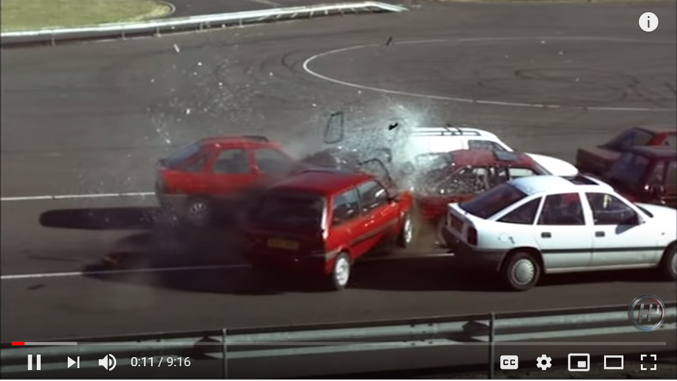
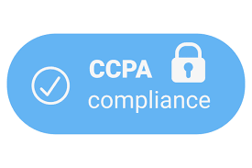

BRAND SAFETY
Brand Protection via video level analysis precisely excluding non brand safe content
Smoking Detected
Unrest/ Scene Detected
On-screen text detected
Object/ Gun Violence Detected
Logo Detected
Car Crash Detected
Notes:
Positive Targeting
Negative Targeting
GARM Compliance

Slide 20


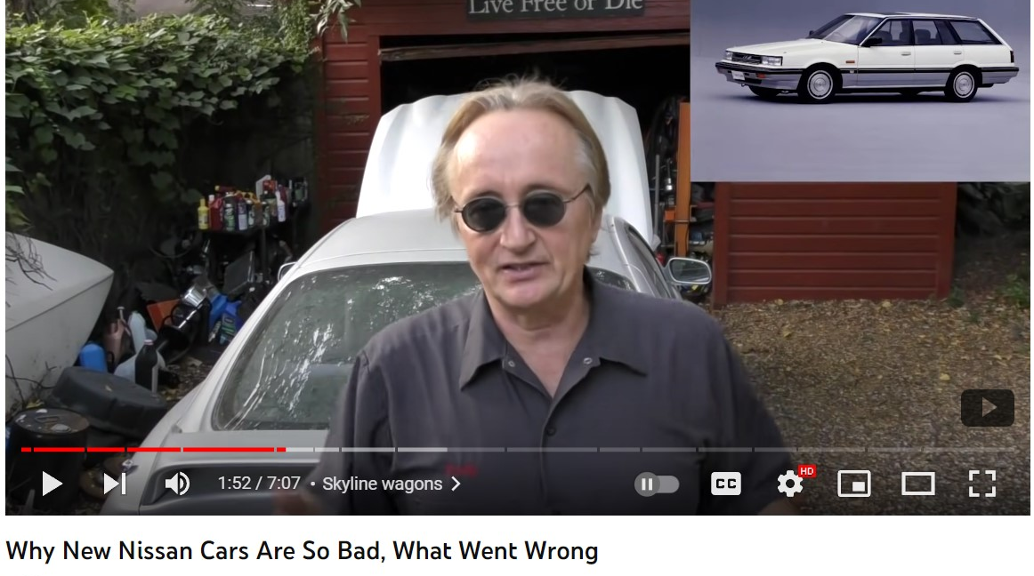
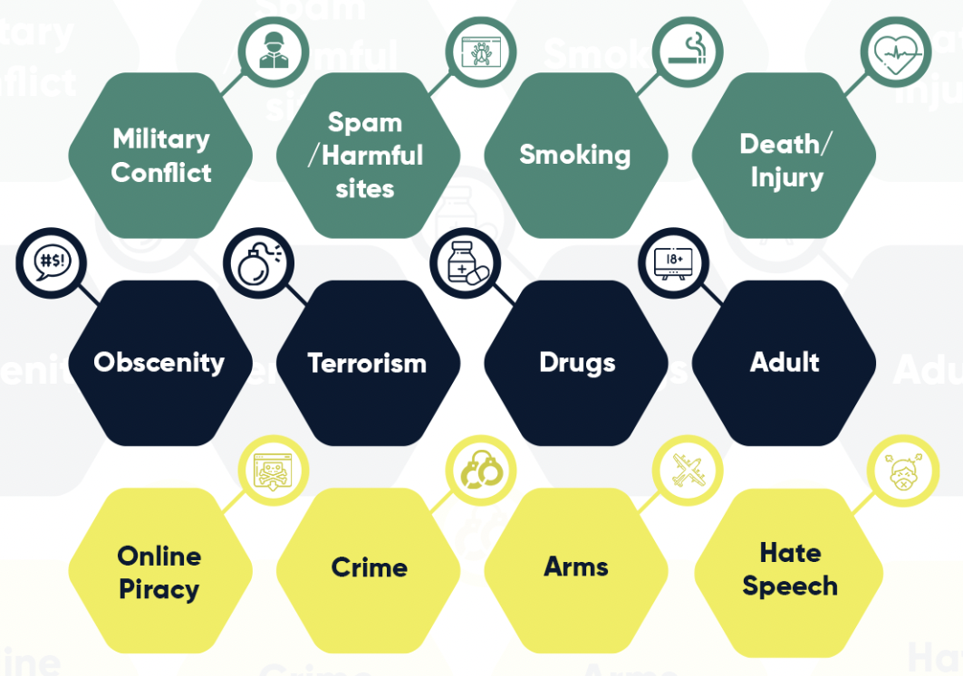

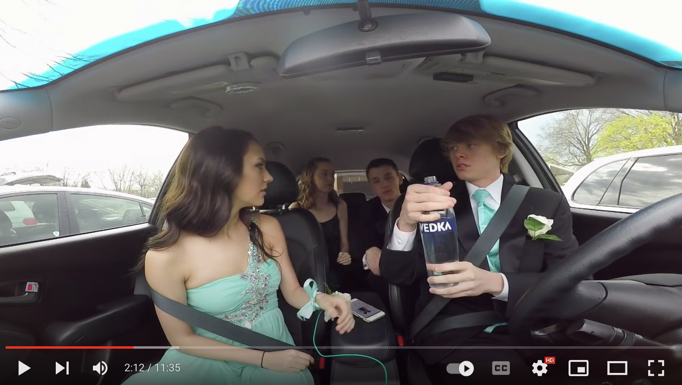

Industry Compliance + Mirrors Customized Brand Safety
Premium Brand Safety
Self Sabotaging Content
Improved Brand
Safety & Suitability
+
=
Sample video
Responsible & Enhanced Ad Performance
Action: Drink & Drive detected
Sustainable Approach to Advertising
Sample video
Notes:
With GARM + Mirrors Safety, advertisers can expect to see greater protection for their brand's reputation and image. As with this AI driven technology, it filters out all the unsafe/harmful content as per GARM standards and also custom includes and excludes those specific to each brand's risk tolerance level.

Slide 21

Programmatic

Slide 22


Pioneering The Privacy
First Open Web
Enhance your brand's impact with our Open web programmatic contextual advertising solution. By analyzing page content, including text, images, and videos, we match it to contextual signals of campaigns, ensuring your brand is advertised in a safe and relevant environment.

Slide 23










Advanced Contextual: Explained
BASIC
MODERATE
ADVANCED
Domain
URL
keyword pattern matching
Natural Language Processing (NLP) to
analyze
semantics
inclusion & exclusion
Channel / sub-domain IAB category
URL
tokenization
On-page keyword targeting
On-page keyword and pattern matching
NLP to analyze subject level sentiment
NLP to analyze subject level emotive tone
Machine learning to enable further optimization
Advanced video capabilities to go beyond metadata analysis
Notes:
DCO to be added

Slide 24
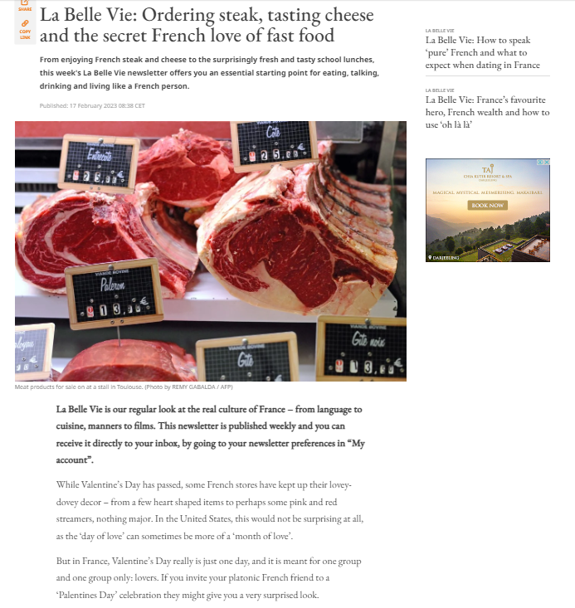



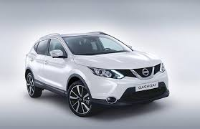
Conventional Targeting Alone Misses The Mark
Misaligned/ Irrelevant ad placement across the internet is a big challenge that results in ad wastage and hampers the brand’s reputation.
Sentiments Analysis
Irrelevant
Ad Placed
[Report]
[Industry]
[Automobile]

Slide 25
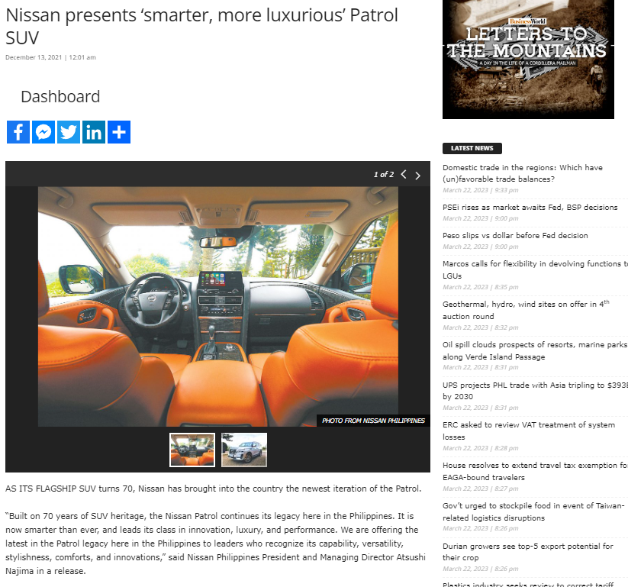
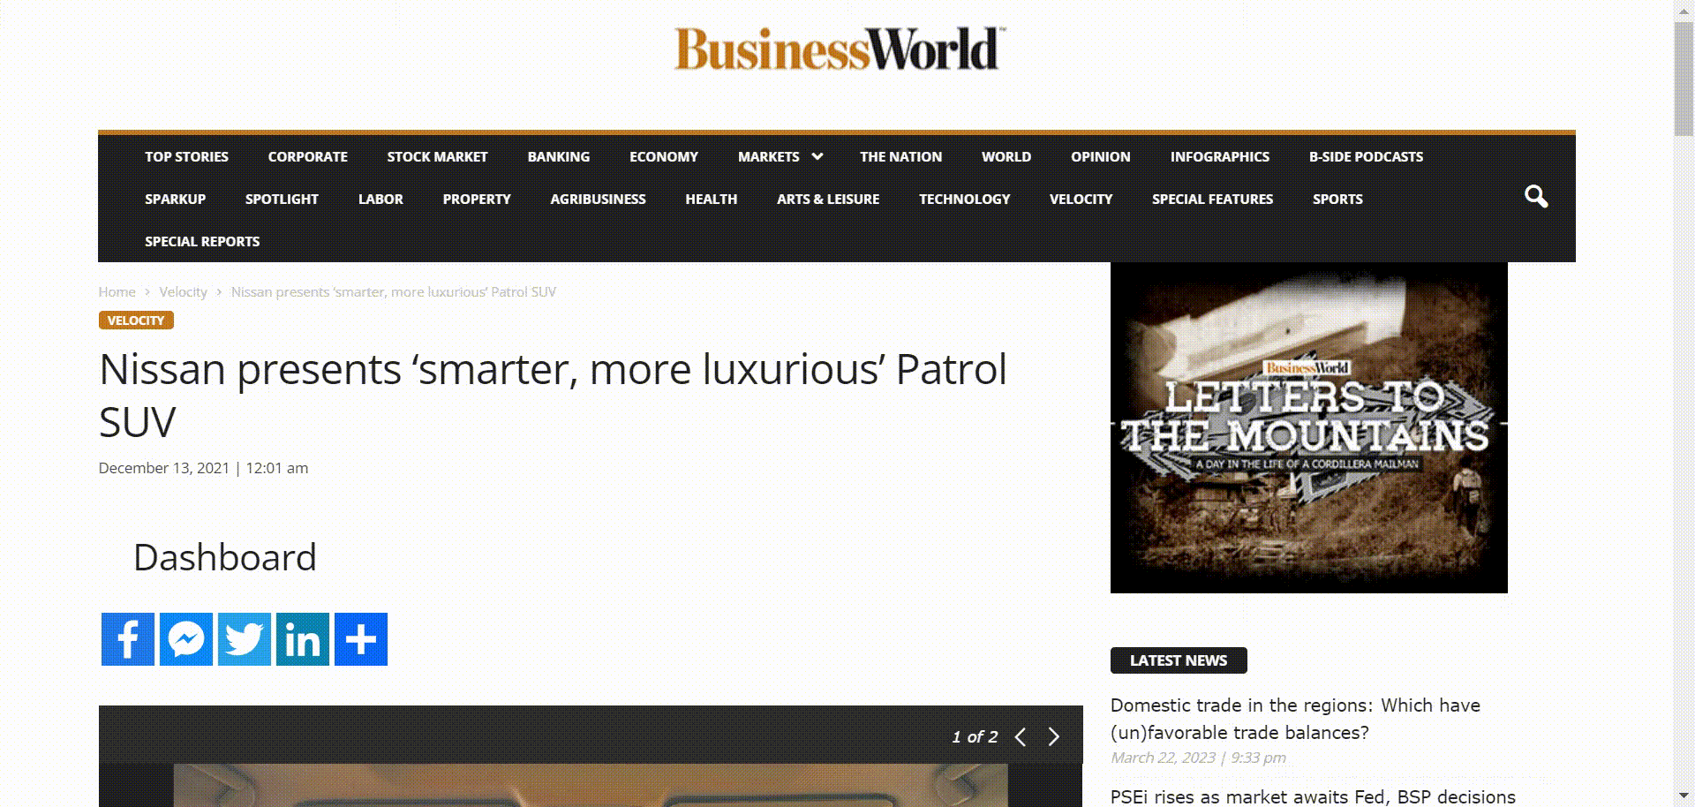

Mirrors Scans And Effectively Places Ads Across The OpenWeb
Mirrors scans through
the most relevant content
+
Detects Multiple Contextual Signals
Higher Performance
Keywords
[Sedan]
[Luxury]
[SUV Heritage]
[Automobile]
Drives Better Engagement
Increased Purchase Intent
Boost your CTR to at least 3-5X higher than the industry benchmark
Sentiments Analysis
[Luxury]
[Innovation]
Brand Safety
[positive tone]

Slide 26

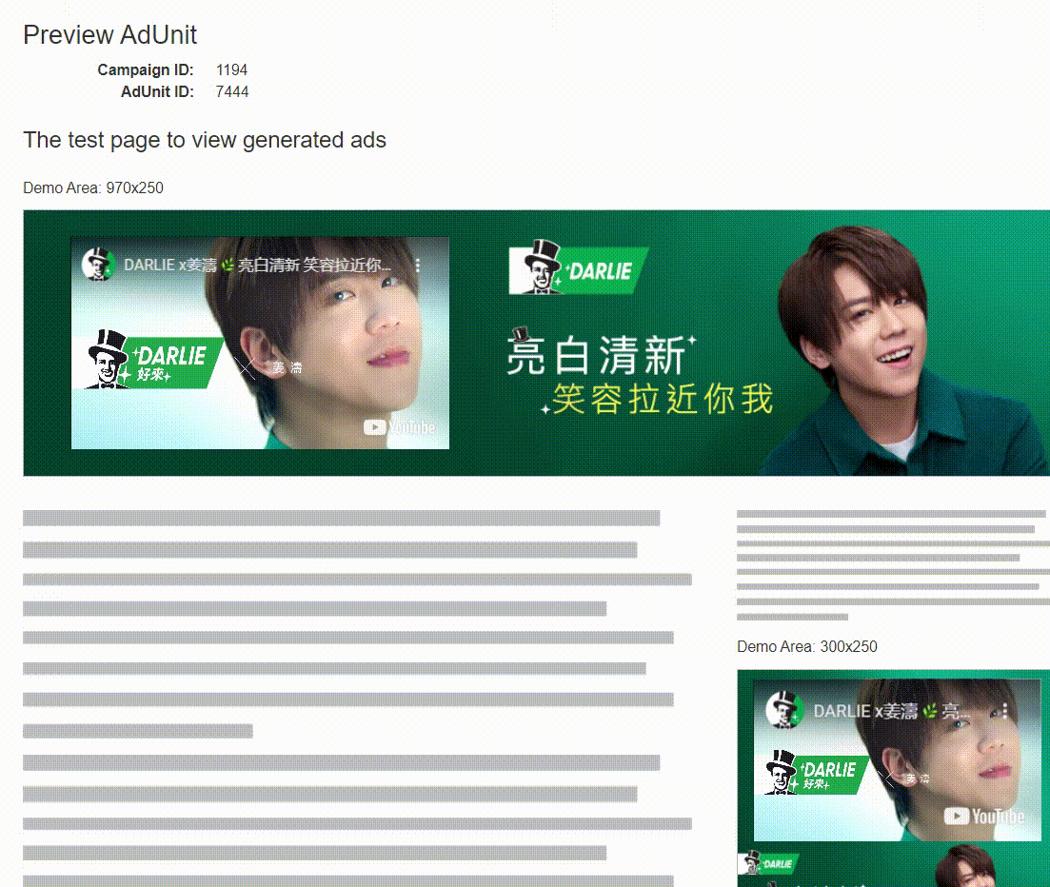
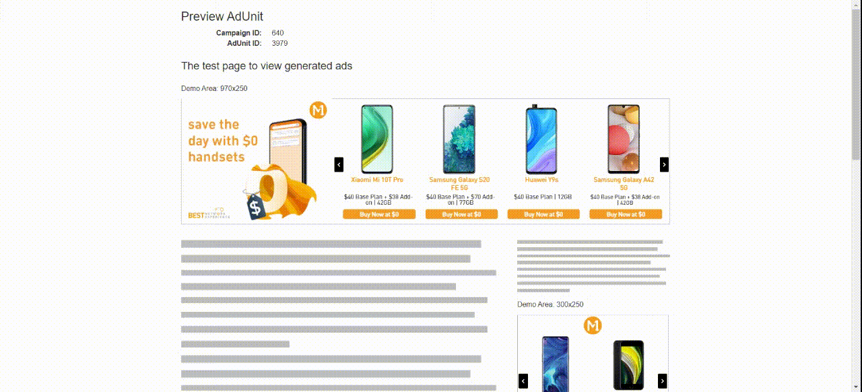
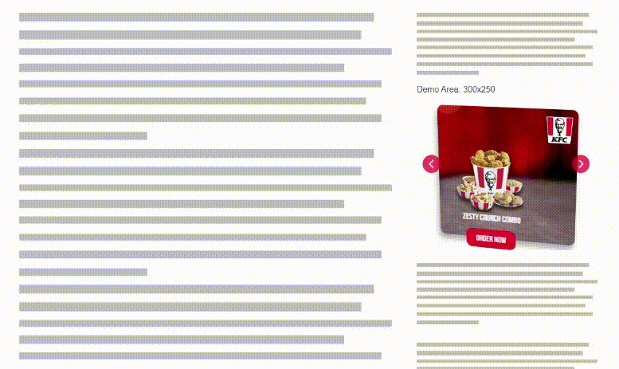


Leverage Contextual Signals To Power Dynamic Creatives
Mirrors generates content-rich and visually captivating dynamic creative ads. With a robust series of creative assets to rotate and optimize, your campaigns can achieve speed and scale for higher performance.
Mirrors Creative Management Process is an effective dynamic advertising solution that enables the cost-efficient development of rich media ads by using 45+ ad templates.
Social Display Creative Ad
Carousel Dynamic Product Ads
3D Parallax Ads

Slide 27
Meta - Facebook

Slide 28



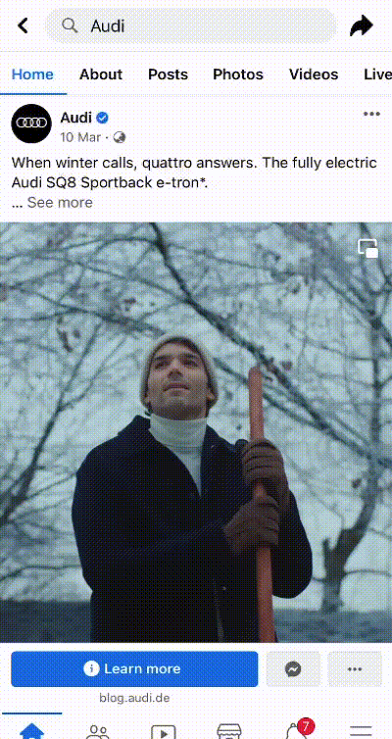
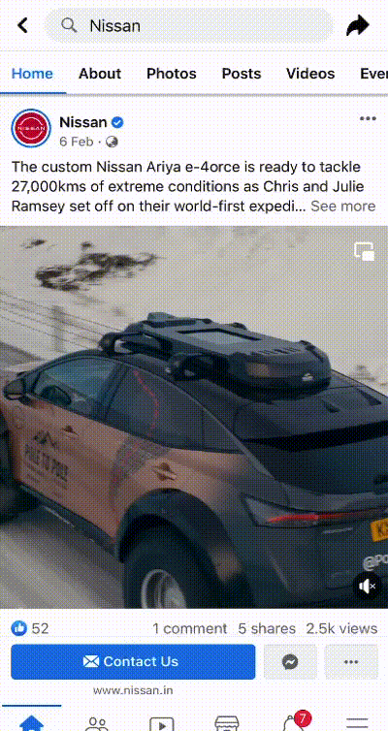

How MIRRORS works with Meta
+
=
Relevant, in-moment, real-time, ad served for higher performance
Relevant brand safe page is been selected and processed to derive contextual signals, interest, etc using AI & ML, NLP models

Slide 29
Why Silverpush?

Slide 30


Unprecedented Value To Our Clients
Precise Content Analysis
Ensure only content aligned, high-performing, and brand suitable videos pass through for final ad placement
Granular Targeting for Data -driven performance
Narrows affinity-based targeting to control who your ad reaches– while minimizing ad waste and improving performance
Enhance user-experience
Users experience that are relevant to their current state of mind, leading to higher engagement
Positive brand recall
Contextually relevant ads are less intrusive and more engaging, leading to a more positive brand recall, clicks and views
Brand Safety
Accurately detects harmful contexts across categories including nudity, hate speech, smoking, alcohol, violence and more. Blocks only unsafe ad placements without over-blocking or killing reach.

Slide 31



End to End Solution for our Partners to help them Succeed
PRE-ACTIVATION
IN-FLIGHT DASHBOARD
POST CAMPAIGN
Visual and Audio Trigger Recommendations for upcoming YouTube Campaigns
Custom Demos for Client
Ad Experiences Mocks
Efficient Pricing
Mass Reach
Real-Time Campaign Dashboard
Weekly Findings
Sample delivered videos
Key Trigger Analysis
Video Creative Performance
VTR Trends
Platform Performance
Optimization
Recommendations
Post Campaign Report
Campaign Summary
Recommendations
Visual and Audio Trigger Analysis
Share of Content Delivery
Creative Analysis
Delivery of Audience and
Analysis and Insights

Slide 32
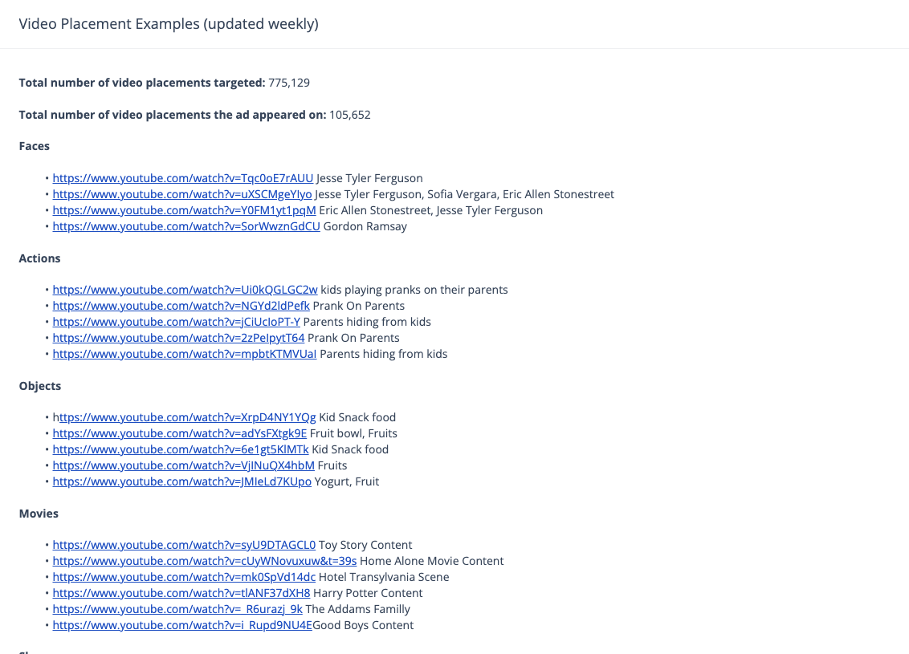
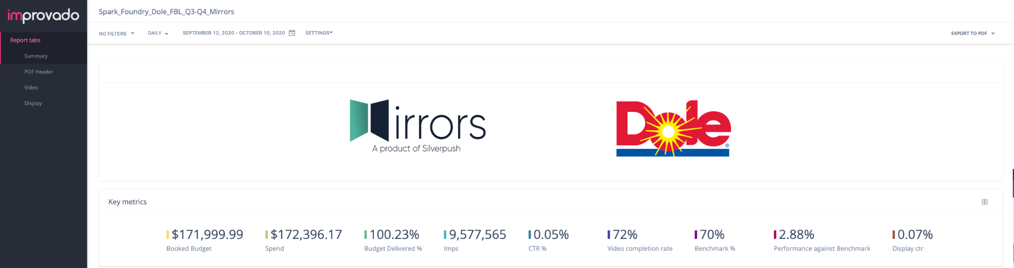
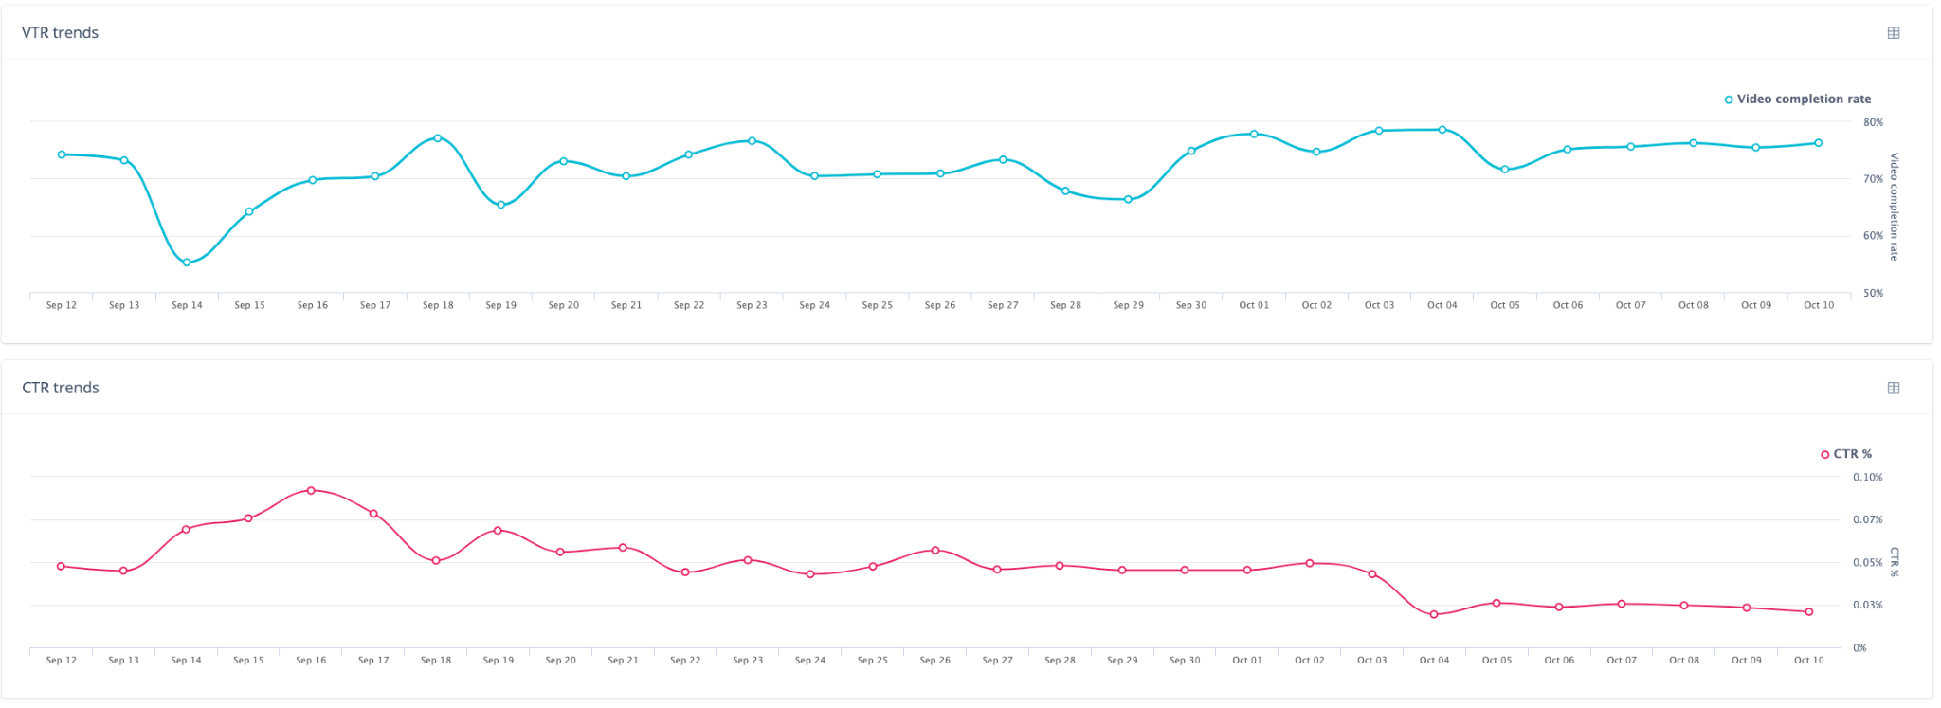
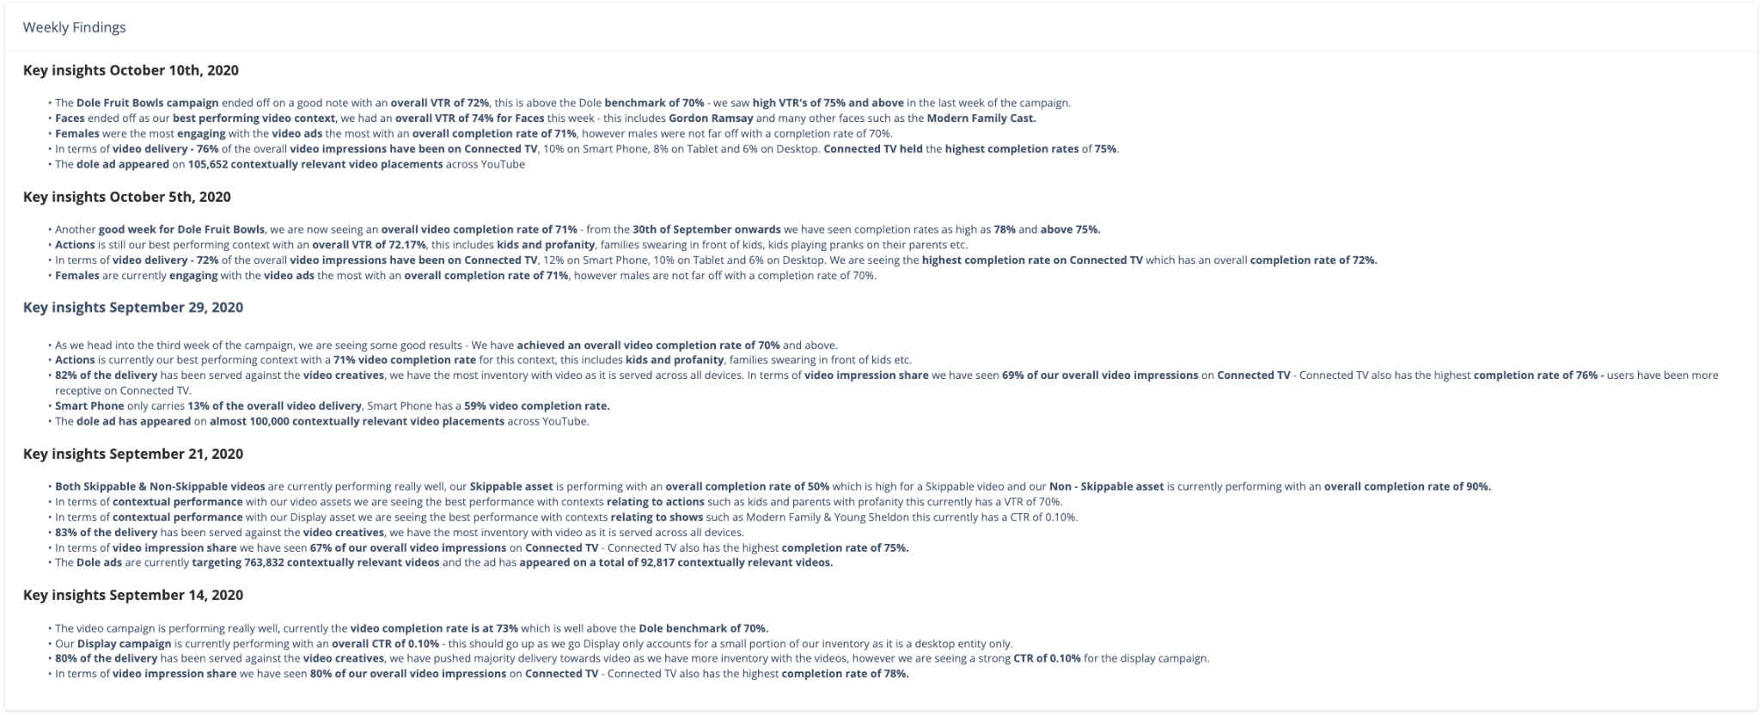
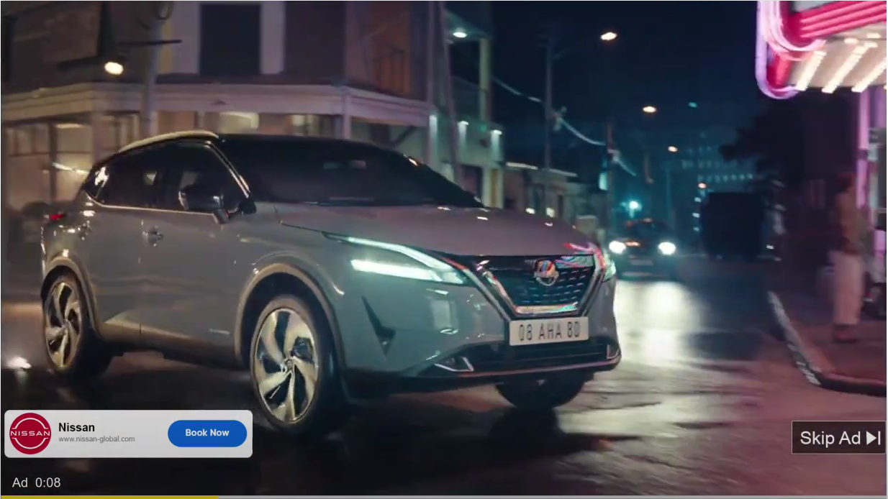
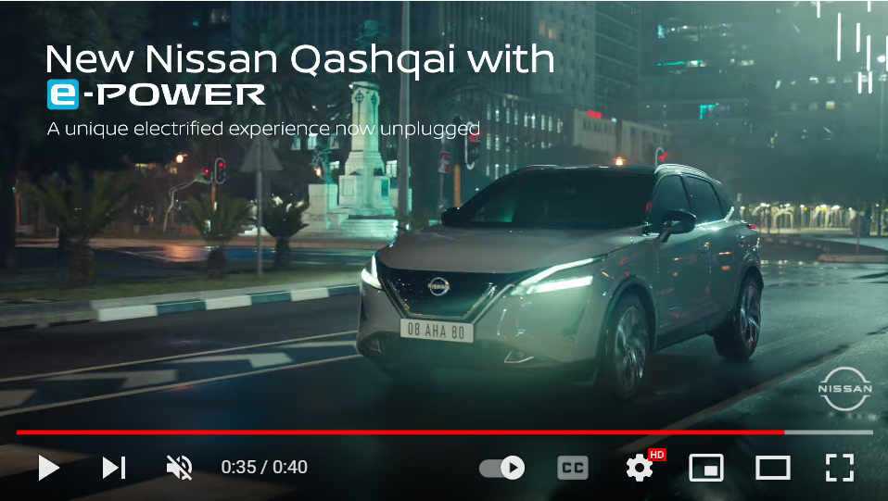
Improvado Reporting Dashboard (Updated Weekly)
Key Metrics
Top Video Placements
Live Graphs
Weekly Findings
Live Demos
Notes:
Our team will also provide weekly finding an optimizations to keep you informed every step of the way.

Slide 33
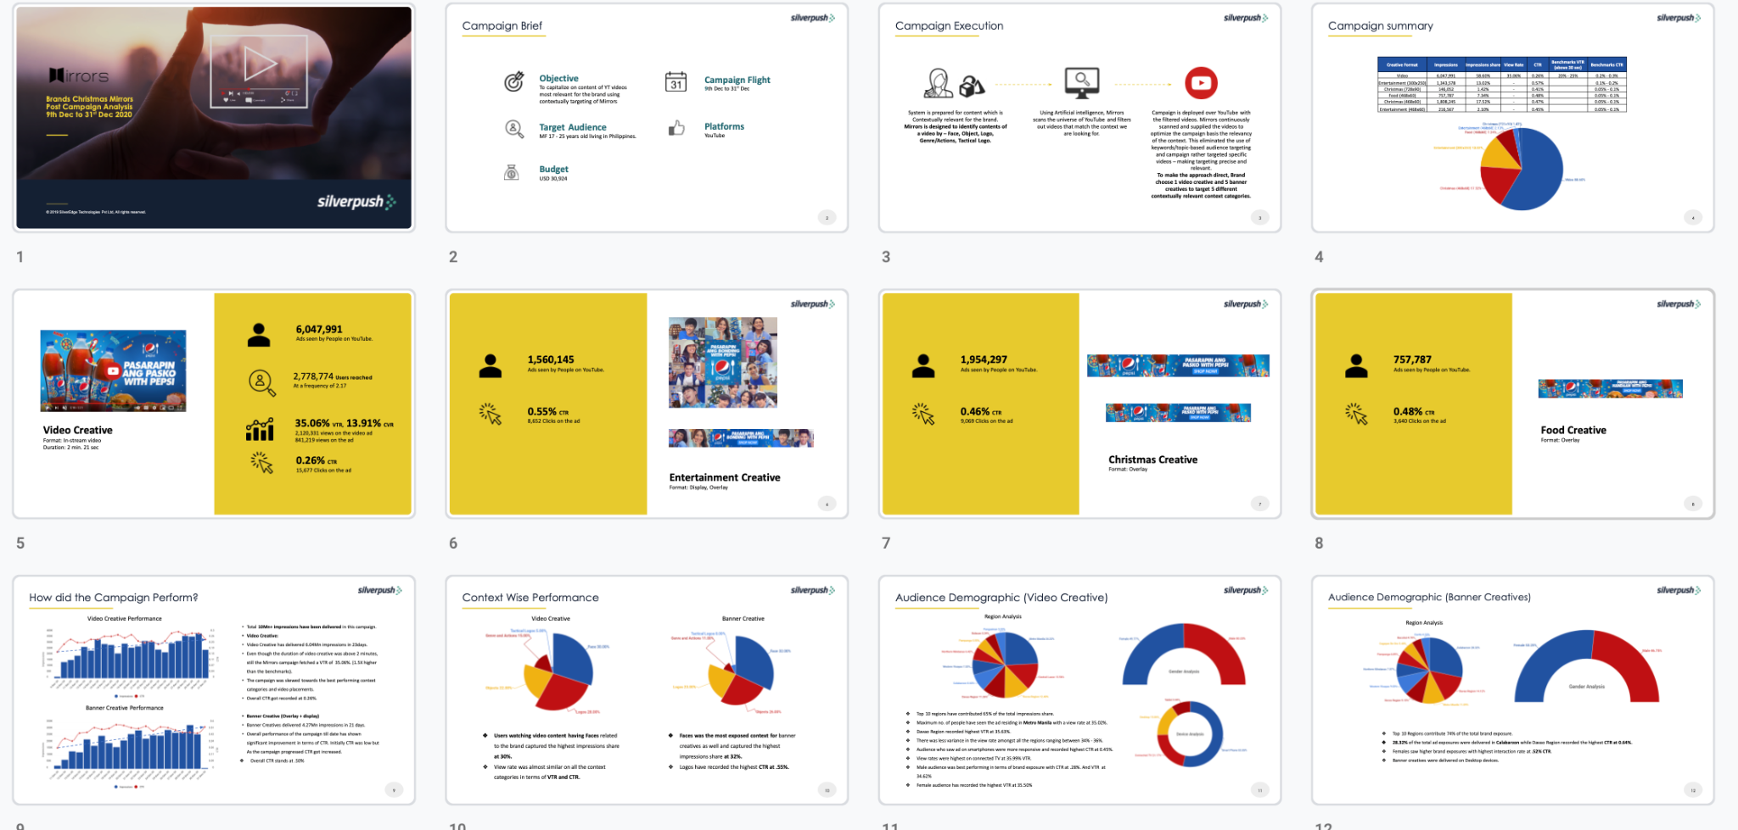
Comprehensive Post Campaign Analysis For Each Campaign

Slide 34
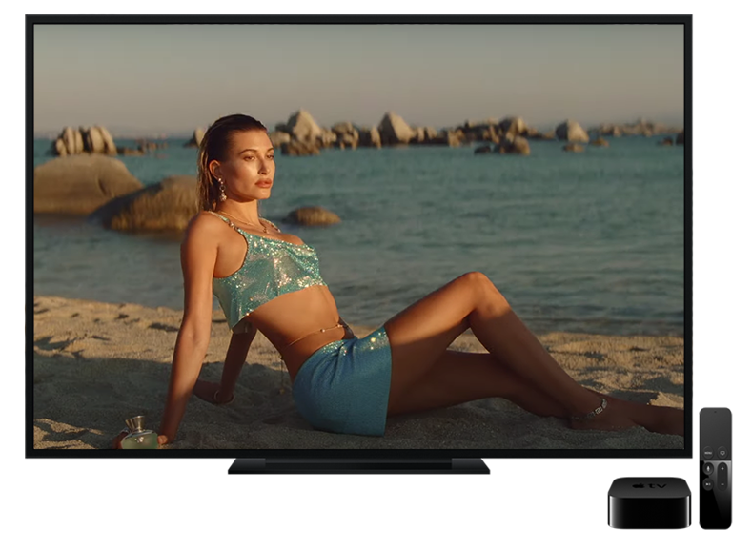


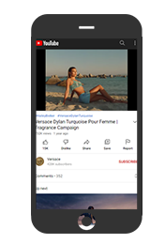
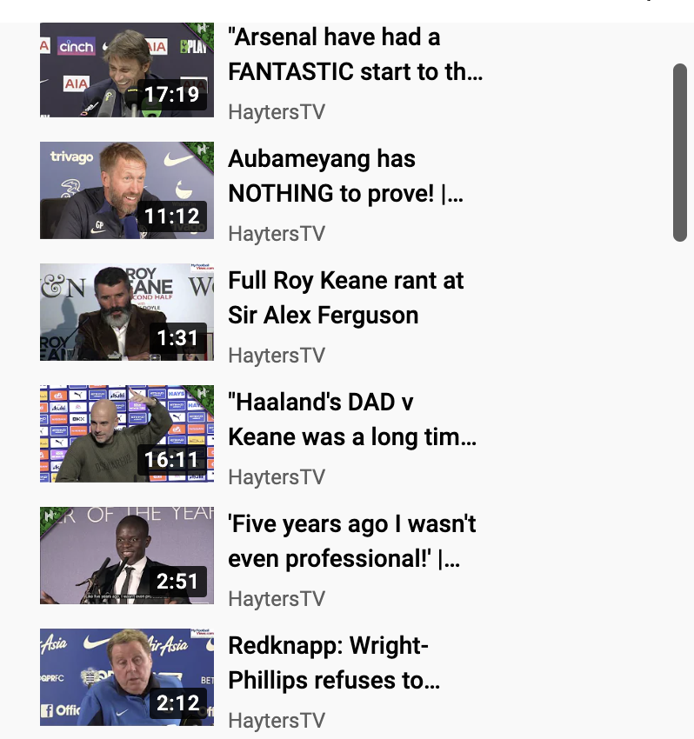



Cross Channel Activation: Most Viewed from Mobile and CTV
Connected TV
Desktop
Mobile + Tablet
(~65% views)
(~10% views)
(~25% views)
Notes:
~% of each en

Slide 35
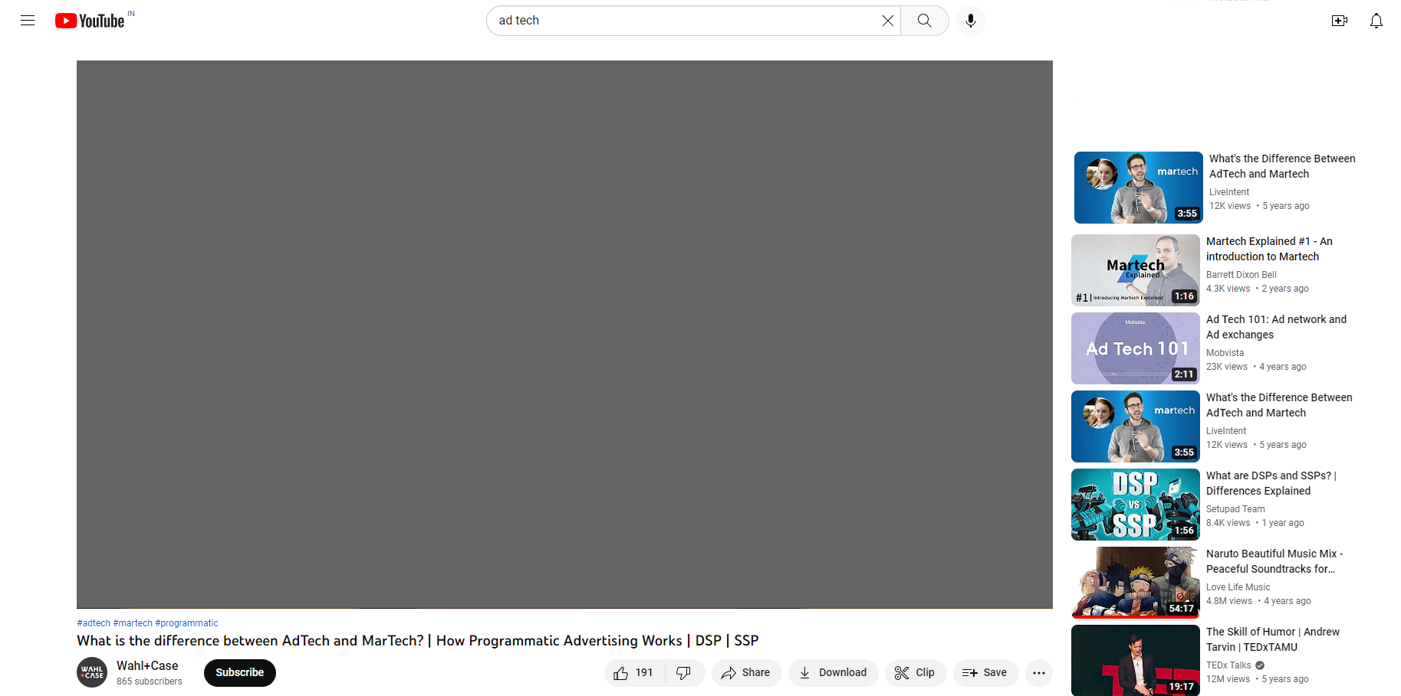
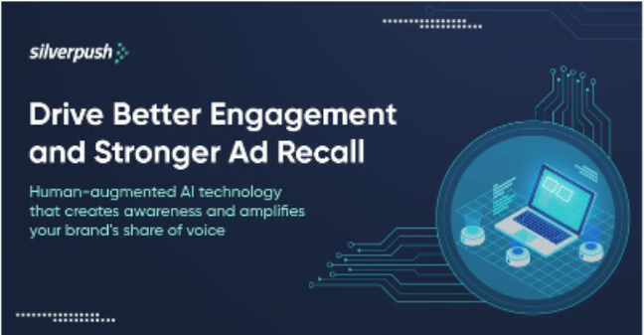

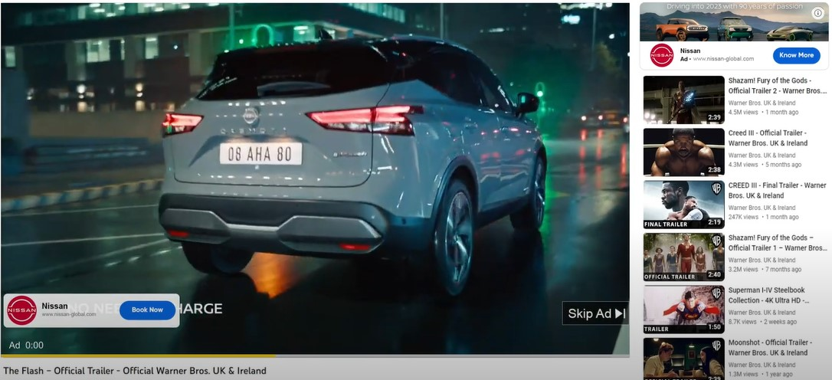
Creative Specs
Desktop & TV:
Companion Banner:
Maximum animation length: 30 seconds
Appears to the right of the feature video and above the video suggestions list.
(300× 60 and Desktop Only)
  JPG, static GIF, or PNG
  Google ad image policies apply
  Maximum Size. 150 KB
Overlay Ads:
Image dimensions: 468×60 or 728×90 image ads or text
Semi-transparent overlay ads that appear on the lower 20% portion of the video.
TrueView Skippable Video
Skippable video ads allow viewers to skip ads after 5 seconds.
Inserted before, during, or after the main video.
Length: 12 seconds to 3 minutes (less than 30 seconds recommended)
Pre-Roll Or Bumper Ads:
A bumper ad is a non-skippable video ad format
Perform well on mobile devices.
Length: Maximum 6 seconds
Headline & CTA:
Headline 15 characters
CTA 10 characters
VIDEO AD

Slide 36
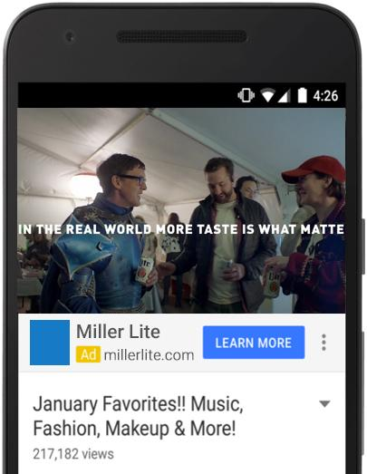

Creative Specs
Mobile:
YouTube Pre-Roll Or Bumper Ads:
A bumper ad is a non-skippable video ad format
Perform well on mobile devices.
Length: Maximum 6 seconds
YouTube TrueView Skippable Video
Skippable video ads allow viewers to skip ads after 5 seconds, if they choose.
Inserted before, during, or after the main video.
Length: 12 seconds to 3 minutes (less than 30 seconds recommended)
Skippable video ads allow viewers to skip ads after 5 seconds
Video Ad Specs:
Video Codec: H.264, MPEG-2, MPEG-4
Audio Codec: AAC, MP3
Resolution: 640×360 (19:9 aspect ratio) or 480×360 (4:3 aspect ratio)
Frame Rate: 30 FPS
File Size: Maximum: 1 GB
CTA : 10 characters including spaces
Headline : 15 characters including spaces
NB: Must be uploaded to YouTube and the videos themselves must be public or unlisted
Video ads
Call to Action
Headline
Display URL

Slide 37

THANK-YOU! Questions?
pierre.gauthier@silverpush.co

