Slide 1


Get Control Over BedBugs
November 2021 - Women’s Forum

Slide 2
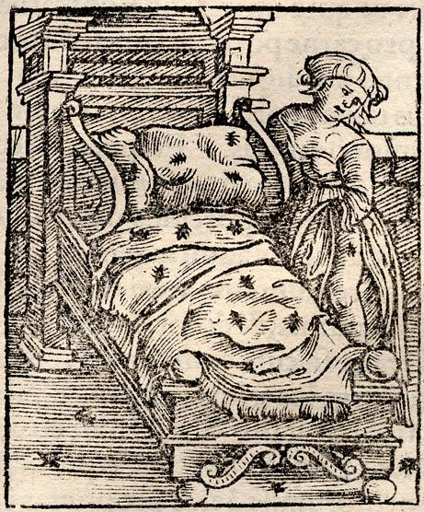
BugSafe
We founded BugSafe based on the twofold observation that bedbug infestations are on the rise, a serious public health issue for so many people, and that the range of treatments available is still mainly chemical, and more than often imperfect in terms of reliability and effectiveness.
Private individuals and professionals, faced with the heavy financial consequences and psychological after-effects, are in great demand of new solutions.
BugSafe has therefore set itself the objective of designing, producing and marketing natural devices as part of a mechanical pest control protocol and the design of resilient habitats.

Slide 3
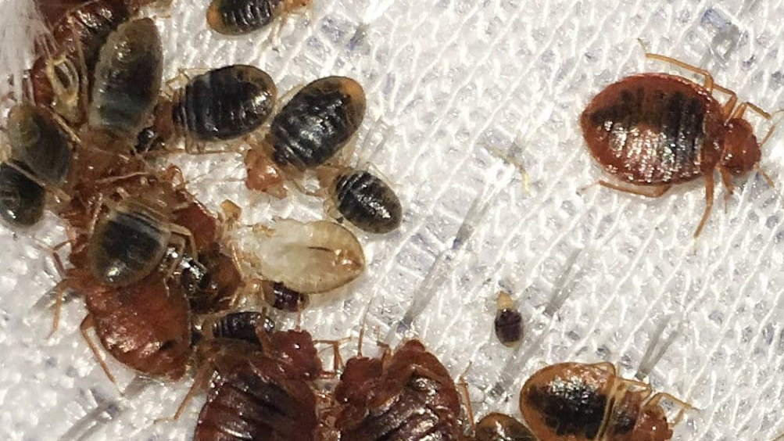



Bed Bugs are bad news
A haematophagous insect
Feeds exclusively on human blood
A human parasite
It colonises our living spaces and particularly the bedroom
A challenging pest to eradicate
Can survive for more than a year without feeding and has developed resistance to most biocides

Slide 4
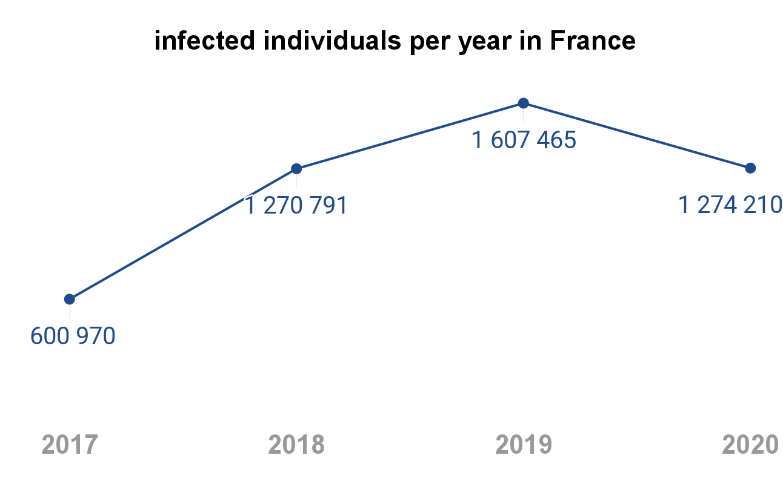
A fast growing phenomenon
0,5 to 1 Md € ⁽²⁾
Yearly costs of treatments and related expenses
3 % ⁽¹⁾
Yearly percentage of housing stock affected
1. Ipsos for BadBugs. (2021). Les Français face aux punaise des lit.
2. Source CS3D

Slide 5
Resulting in major dissatisfactions
70 % ⁽¹⁾
of victims dissatisfied with professionals' services
80 % ⁽¹⁾
of victims report psychological disorders
1249 € ⁽¹⁾
Significant financial impact for households
passive exposure to persistent pesticides
in the home or hospitality sector
1. Ipsos for BadBugs. (2021). Les Français face aux punaise des lit.

Slide 6
Practices are only slowly evolving
CHE
Chemical control
Integrated control
Regulations
Efficiency
environmental concerns
Ecological impact
Product resistance
Financial issues

Slide 7
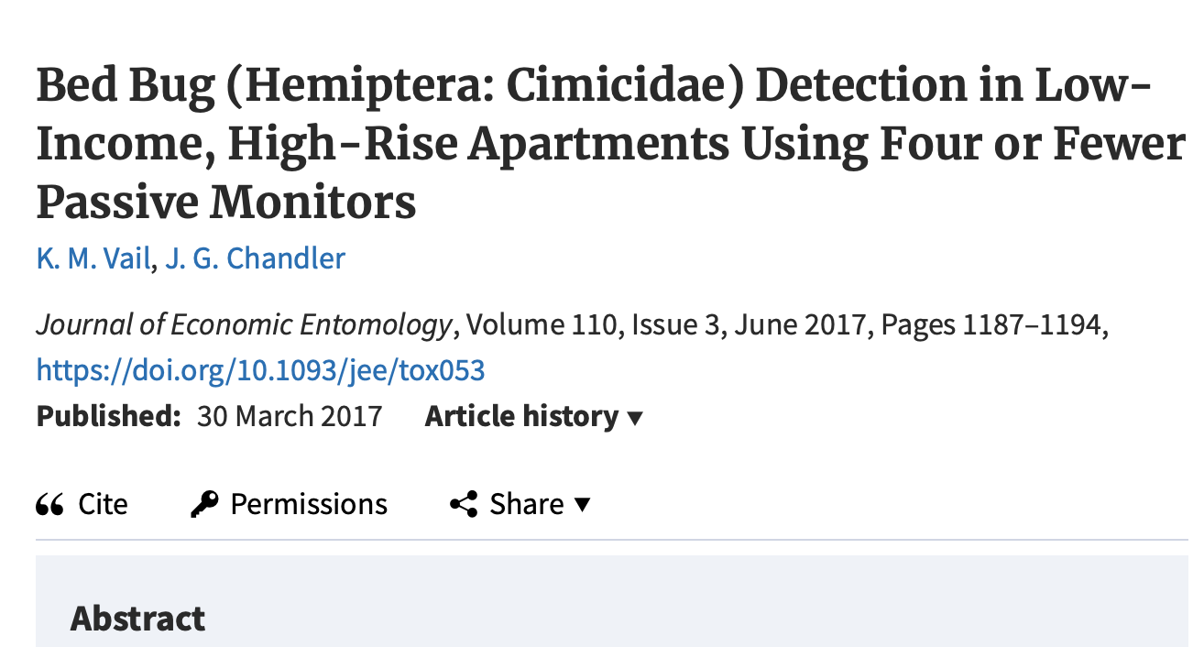
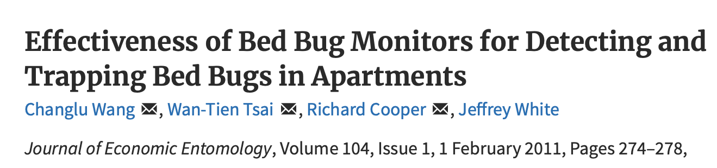
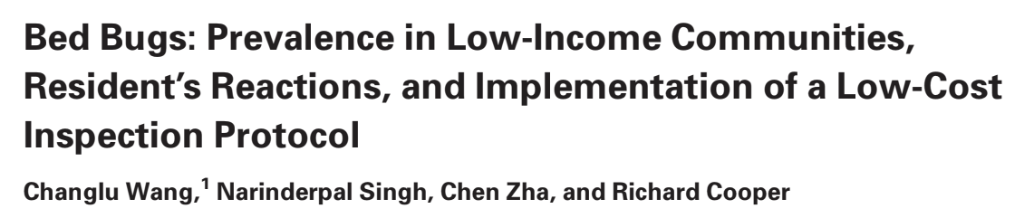
BugSafe's ambition :
To become the leading player in the segment of mechanical traps and barriers against bedbugs
The team at BugSafe studied scientific reports, interviewed entomologists and analysed the best practices and existing protocols, particularly in the more mature markets (US). It also met the victims of infestations: individuals, hoteliers, social landlords, etc and main competitors.
The main outcome is that, within the framework of integrated pest control, trapping systems are currently poorly used in France and Europe, despite the strong recommendations of the scientific authorities on the subject.

Slide 8



BugSafe commitments
100 % locally produced Scientifically proven effectiveness Zero chemical exposure
reduced environmental impact Lab and field tested no pesticide required

Slide 9
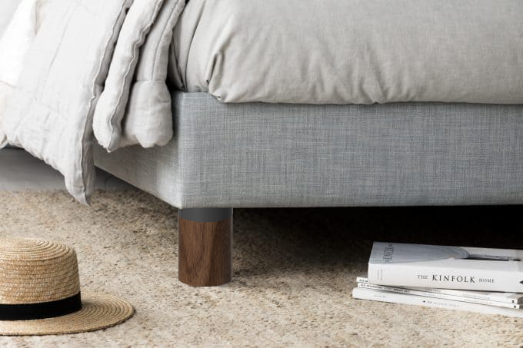
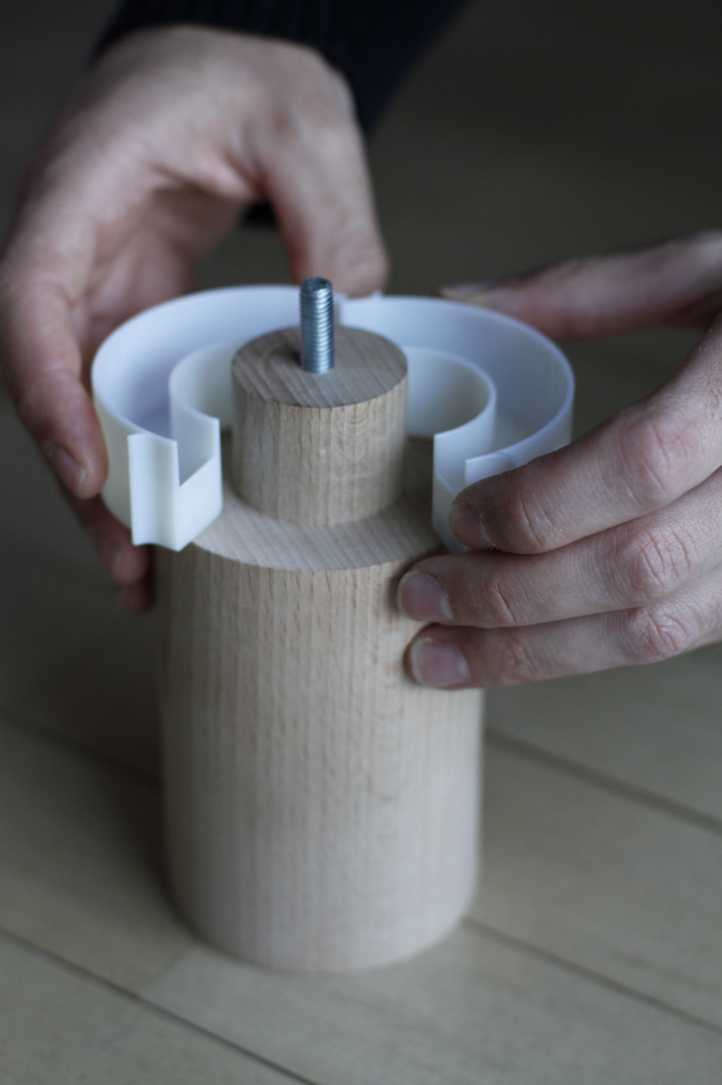
BugSafe first device

Slide 10
Advantages
Prevention
Reduce by half the risk of infestation ⁽¹⁾
Detection
Enhance early detection by 90+% ⁽²⁾
Isolation
Protect from the bites
1. Cooper et al. (2015). Effects of Various Interventions, Including Mass Trapping with Passive Pitfall Traps, on Low-Level Bed Bug Populations in Apartments. Journal of Economic Entomology, 109(2), 762‑769.
2. Wang, C., Singh, N., Zha, C., & Cooper, R. (2016). Bed Bugs : Prevalence in Low-Income Communities, Resident’s Reactions, and Implementation of a Low-Cost Inspection Protocol. Journal of Medical Entomology, 53(3), 639‑646.

Slide 11
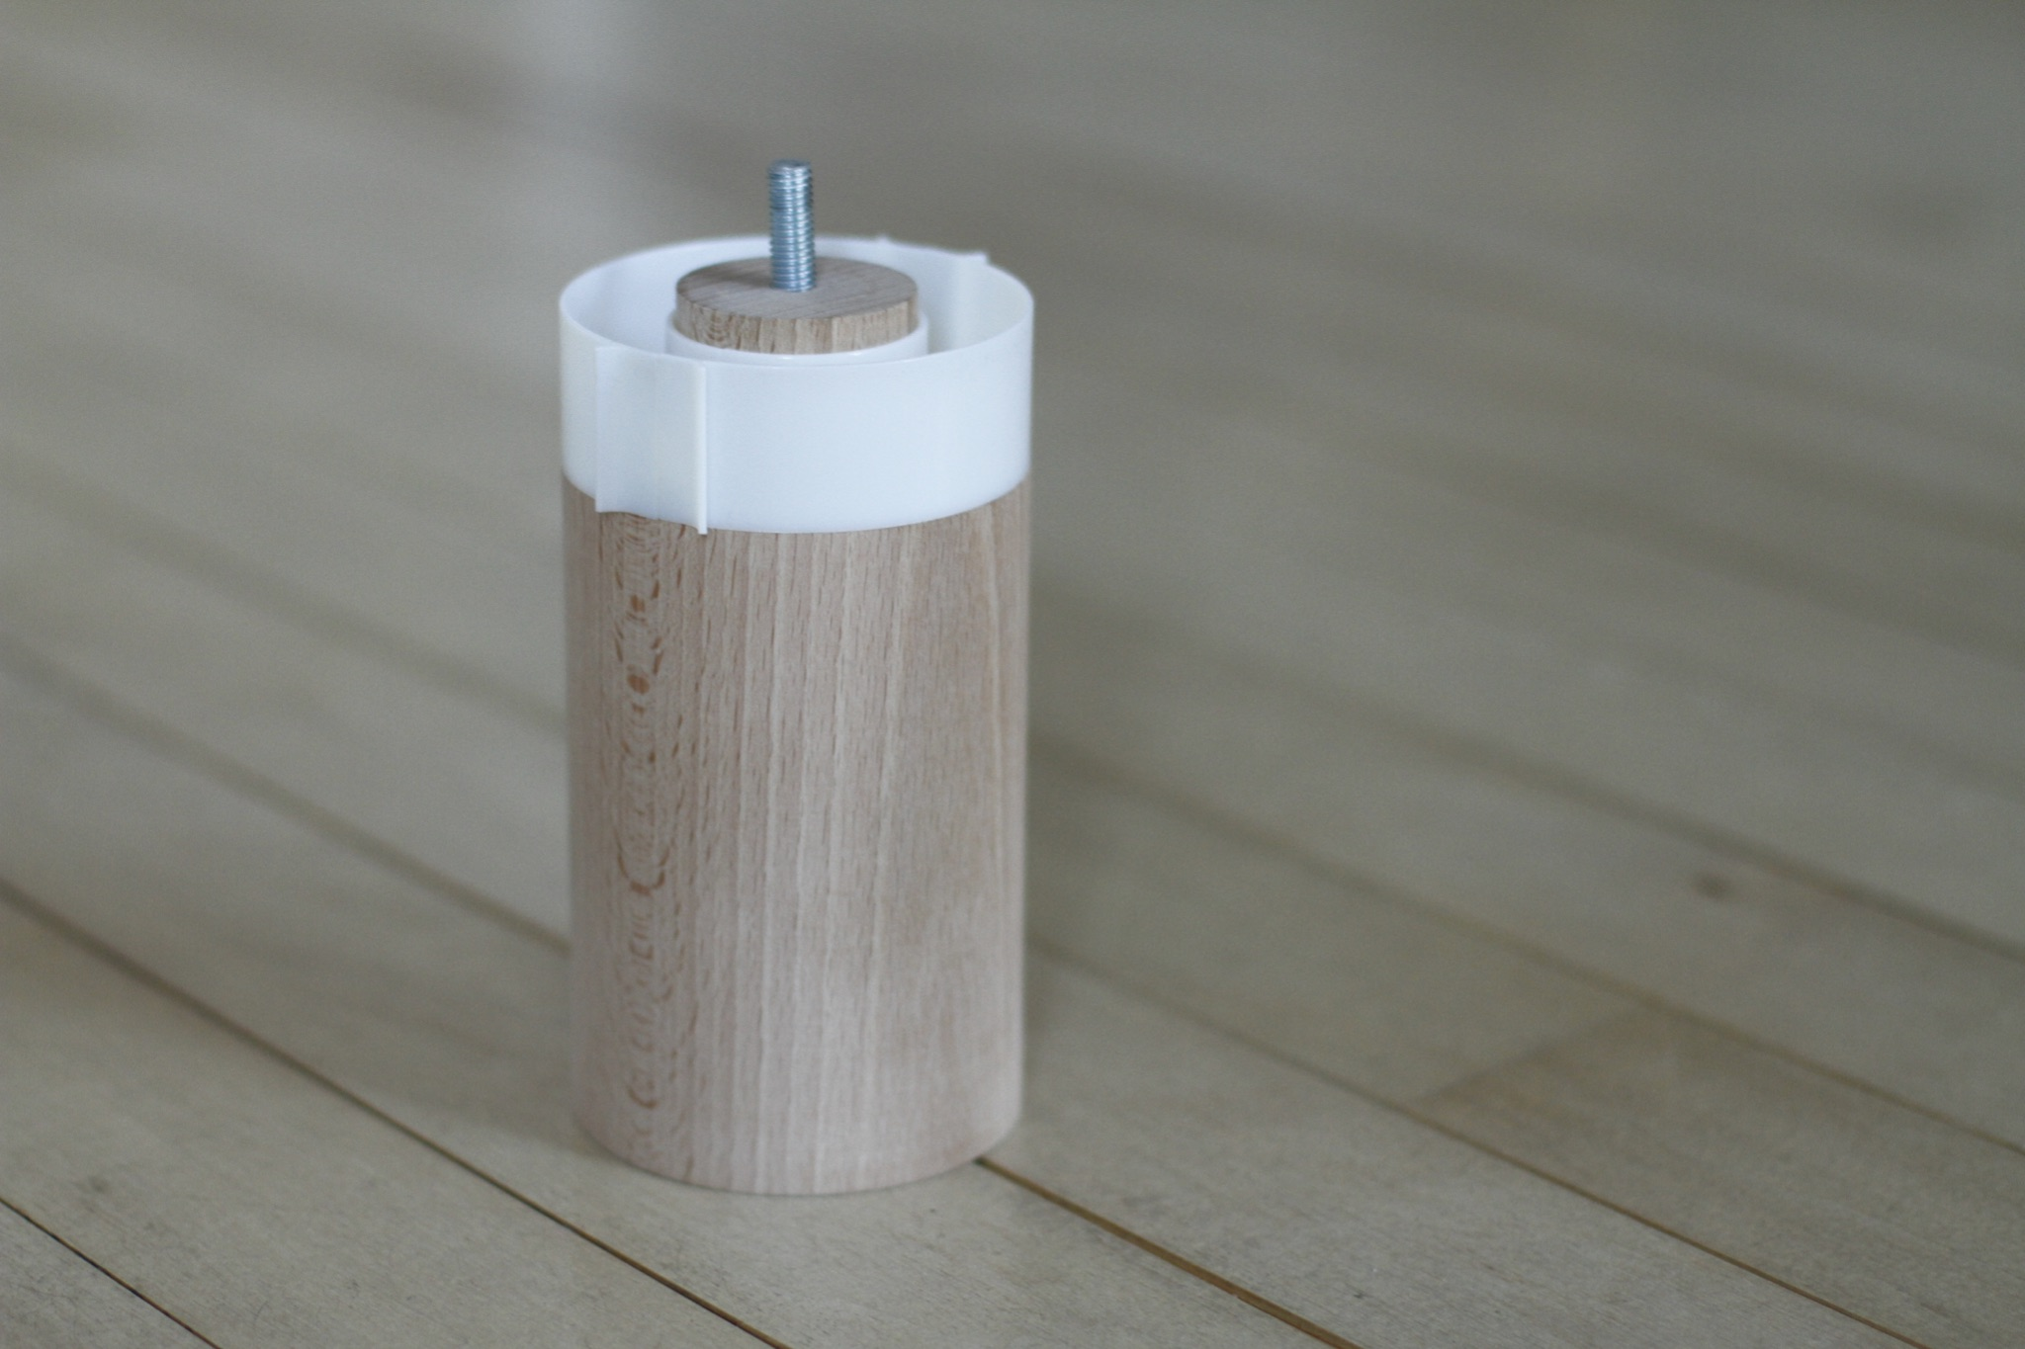
Reduce by half the use of pesticides
Naturally improve the quality of life
for the inhabitants

Slide 12
Contact : Louis Gerondeau - louis@bugsafe.fr
33 7 82 28 58 15

