Slide 1

State Tax Committee of the Republic of Uzbekistan
Role of the software on the tax audit and cryptocurrency policy in UZBEKISTAN
JAPAN, Saitama
SADIKOV Ulugbek Nosirovich

Slide 2
What is the tax audit?
According to the article 140, Tax audit is survey of the correctness of the calculation and payment of taxes and fees for a certain period.
Tax audit is carried out in relation to a taxpayer (tax agent) belonging to the category of taxpayers (tax agents) with a high degree of risk.
Tax authorities should send to the taxpayer a notice of the tax audit no less than thirty calendar days prior to the commencement of the tax audit.
The tax authority, in agreement with the State Tax Committee of the Republic of Uzbekistan, has the right to initiate a tax audit without prior notification of the taxpayer if there are signs of tax evasion
Identification, Analysis and Assessment of Tax Risk Program
Identified tax risk-signs of tax violations identified through the automated program;
Potential risk-tax risk that has not been determined, but there are conditions for its occurrence;

Slide 3

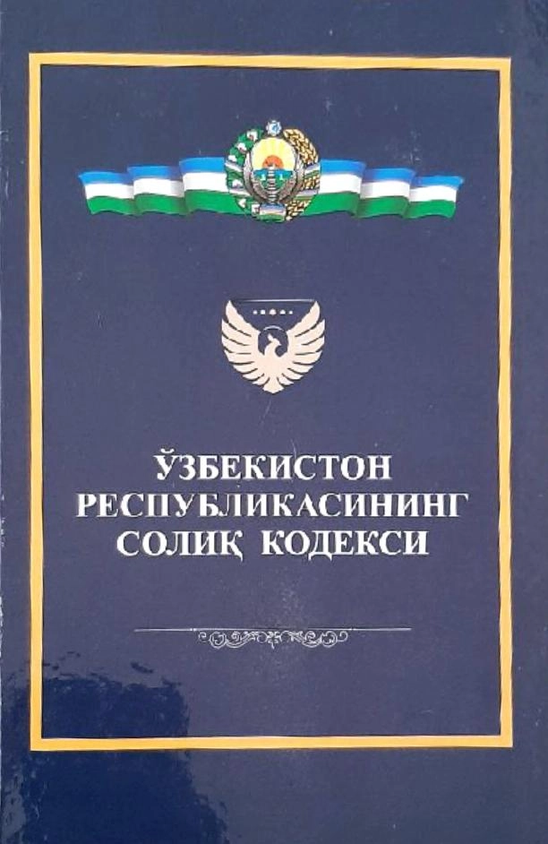
State Tax Committee of the Republic of Uzbekistan
The procedure for organizing and conducting a tax audit:
- Belongs to a high tax risk category;
- As a result of desk control, if the taxpayer fails to submit a revised tax return
Legal entities undergoing voluntary liquidation;
- Within the framework of the audit of the financial and economic activities of taxpayers in criminal cases;

Slide 4
State Tax Committee of the Republic of Uzbekistan
TAX RISK MANAGEMENT SYSTEM
Internal Source
External Source
- Tax and financial statements
Tax audit materials
Clarified tax reports
Losses (3 years or more)
Address change
Profitability index
Income increase but tax decrease
Electronic invoice
Bank transactions
Information of other government agencies
Appeals of individual and legal entities
Media information

Slide 5
State Tax Committee of the Republic of Uzbekistan
Slogan
Before tax audit (investigation)
Tax authorities have started working under the slogan of Tax authority is the assistance of entrepreneur.
We provide that all taxpayers with differences in numbers are sent a request form for correction of tax and financial reports submitted to the tax authorities. All taxpayers were satisfied with such analysis, and it was ensured that some taxpayers submitted corrected tax reports without errors and omissions.
In some cases, taxpayers will not obey the Tax law and tax authority starts to investigate. (How pity((((( sorry bro)
-collect all data regarding to the production expenditures (gas and electricity)
-prepare a comparative table
-input and output the raw materials (surplus or shortage)
-conduct investigation the property of the CEO
-bank transactions
-VAT refund
-export and import operations
-compare tax reports
-electronic invoice

Slide 6
State Tax Committee of the Republic of Uzbekistan
Is Cryptocurrency legal in Uzbekistan?
The latest news in my country is that a joint platform between Coinpay and Binance has launched in Uzbekistan, providing services in the field of crypto assets. The announcement was made by the cryptocurrency exchange Coinpay. The partnership was revealed by the National Agency for Project Management (NAPM) in January 2025. The platform is the first of its kind to be officially integrated into Uzbekistan’s legal system.
Binance is not directly legal in Uzbekistan but is operating through a local partner, Coinpay. Binance was previously fined in 2024 for operating without a license. Uzbekistan requires crypto-asset transactions to be conducted through national providers.
All crypto transactions, whether conducted by individuals or legal entities, including non-residents, are exempt from taxation in Uzbekistan.

Slide 7
State Tax Committee of the Republic of Uzbekistan
M I N I N G
Resolution of the President of the Republic of Uzbekistan of July 3, 2018 № RP-3832 “On measures to develop the digital economy and the sphere of crypto-assets turnover in the Republic of Uzbekistan” has established that mining is one of the activities in the sphere of crypto-assets turnover.
Mining is the activity of maintaining a distributed data registry, creating and confirming the integrity of blocks by performing computational operations
Mining is carried out exclusively by a legal entity using electricity produced by a solar photovoltaic station.
In the case of using electricity with connection to a single electric power system:
payment for consumed electricity is carried out using a multiplier of 2 to the established tariff;
Persons engaged in mining (miners) are required to register in accordance with the procedure established by legislative acts.
Coinpay also reminded that crypto asset transactions are only permitted through the official website. Using third-party P2P platforms or other services is a violation of the law and may result in legal consequences.

Slide 8

World’s Billionaires List
The Richest In 2025

Slide 9
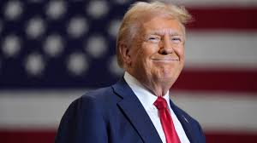

How policy influences the crypto market and price
"Hello bitcoiners!" He courted cryptocurrency fans during his election campaign.
"If crypto is going to define the future, I want to be mined, minted and made in the USA, and it's going to be.” Now Donald Trump is taking steps to deliver on his promise to be a “crypto president."
On January 20, Bitcoin surged dramatically, setting a new all-time high near $109,000 immediately after the inauguration of U.S. President Donald J.
U.S President Donald Trump has signed an executive order to establish a strategic bitcoin reserve, which will include BTC seized by the U.S government through law enforcement action.
Bitcoin plunges 12% after Trump's tariff announcement mirroring stock market downturn.
Trade war with China, Canada, Mexico and other countries.

Slide 10
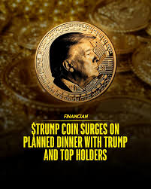
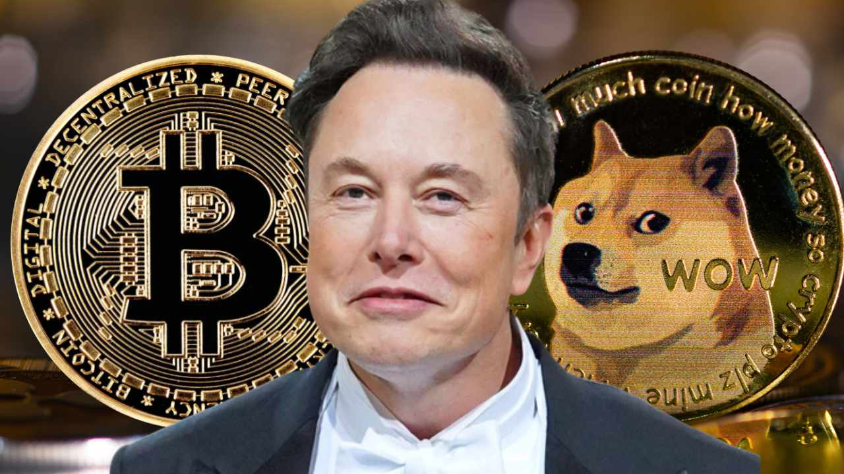
Is Elon Musk involved in cryptocurrency?
President Trump's meme coin, which had slumped 88% from its most recent high, got a boost Wednesday after its website invited the top 220 holders of the digital token to an "intimate private dinner" with the president.
Elon Musk owns Bitcoin, Dogecoin, Ethereum, and Shiba Inu. He supports Dogecoin the most, with Tesla and SpaceX accepting it for some purchases. Elon Musk hasn't confirmed buying a new cryptocurrency, but he has shown interest in Bitcoin, Dogecoin, and Ethereum.

Slide 11

Blockchain-based HUMO token backed by government bonds to be piloted in Uzbekistan
A new digital asset, the Humo token, secured by government bonds, is currently being tested in Uzbekistan. This was reported by the press service of the Humo payment system.
HUMO, the payment system serving over 35 million cardholders and widely integrated into the country’s banking and retail sectors, will serve as the foundation of the project.

Slide 12
THANK YOU FOR ATTENTION!!!

