Slide 1
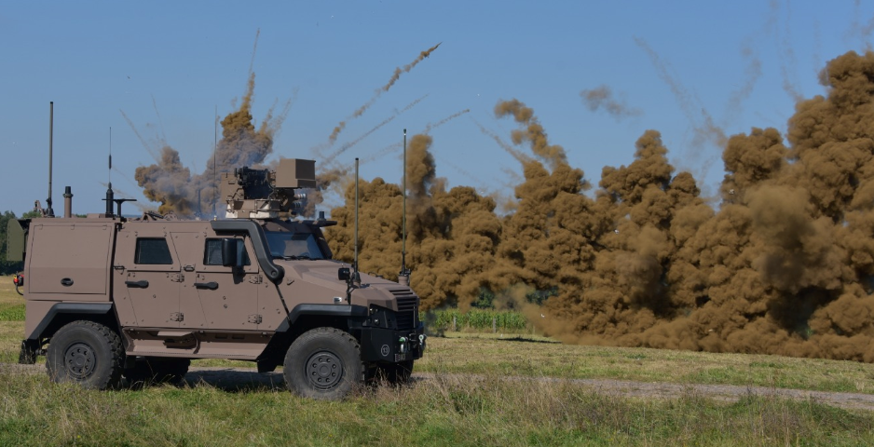

04 November 2024
2016
2018
2020
LtCol HANSEN Guillaume
ARMÉE LUXEMBOURGEOISE
DÉPARTEMENT
GESTION DE PROJETS

Slide 2
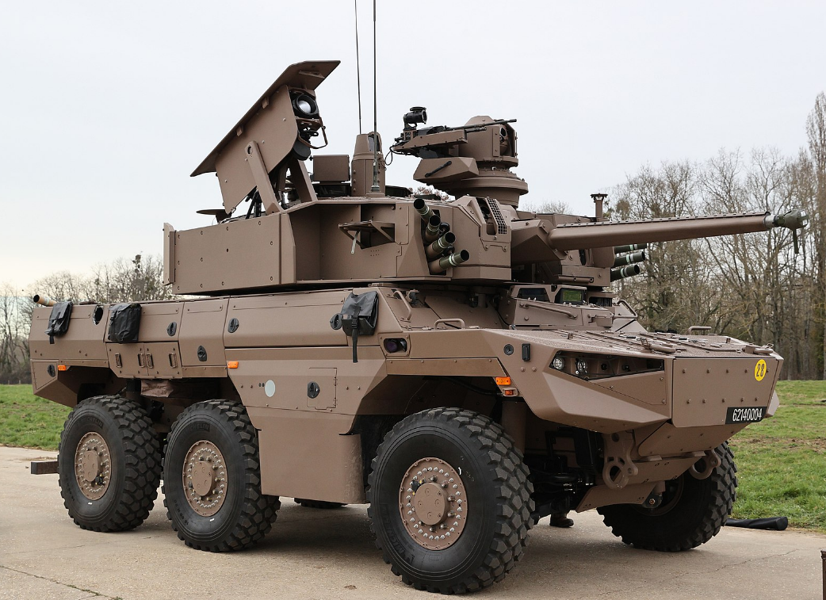
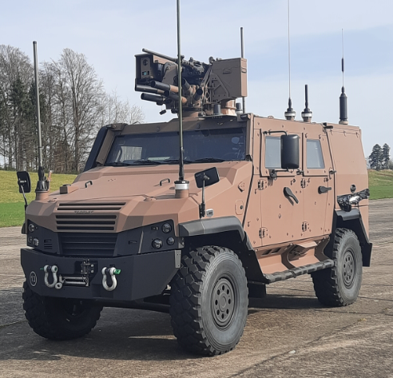
New Land Targets allocated => new Army
2016
2018
2020
From 2 light Recce Companies -> half of a medium Combat Recce Battalion
Changes are:
light vehicles (10 tonnes) -> medium vehicles (30 tonnes)
Recce (light weapons) -> Combat Recce (heavy weapons)
2x Companies (240 persons) -> 0,5 Battalion (350 persons)
-> full operational in 2032
LtCol HANSEN Guillaume
ARMÉE LUXEMBOURGEOISE
DÉPARTEMENT
GESTION DE PROJETS

Slide 3
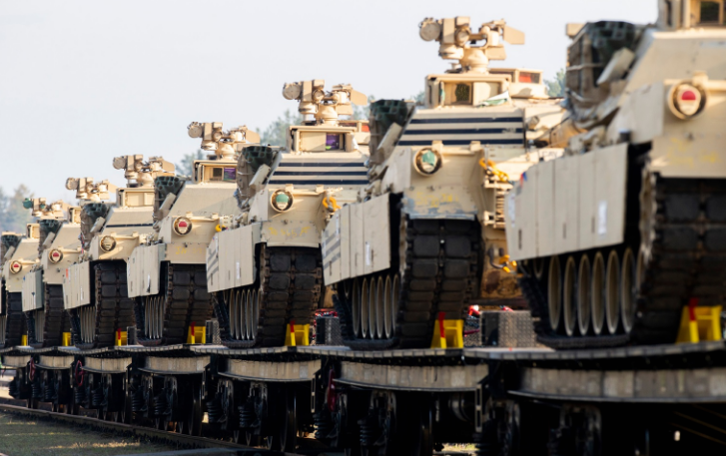
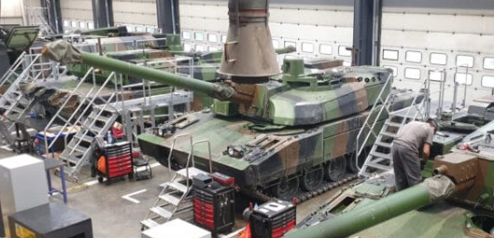
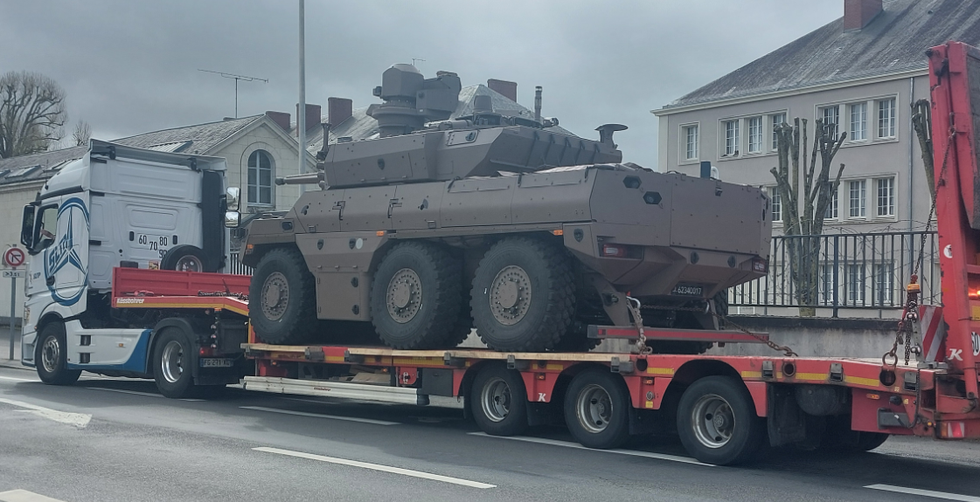
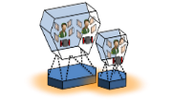
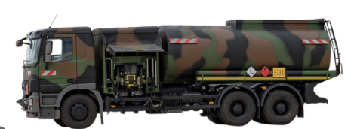
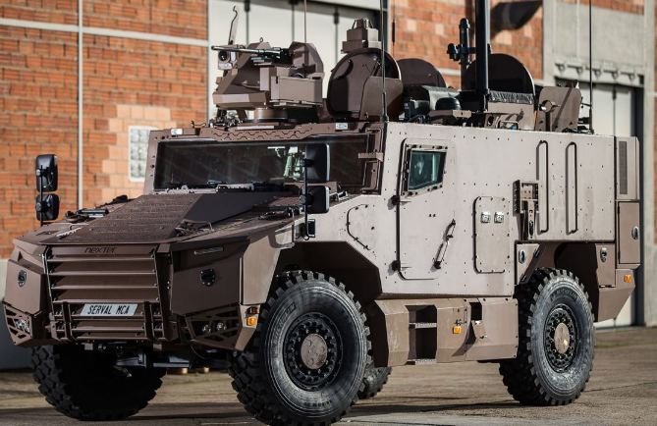
What has to be done?
Mobility/Movement:
railway
road
Infrastructure:
ARLON (barracks)
SANEM (logistics and maintenance)
Service provider for Maintenance/Security
Sustainement:
local reseller,
specialized maintenance, helpdesks/industrie,
support equipment,
Training means:
Simulators to be designed,
Infrastructure,
Maintenance/Service contact
Binational Battalion
Communication:
COTM/SOT-M on vehicle plateform,
Ammunition:
Big contracts for new types (missiles, time fuze, attack drones, …
Big quantities (be prepared for..)
Recycle or disposal after end of shelf live
Décisions
ARMÉE LUXEMBOURGEOISE
DÉPARTEMENT
Gestion de projets
Notes:
COTM = Comms on the move; SOT-M = Satcom on the move
Establishes distributed maintenance and repair capabilities
Have regional Maintenance, Repair, and Overhaul (MRO) capabilities of industrial partners, or through cooperative partnerships ... particularly for shared weapon systems operated by allies and partners
Accounts for geographic distribution, regional sustainment
ages

