Slide 1

LUXEMBOURG CYBER DEFENCE
Luxembourg Cyber Defence
– 04/11/24 –
Ben Fetler
Cyber Defence Principal Advisor

Slide 2


Agenda
1
Cyber Defence Strategy
2
LUX Cyber Defence capabilities

Slide 3
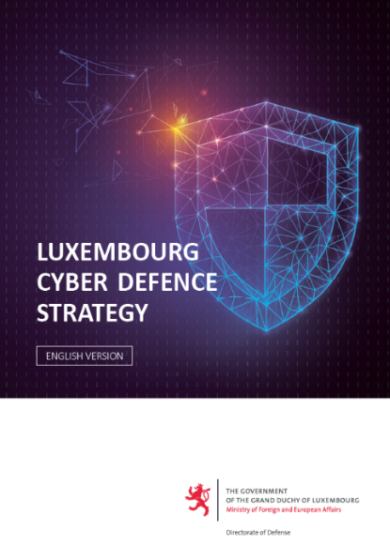
Cyber Defence Strategy
LIMITED DISTRIBUTION
1
Long-term objective
Key elements
Have one of NATO and EU’s most cyber secure Defences
Strengthen LUX reputation as a reliable partner for international organisations
Become a reference point for relevant national actors in the cyberspace domain
3

Slide 4
Cyber Defence Strategy
LIMITED DISTRIBUTION
1
Long-term objective
Strategic Goal SG1
SG2
SG3
SG4
A skilled and motivated workforce
“CyberFutures” landscape mapped, priorities identified and research programmes underway
Strong national and international cyber cooperation
Cyber defence integrated in all Luxembourg Defence activities, assets and culture
4
Notes:
Strategic Goal 2: Capability 1: Mutual needs and capacities and enabling factors identified
Cataloguing of Luxembourg cyber defence industry capability and support of Luxembourgish companies access the international cyber defence market in the defence domain is part of this capability.

Slide 5

Luxembourg Cyber Range
LIMITED DISTRIBUTION
2
Simulation platform that replicates a real environment allowing teams responsible for the security of IT infrastructures to train and develop their expertise.
Mainly used for 3 scenarios:
Training
Exercises
Security testing
5
Notes:
Cyber Range key facts & contact information: https://www.cyber-range.lu/
Project extension 2025-2030 planned

Slide 6

LUX Cyber Defence Cloud
LIMITED DISTRIBUTION
2
Resilient multi-technology, multi-tenant private cloud hosted on NATO Ground in Luxembourg.
Provides the ability to store and process sensitive and classified data.
Owned by Luxembourg Defence and operated with the support of NSPA (in charge of acquisition, implementation and exploitation/maintenance).
Dynamic provision of storage and computing capacities according to the needs of the beneficiaries.
6

Slide 7
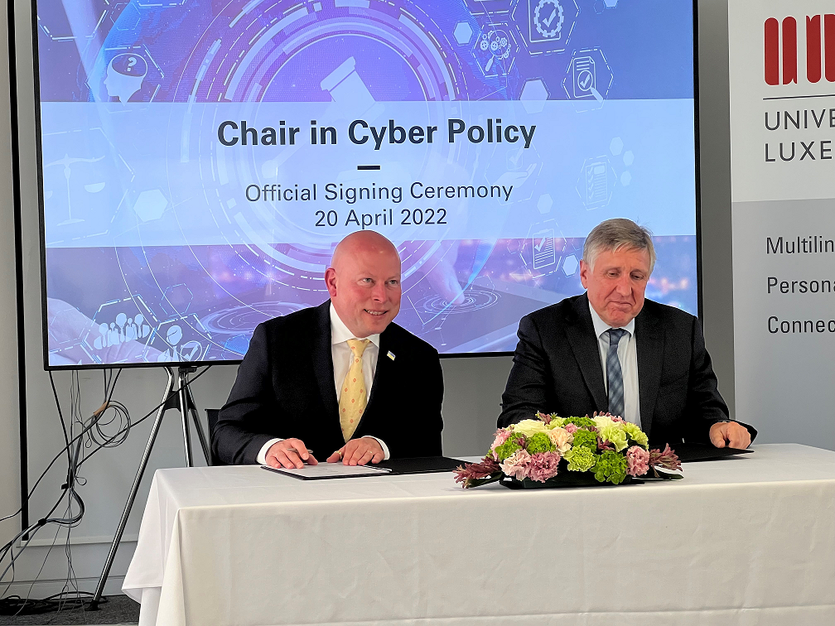

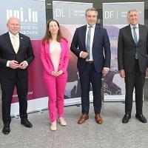

Chair in Cyber Policy (University of Luxembourg)
LIMITED DISTRIBUTION
2
  Objective: Focus on the legal and political aspects at the intersection of digital and network technologies such as privacy, data protection, cybercrime, cyber defense, contract law, Intellectual property law, and human rights.
  Will carry out research, teaching and outreach activities
7

Slide 8


CyberHub (University of Luxembourg)
LIMITED DISTRIBUTION
2
  Objective: Strengthen and increase Luxembourg's capacity to meet national and international challenges such as cyberthreats, and also create the skills needed to develop innovative cybersecurity and cyberdefense solutions.
  Support the government’s Cybersecurity Strategy IV and Cyber Defence Strategy through research, technology transfer, and education
8

Slide 9

LUXEMBOURG
CYBER DEFENCE
THANK YOU

