Slide 1
1st Luxembourg Defence Technology & Innovation Day
Overview of the EU defence industrial landscape
4th of November 2024
Direction de la Défense (MAEED)
Aziliz GUÉRIN, Attachée for EDA & Defence industry
aziliz.guerin@mae.etat.lu

Slide 2
Timeline of EU defence industrial actions
24/02/2022
Russia’s invasion of Ukraine
July 2023
ASAP
October 2023
EDIRPA
2021
2022
2024
01/01/2021
European Defence fund
18/05/2022
Defence Investment Gap Analysis
05/03/2024
EDIS
+
EDIP
2022
2023

Slide 3
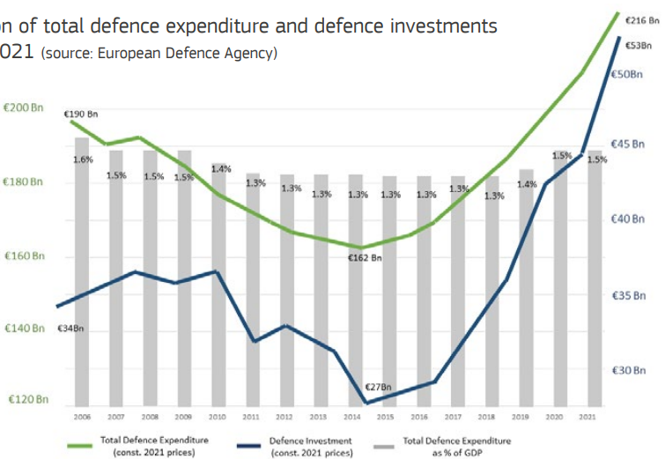
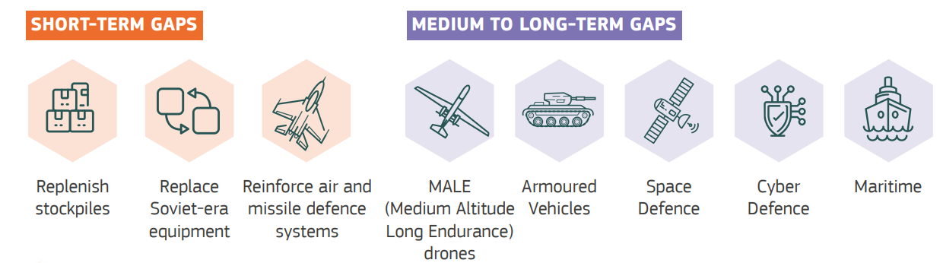
EU Strategic Policy document
18/05/2022
Defence Investment Gap Analysis
Insufficient defence expenditure
Addressing capability gaps

Slide 4
EU Programmes
July 2023
ASAP
October 2023
EDIRPA
ASAP
Support of Ammunition production
EDIRPA
European Defence industrial reinforcement through procurement
€500
million
€310
million
For EU Industry
Support ramping up ammunition production
Replenish defence stockpiles + deliver to Ukraine
31 projects funded in 15 MS
For Member States
Incentivize joint procurement
Replenish defence stockpiles + deliver to Ukraine
No outcome yet

Slide 5
2024 – Where do we stand?
(+)
(-)
Boosting EU defence budgets (€290 bn in 2025) 2022: LU = 2nd highest increase (+28%)
Breaking taboos on investing in arms production
Opening up of EIB lending rules
Supply chain of chips and critical raw materials
First EU strategy for defence industry
First EU defence industry toolbox
Manufacturing capability & production capacity too low
Lack of cooperation/joint procurement among Member States
Long-term contracts and orders missing
Dependency from non-EU actors
Access-to-finance, EIB funding limited, private banks reluctant
EU defence industrial competitivity at risk

Slide 6
What’s coming?
EDIS
European Defence industrial strategy
EDIP
European Defence industry Programme
05/03/2024
EDIS
+
EDIP
Policy document
€1,5
billion
Strengthen the competitiveness of the EDTIB
Indicators to boost collaborative actions & joint procurement
Mainstream defence readiness culture
Financial support to boost investment
Sustain long-term support to Ukraine
Security of supply regime
Currently under negotiation by MS/EP

Slide 7
What’s left to do - in a nutshell?
EDTIB to produce sufficiently and in time to provide the MS with the required capabilities
EU defence readiness and preapredness to handle threats and ensure own security
Reduce fragmentation
Increase joint procurement
Boost funding & access-to-finance
Reduce dependency on non-EU supply
Increase procurement from the EDTIB

Slide 8
Thank you !
Overview of the EU defence industrial landscape
4th of November 2024
Direction de la Défense (MAEED)
Aziliz GUÉRIN, Attachée for EDA & Defence industry
aziliz.guerin@mae.etat.lu

