Slide 1

NATO
Science & Technology Organization
Capt. Salvatore CALABRO’
OCS Advice Section, Head

Slide 2
Agenda
What is STO
Topics
Examples

Slide 3
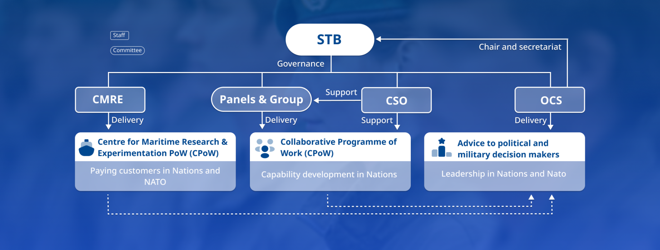
What is STO

Slide 4

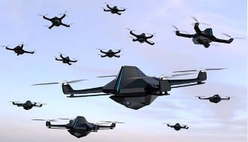
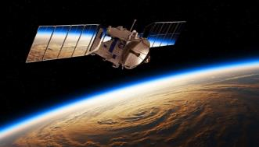
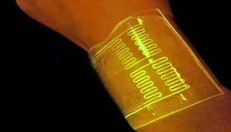
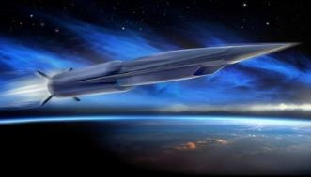


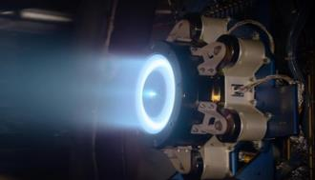

NATO adopted EDTs
Artificial Intelligence
Autonomous Systems
Space
Hypersonics
Biotechnology and Human Enhancement
Quantum
Novel Materials and Manufacturing
Energy and Propulsion
Next-Generation Communications Networks

Slide 5
S&T impact on Security and Defence
Climate Change & Security
Resilience
CBRN
Critical Undersea Infrastructure
Research Security and Integrity

Slide 6
Examples - Space
Activity | Type | Title | Start Date
AVT-387 | RTG | Common Research Wind Tunnels for CFD Verification and Validation | 01/01/2024
AVT-406 | RTG | Innovative Solutions for Micro-Propulsion Systems for Small Spacecraft | 01/01/2024
AVT-SCI-405 | RTG | Conceptual Aggregated Design of Hypersonic Glide Vehicle (HGV) | 01/01/2024
SET-340 | RTG | Multistatic RF Sensing for Enhanced Space Domain Awareness | 04/03/2024
SCI-SET-355 | RTG | Cross-Panel Collaborative Experimentation for Improved Space Situational Awareness (SSA) | 06/03/2024
SET-338 | RTG | Assessment of Navigation with and without GNSS for Military Applications | 19/06/2024
SCI-357 | RTG | Comparison of Allied Nations Space Strategies | 11/12/2024

Slide 7
Examples - Cyber
Activity | Type | Title | Date
SAS-190 | RSY | Enhancing Energy Security Resilience, Capabilities and Interoperability | 01/2024
SAS-191 | RTC | Nordic Pine 2024: Hybrid Threats to Renewable Energy Systems | 02/2024
SAS-MSG-ET-FP | RSY | Measuring the Operational Effectiveness of Software-Intensive Military Platforms in Cyber and Electronic Warfare Environments | 07/2024
IST-228 | RSM | Classified Military Communication and Information Systems Research | 07/2024
SAS-198 | RTC | Nordic Pine 2025: hybrid threats to renewable energy systems | 10/2024

Slide 8
Examples - AI
Activity | Type | Title | Start Date
AVT-411 | RSM | Machine Learning and Artificial Intelligence for Military Vehicle Design | 01/2024
SCI-MSG-ET-067 | ET | Countering Autonomy/AI Threats | 01/01/2024
IST-ET-127 | ET | Explainable AI in decision support systems | 04/04/2024
HFM-MSG-ET-218 | ET | Artificial Intelligence in Military Training and Education | 17/04/2024
IST-221 | RTG | Defense against adversarial attacks on machine learning systems | 16/05/2024
SAS-200 | RTG | AI tools for Operational Planning | 01/09/2024
SET-343 | RTG | Using Simulation to Train AI for Automated Scene Understanding | 09/09/2024

Slide 9
Examples – NMAM
Activity | Type | Title | Start Date
AVT-342 | RTG | Interoperability of Additive Manufacturing in NATO operations | 01/01/2021
AVT-384 | RSM | Novel Materials and Manufacturing in Military Vehicle Design | 01/01/2023
HFM-ET-204 | ET | Additive Manufacturing to Support Forward Deployed Medical Forces- Printable On-Demand Medical Capabilities | 02/04/2024
AVT-ET-249 | ET | Novel two-dimensional and Related Materials for Military Applications | 01/07/2024
HFM-391 | RTG | Biomanufacturing of National Security Materials | 15/09/2024
AVT-SET-417 | RTG | Materials for Thermal Infrared Camouflage – Development and Characterization | 01/01/2025

Slide 10
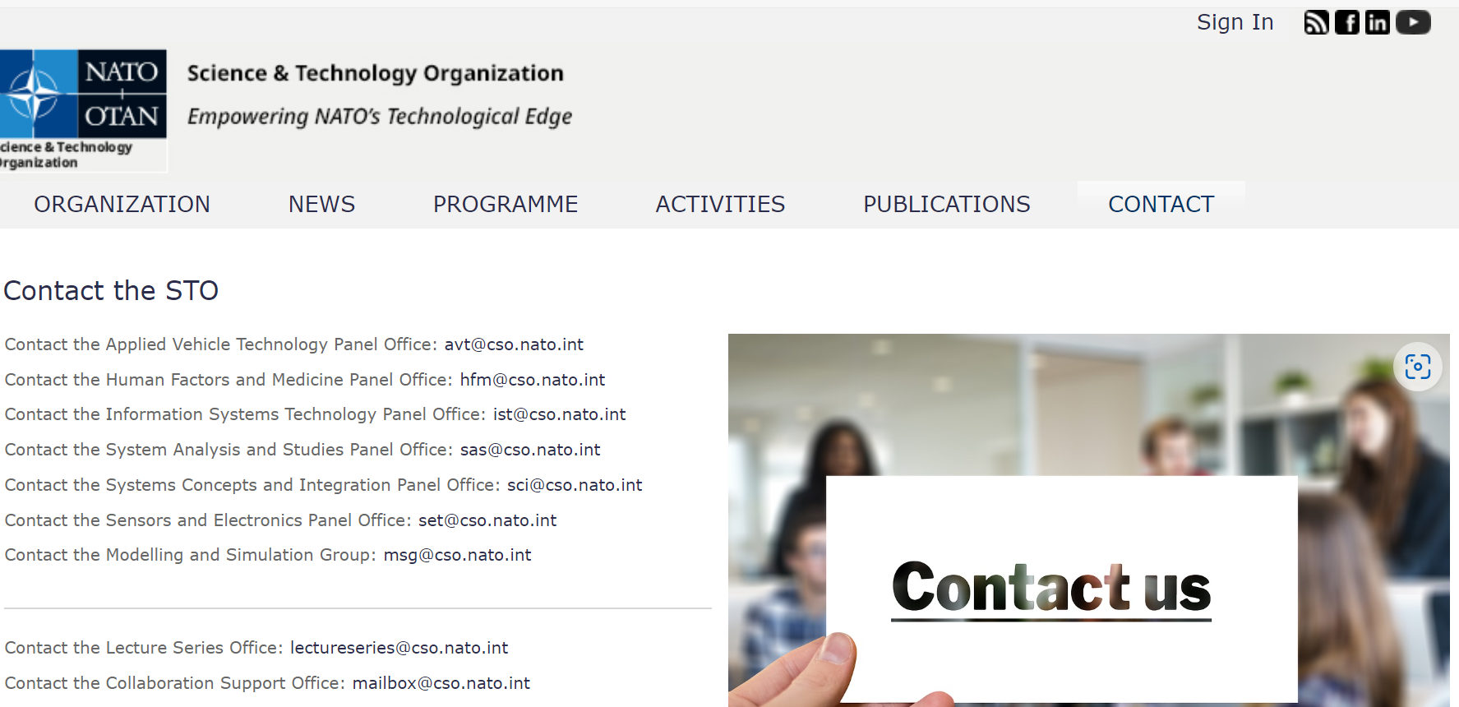
https://www.sto.nato.int/Pages/contactus.aspx

Slide 11
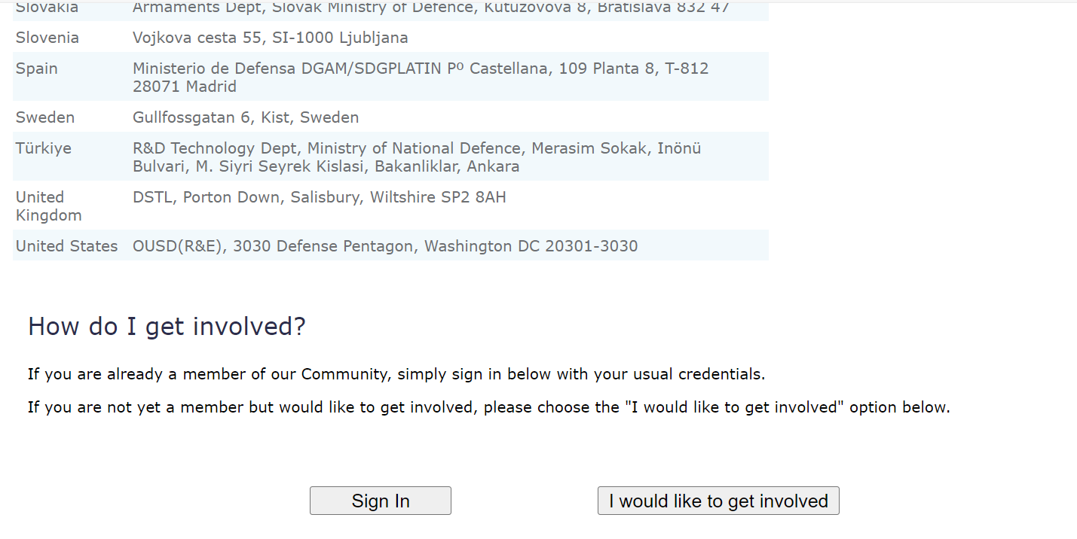
https://www.sto.nato.int/Pages/contactus.aspx

Slide 12
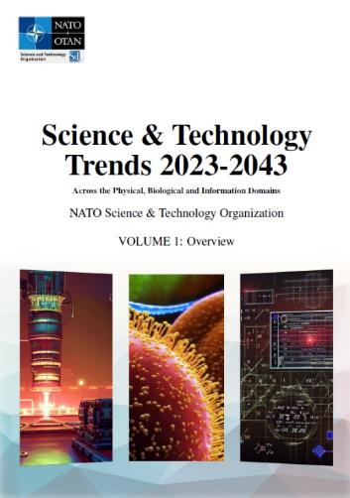
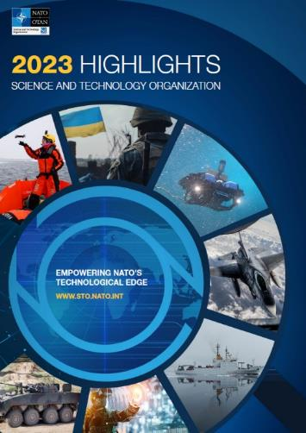
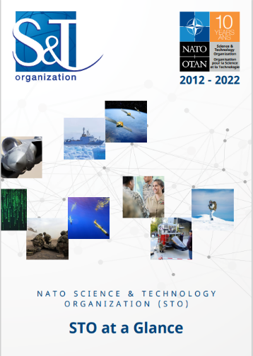
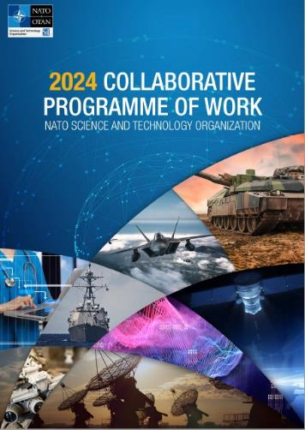
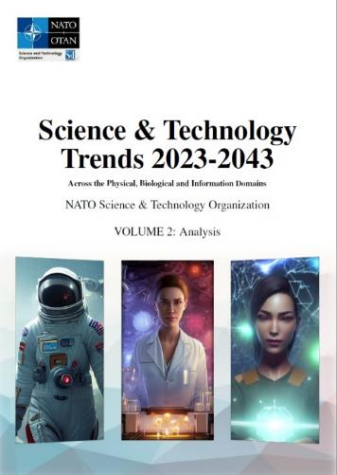
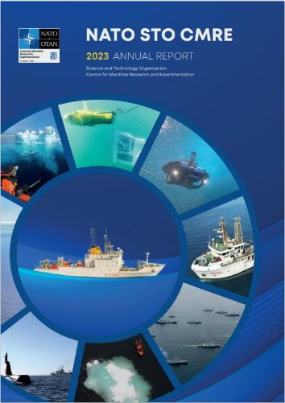
12

Slide 13

NATO
Science & Technology Organization
Capt. Salvatore CALABRO’
OCS Advice Branch, Head
calabro.salvatore@hq.nato.int

