Slide 1
Corporate Structures & ENABLERS and THEIR context in financial crime
Douglas Sloan
October 2023

Slide 2

Types of Enablers & Their Methods
Key is lack of transparency
Remove the true owners as far away from the assets as possible.
Disguise or obscure the nature and purpose of transactions to facilitate crime

Slide 3

Who are the enablers?
Lawyers
Accountants
Business Formation Companies/Agents
Business Service Companies
Bankers/Financial Service Professionals
This Photo by Unknown Author is licensed under CC BY-SA-NC

Slide 4
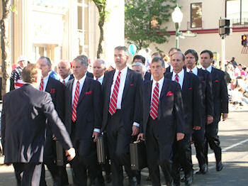
What are the persons/schemes? - People
Nominees
  Nominee Shareholders
  Nominee Officers
  Nominee Directors
Strawmen
Lawyers (e.g. Power of attorney)
Bankers (e.g. Full discretion)
Trustees
Accountants
Auditors

Slide 5

What are the persons/schemes? - Places
Offshore Jurisdictions/Tax Havens
  Belize
  Mauritius
  Seychelles
  Hong Kong
  Singapore
  Switzerland/Liechtenstein
  Gibraltar
  Bermuda?
  UK?
  US?

Slide 6

What are the persons/schemes? - Things
Entities
  Complex and Simple Structures
  Shell Companies
  Trusts
  Foundations
  NFP
  PICs
  Hedge Funds
  Asset Managers

Slide 7

Systemic Jurisdictional Weaknesses
Weak AML requirements and related laws
Weak law enforcement
Limitations to investigations
Lack of international law enforcement cooperation
Bank Secrecy Jurisdictions
Tax havens
Lack of independent corporate registers as well as those that are accurate and current.

Slide 8

Creating Complex Structures
Not all complex structures are illegal. There are many reasons why creating a complex structure is appropriate.
Consequently, for every organizational structure, as part of due diligence, one must understand the specific legitimate reasons for a given business ownership model.
This Photo by Unknown Author is licensed under CC BY-ND

Slide 9

Justifying Complex Ownership Structures:
2-Part Test
1. Efficient
2. Economic

Slide 10
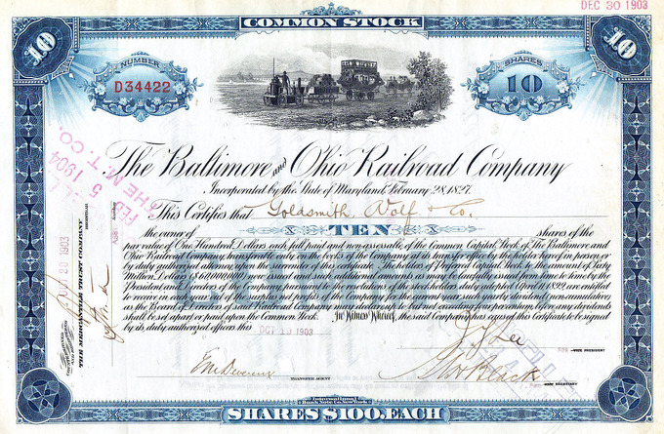
Minimum Ownership Percentages
Many banks set a minimum threshold of 25% or more for low-risk clients and 10% or more for high-risk clients.
Criminals and facilitators know this and structure ownership around this.
This Photo by Unknown Author is licensed under CC BY-SA

Slide 11
Complex Ownership Structure
100%
2%
51%
Incorporated LLC July 22, 2017 Florida
100%
Incorporated LLC May 15, 2017 Delaware
51%
2%
100%
98%
51%
100%
49%
49%
DOB Dec. 7, 1970
DOB March 5, 1968
51%
50%
19%
50%
15%
15%

Slide 12

Circumventing Minimum Ownership Percentages
Diffused Ownership
Rigged Voting
Circular Ownership
Separating ownership from control
  Powers of attorney
  Contractual arrangements
  Using financial products and services

Slide 13
Abusive Ownership of Partnerships
Spirit of the law violated even if technically not a violation.
Chances are the reason is unacceptable for AML reasons
Holding Company
A
John Doe,
UBO
Entity S.A.
Holding Company
B

Slide 14
Identification & Verification - Entities
All entities, ownership structure and control persons
All nominee shareholders
All nominee directors
Senior officers and control persons
Source, verification and date of such should be properly documented including:
  Corporate registries
  Lawyers and notaries
  Articles of formation
  Corporate resolutions
Note names of external lawyers, business formation companies, auditing firms, business service providers

Slide 15
Special Challenges of Trusts
Protector
Director
Corporate Trustee
Legal Settlor
Beneficiary(-ies)
Trust (Discretionary)
Economic Settlor
Entity
Person
Purpose

Slide 16
UBO/Beneficiary Identification
Owners (each 20%)
Beneficiaries
Company
Beneficiary
Trust
Trust
Person

Slide 17
Identification & Verification - Trusts
FATF recommends the identification of all parties to a trust. All persons of trust structure including
  Trustees
  Directors
  Beneficiaries
  Settlors
  Protector
  Any other person with effective control over a trust.

Slide 18

Periodic Reviews
Periodic reviews must include all changes to ownership and ownership structures [Note: Many corporate registries are not regularly updated].
Clients must notify banks promptly of any and all changes
Banks must develop policies and procedures within their KYC programs addressing this as well as client’s failure to comply.

Slide 19

Other Issues – Bearer Shares
Is corporate ownership established through bearer shares?
Are bearer shares issued at any given level of an ownership chain?
What policies, controls and checks exist at the financial institution?

Slide 20
If you are interested in exploring the possibilities for collaboration and strengthening your abilities…
    Douglas A. Sloan
    Catamount Huntsman
    DASloan@outlook.com
    +1-917-565-7695

