Slide 1


SuperComputing National Competence Centre in Luxembourg

Slide 2


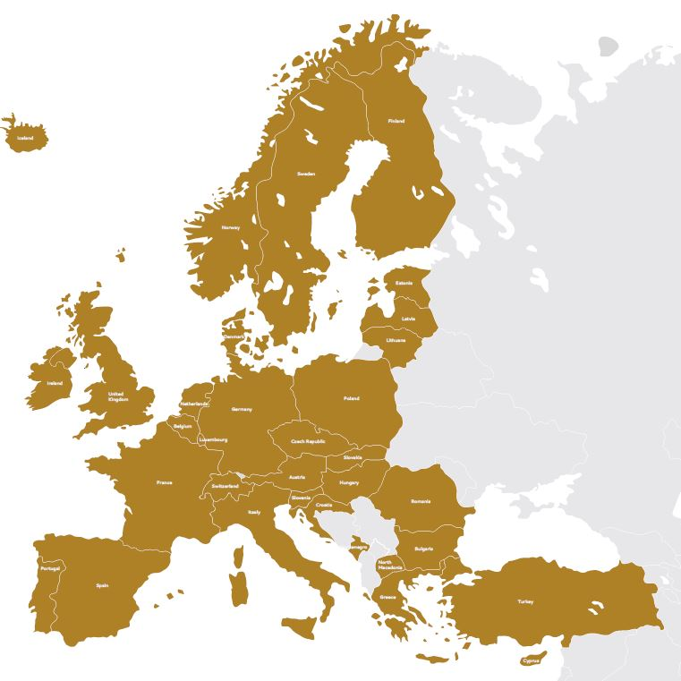

Luxembourg’s contact point for high performance computing and data analytics
    Collaboration in a network of national competence centres in HPC across Europe

Slide 3





National HPC Competence Centre
HPC support for industry, academia & public administration
    R&D and innovation support
    Company support
    HPC-NCC Luxembourg host
    National supercomputing centre
    Supercomputing experts
    Focus on SMEs and business
    Education and training
    Domain experts/scientists
    Focus on excellence in science
Commercial HPC access
Pay-per-use
High-security environment
Research access
Industry-research collaboration

Slide 4
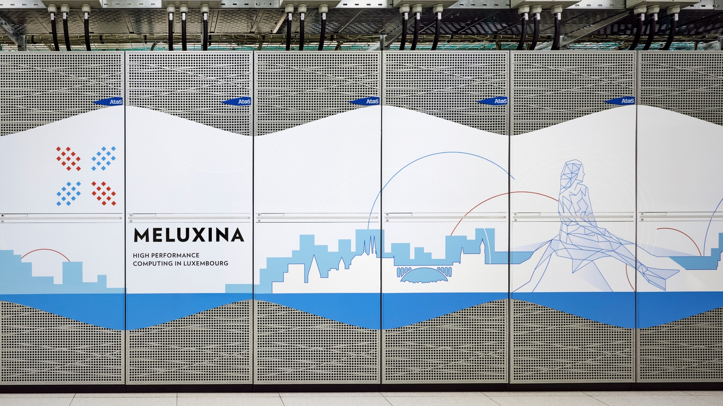
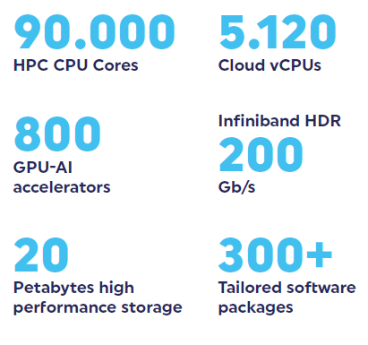

Luxembourg’s national supercomputer MeluXina

Slide 5
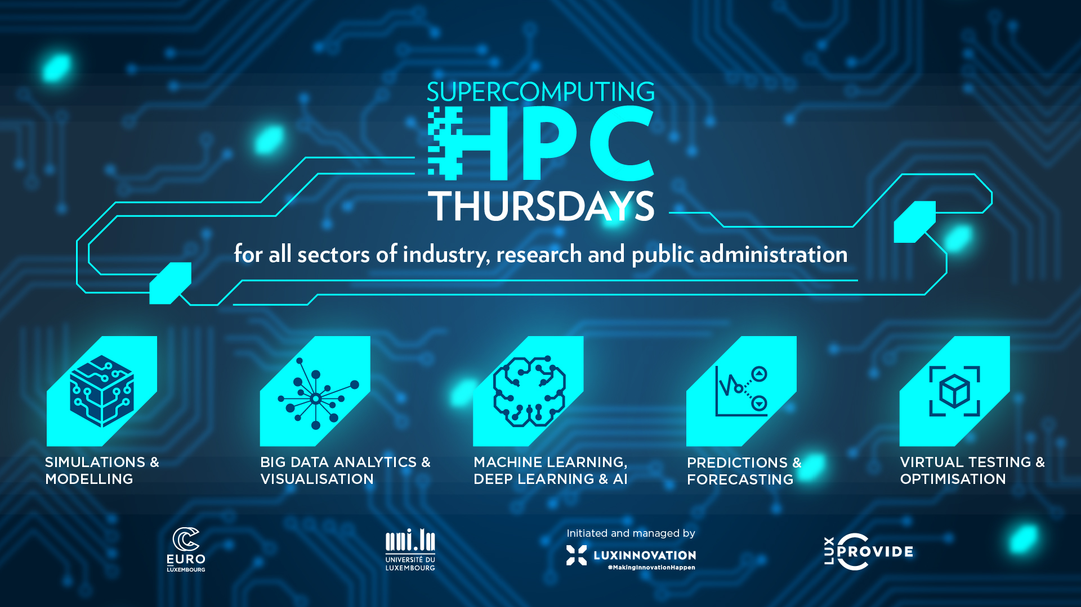
What to do with HPC? .. usually
SIMULATIONS & MODELLING
BIG DATA ANALYTICS & VISUALISATION
PREDICTIONS & FORECASTING
VIRTUAL TESTING & OPTIMISATION
MACHINE LEARNING, DEEP LEARNING & AI
in the loop for smarter computations

Slide 6
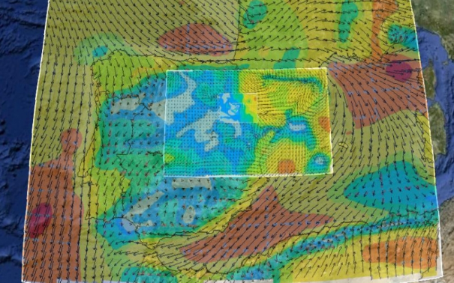
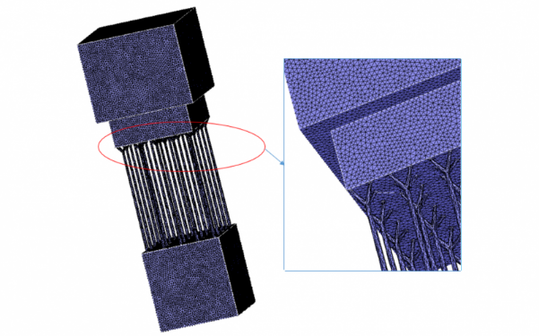
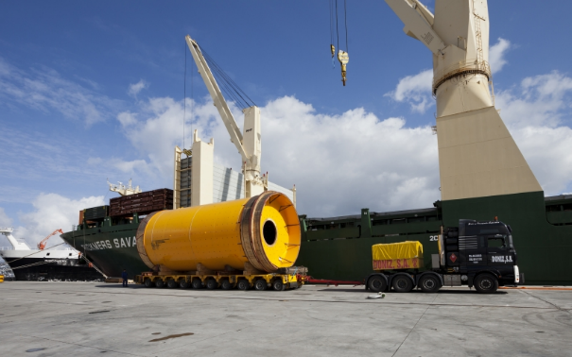
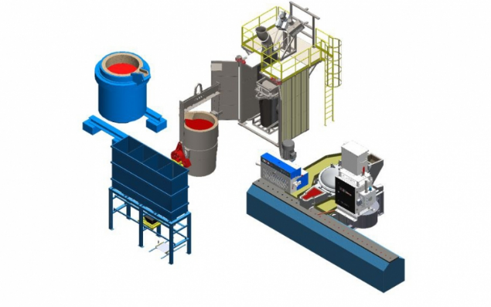

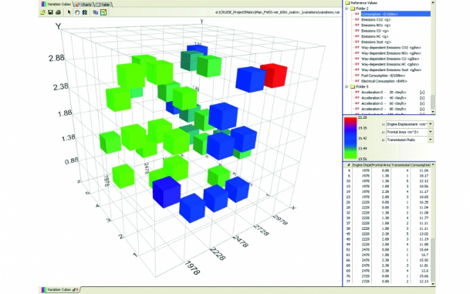
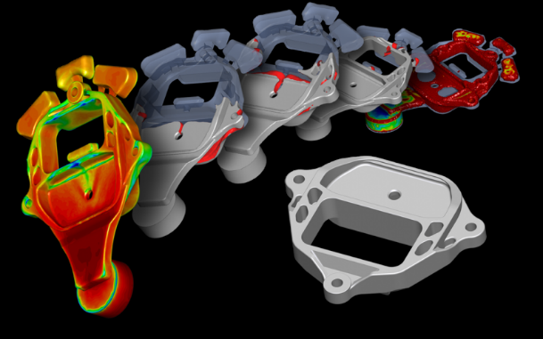
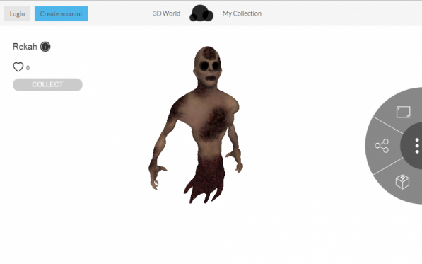
HPC use cases examples
Best position for small wind turbines or solar panels
Simulation of additive manufacturing process
Optimise logistic choices
Reduce waste rate in production processes
Simulation of the thermodynamic properties of chemicals
Reduction of CO2 emissions in the design of vehicles
Simulation of metal casting for moulds design
Smart Retail Recommendation Engine (AI algorithm)

Slide 7
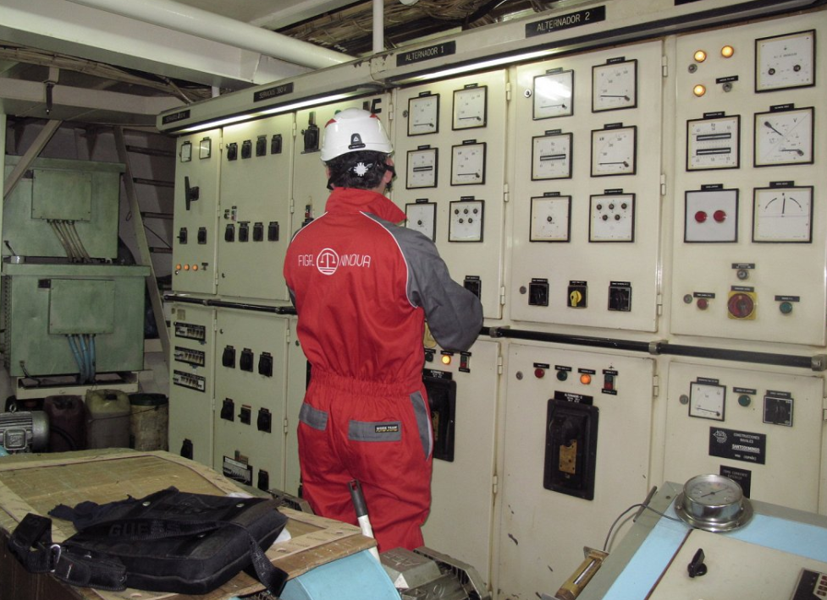
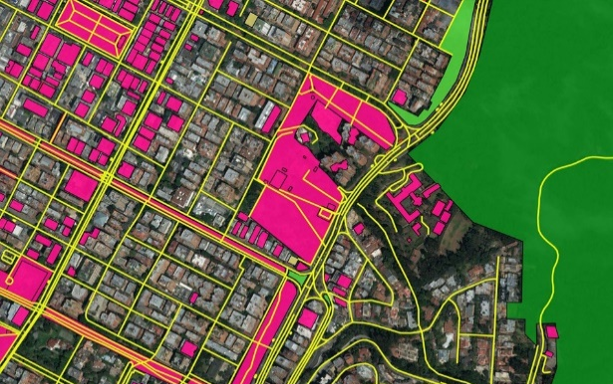
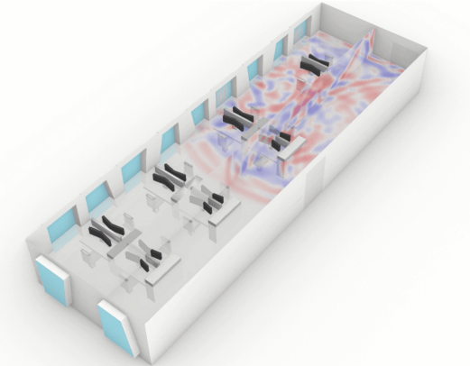
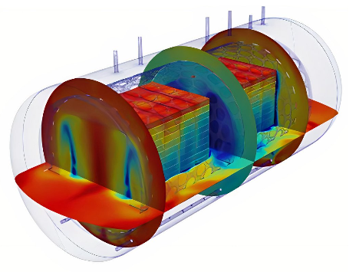
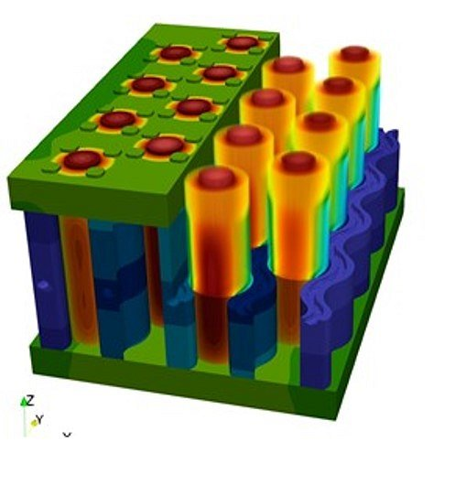

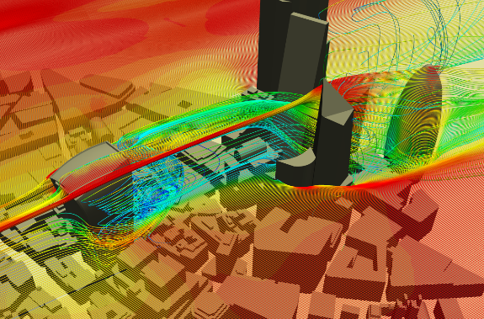
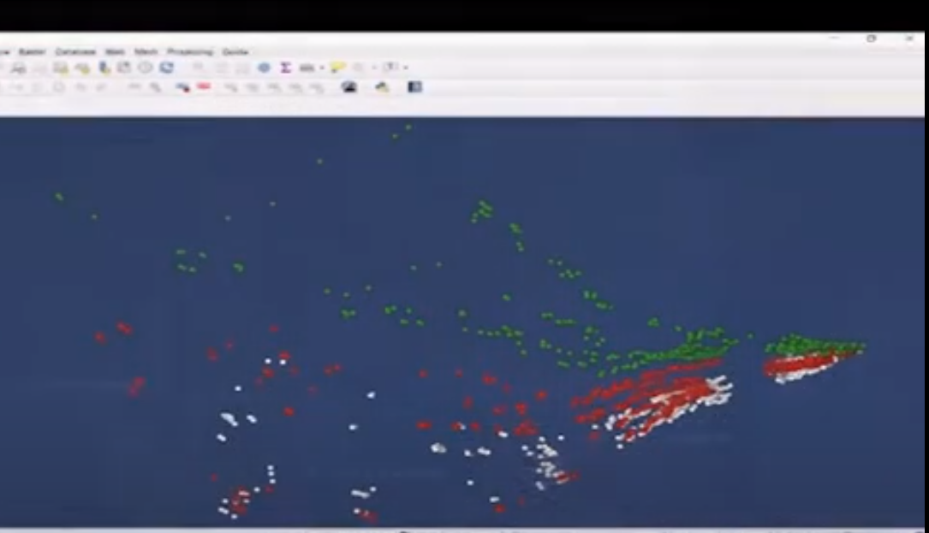
HPC use cases examples
Predictive maintenance of machines and tools
Geospatial intelligence based on AI algorithms
Architectural acoustic simulation
Simulate canned food dynamics
Improved battery materials using molecular modelling
Reservoir monitoring through satellite data (AI algorithm)
Simulation of Pedestrian Urban Microclimate & comfort
Navigation system for maritime litter hunting

Slide 8

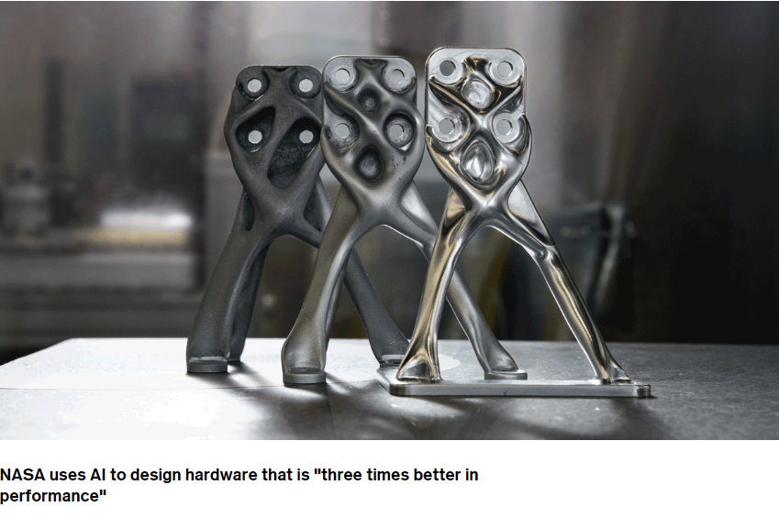

But you can also use an HPC to develop the basis for this

Slide 9


Merci villmols
ralf.hustadt@luxinnovation.lu
Feel free to reach out

Slide 10

Supercomputing Breakfast:
AI, friend or foe for the Creative Industries?

