Slide 1
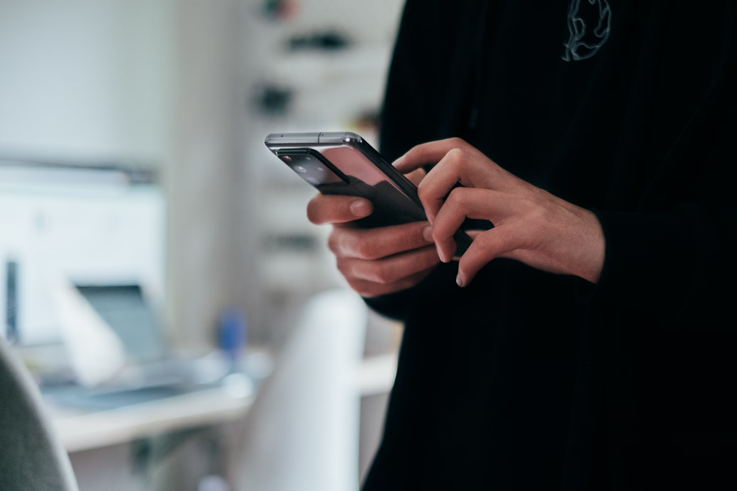

Silverpush is an advanced context intelligence company powered by proprietary AI

Slide 2

Our Global Footprint
We have tested and proved our AI model with top HoldCos, renowned brands and major agencies worldwide
Established in 2012
Presence in 20+ countries
20+ Global Awards
Worked with >400 Fortune 500 Brands

Slide 3

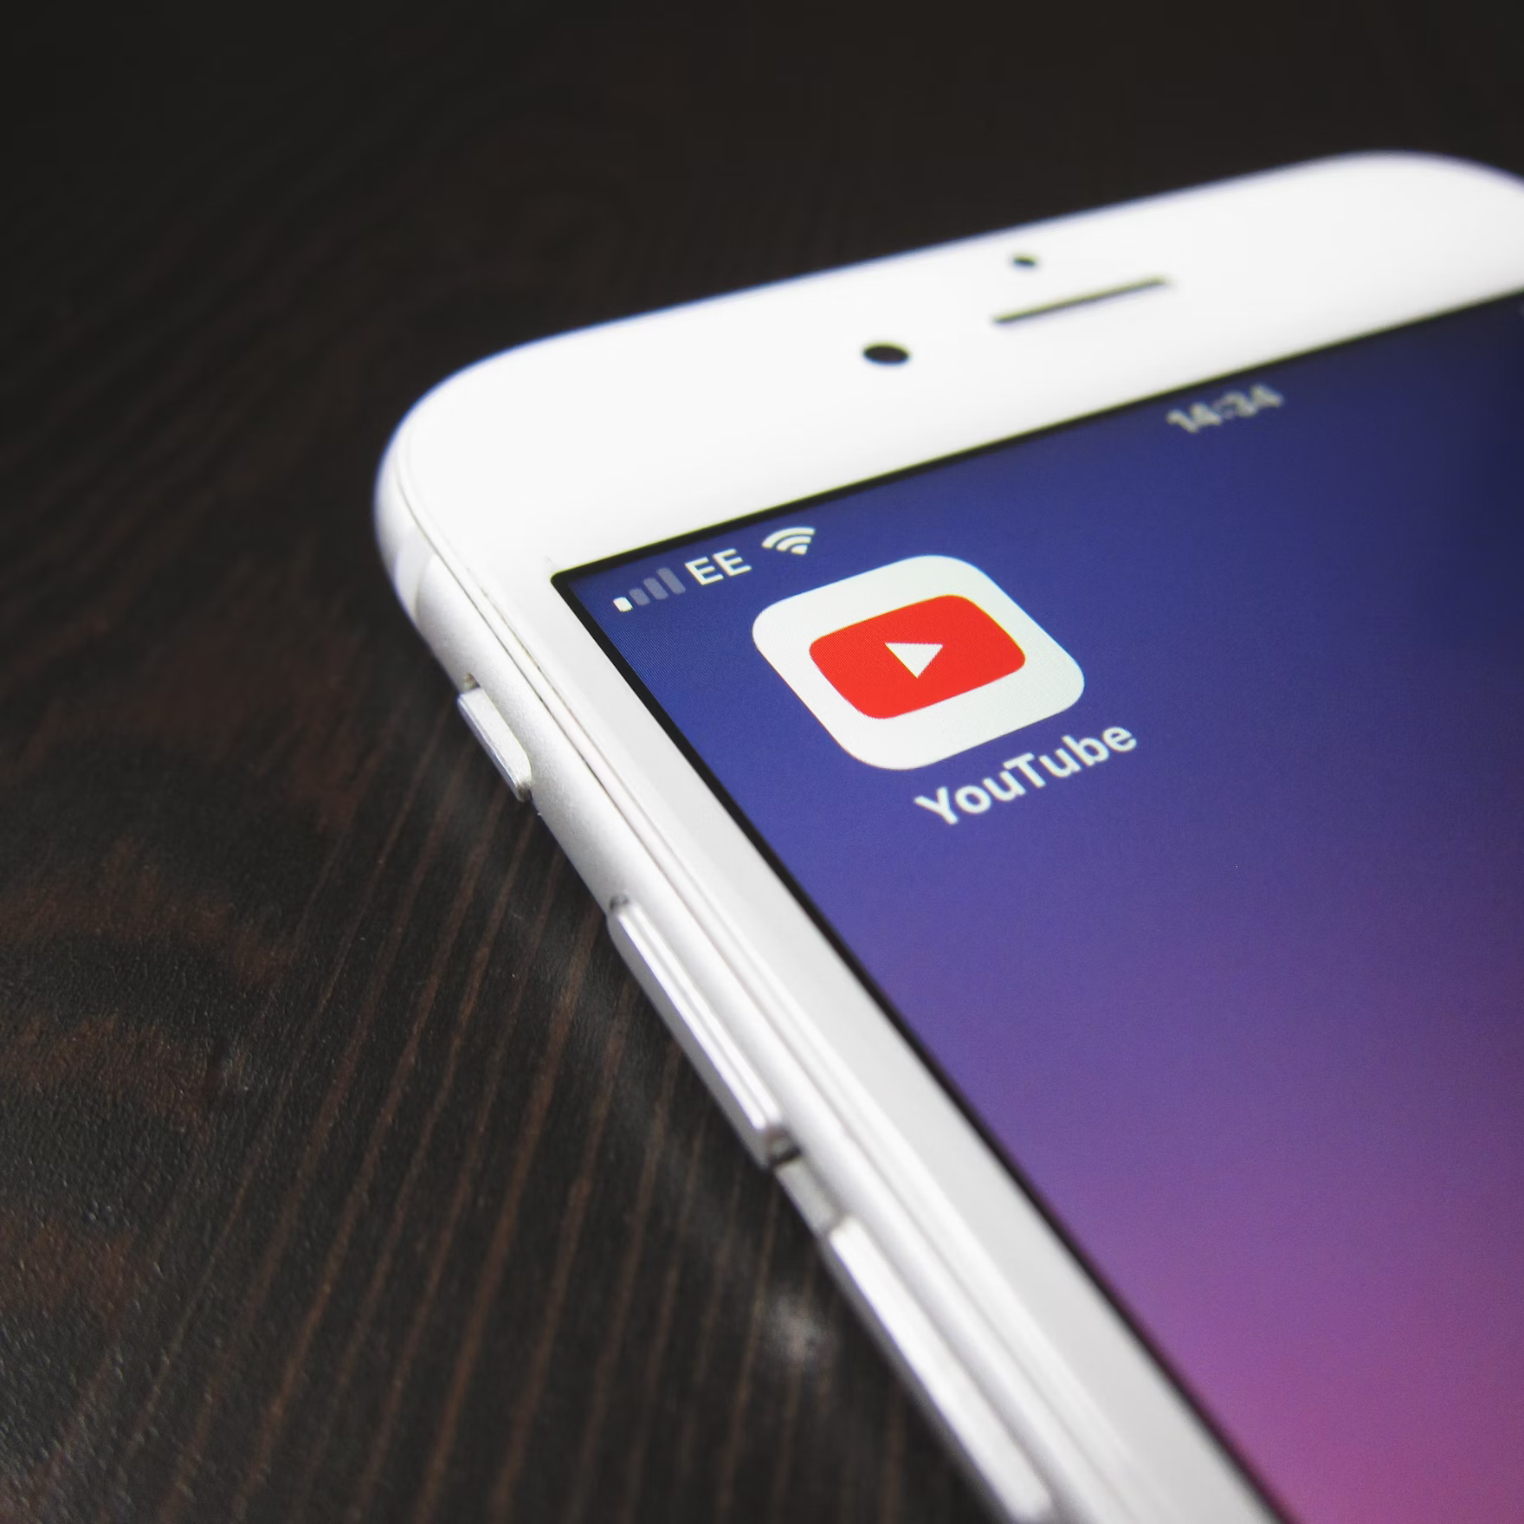
We offer unique contextual
targeting for YouTube

Slide 4
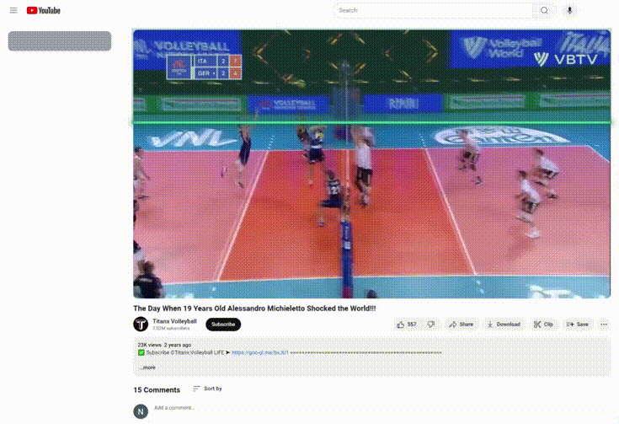
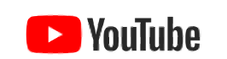
Introducing Mirrors
Step away from standard YouTube solutions where:
Targeting is largely based on audience/affinity, category and/or keyword targeting.
There is limited ability to filter out low quality content
Lower engagement and BLS results are observed
Media misalignment occurs
Leverage Contextual Personalization across YouTube using our next-gen first to market technology
Utilises video level analysis to accurately categorise videos
Analysing 1m+ trending videos a day. Precisely aligning ads with relevant content
Using deep learning and advanced NLP for unique contextual targeting capabilities
Notes:
4

Slide 5
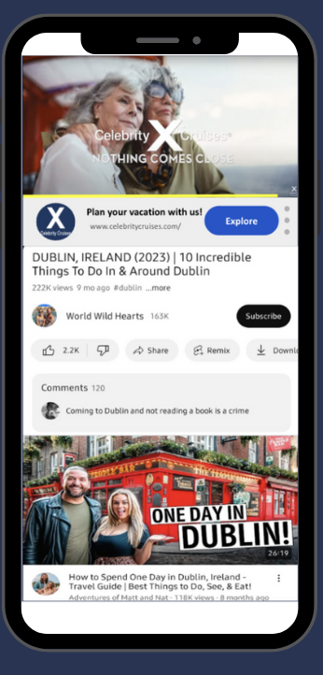
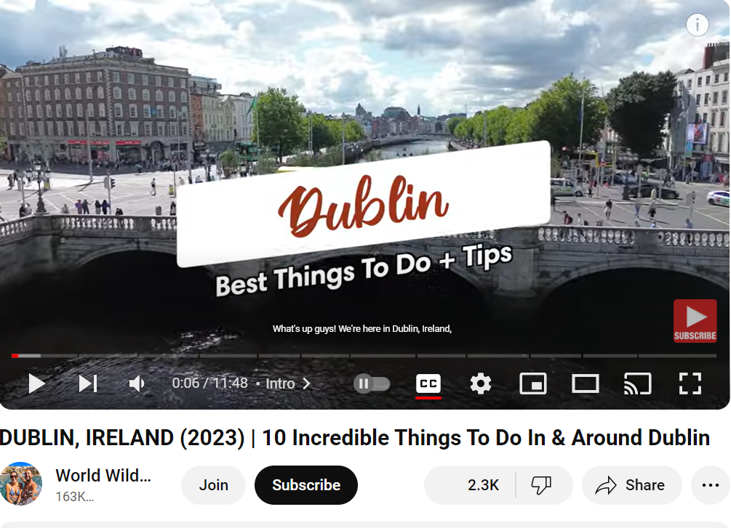


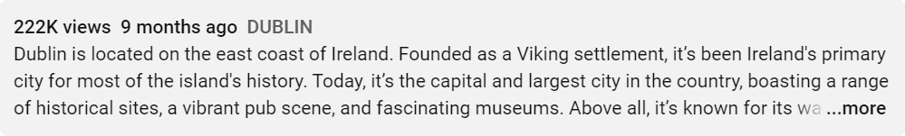
Tap into Desired Contextual Moments with Mirrors
Context
Celebrity Identified
-World Wild Hearts (Zac & Ine)
Brand Identified
- Guiness
Location Identified
-Trinity College, Dublin
Semantic Analysis
-Top Things to do in Dublin
-Experience history & culture of Ireland
-Travel Tips
Positive Verbiage
A brilliant cross-court smash!
Channel Authenticity
Video Metrics
Brand Safe
While others target keywords or channels, we stand out with AI powered Video Level Analysis. Our method delves deep, analyzing videos, channels, creator history, and online presence for precise targeting.
Notes:
Phone screens

Slide 6
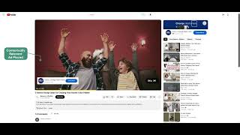




Ads are Placed On Premium Content With Precision
PROPOSED CONTEXTS
defining the exact moment you want
to trigger your ad
Celebrities
Brands
Fifi McGee
Jess Duxbury
Sophie Paterson
Kirsty Gore
Dulux
International
Behr
Sikkens
What’s happening here? AkzoNobel is leveraging Video level AI analysis and human-augmented labeling to match ads with relevant video content in real time on YouTube
CLICK HERE TO SEE THE DEMO!
Audio
Objects
Primer
Paint
Airplane Maintenance
Paint
Airplane
Paint Brush
Spray Machine
Notes:
ADD OLD TOWN DEMO HERE

Slide 7





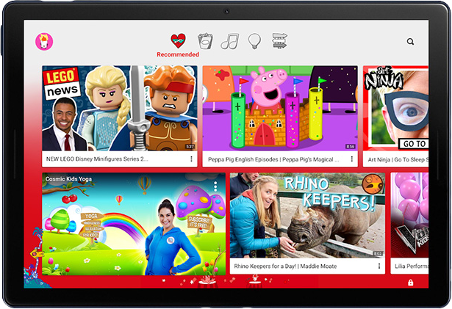


Industry Compliance + Customized Brand Safety & Suitability
Applying Custom Inclusion & Exclusion themes for enhanced suitability
Improved Brand
Safety & Suitability
Ensuring smart optimization by avoiding overblocking through intelligent risk balancing and advanced filtering
Responsible & Enhanced Ad Performance
Adherence to
GARM Guidelines
Using Kids content classification model to categorize videos intended for children on Youtube
Sustainable Approach to Advertising

Slide 8

Silverpush’s End to End Solution for our Partners to help them Succeed
Client
Working Plan Sent to Client
Client
Preview Links shared with Client
Start
Brief Received
Approval Received
Post Campaign Analysis Shared
Weekly Campaign Report Shared
Campaign Launch
Client Approval Received
End
Silverpush Cost Benefits
Exceeds Avg. VTR Benchmark by 10-25%
1.4-2X increase in engagement
1.5-2X Increase
in Ad Recall
25-35% Brand Awareness Lift
Brand Safety and Brand Suitability
Targeting Premium Inventory
In-depth Post Campaign Analysis
Positive Brand Recall
Notes:
Brief shared by the client​
Media proposal including the media plan is shared also with context signals​
Once the plan is approved. Sales shared the duly filed go live with campaign details​
CS shares the go live with tech ops for training and Ops for campaign setup.​
Ops sets up the campaign shares back the previews​
CS take approval on the preview and once approved campaign is taken live basis the client approval​
CS then shares weekly report with the client to highlight the campaign performance.​
Once the campaign is delivered an elaborate post campaign analysis is shared with the client
Go live
Flow chart-
Received the brief
Work on the plan- including contextual triggers, send it to the client
Campaign approved plan
Internal- share go live- preview links
reports

Slide 9
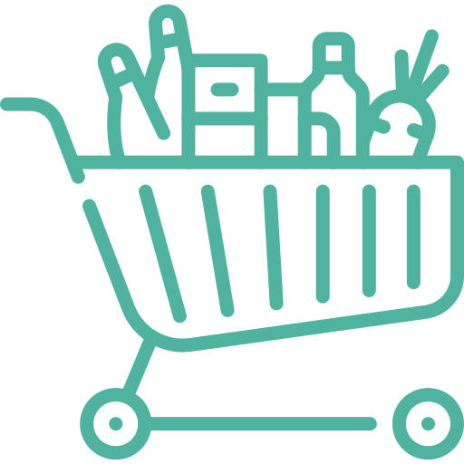





BLS Results Matrix
16.5%
Brand Lift
14.6%
Brand Lift
6.7%
Brand Lift
Grocery Brand
Alcohol Brand
Gifting Brand
6.2%
Brand Lift
5.4%
Brand Lift
3.9%
Brand Lift
Fashion Brand
Beauty Brand
Healthcare Brand

Slide 10

Join the contextual revolution today with Mirrors for YouTube
Thank You!
© 2024 SilverEdge Technologies Pvt Ltd, All rights reserved.
Notes:
10

Slide 11
APPENDIX

Slide 12
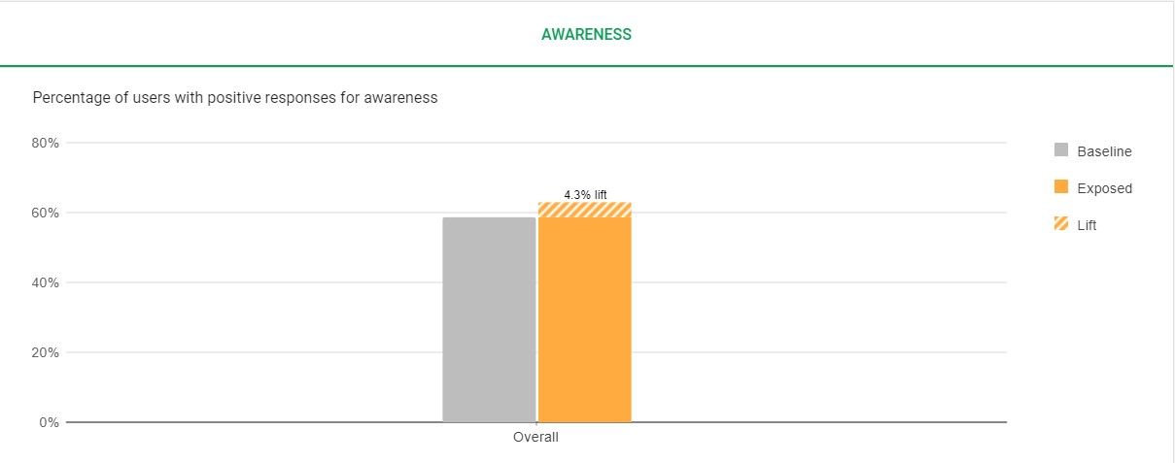
BLS for Beauty Brand
4.3%
Brand Lift
Survey Responses | Baseline Users | Exposed users
7,028 | 2,773,633 | 2,906,279

Slide 13
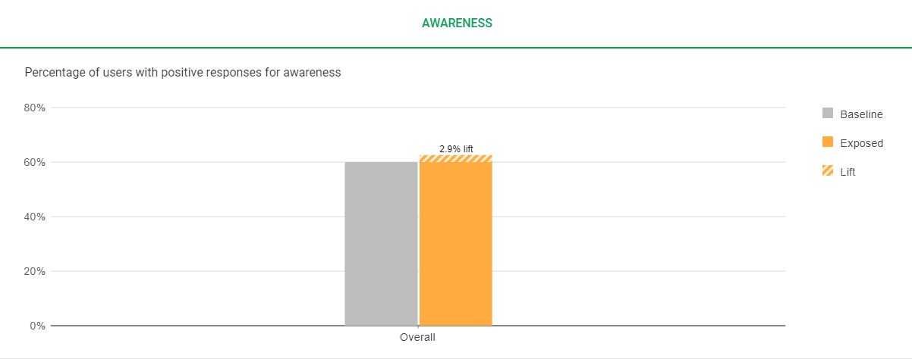
BLS for QSR Brand
2.9%
Brand Lift
Survey Responses | Baseline Users | Exposed users
4,150 | 389,827 | 143,199

Slide 14
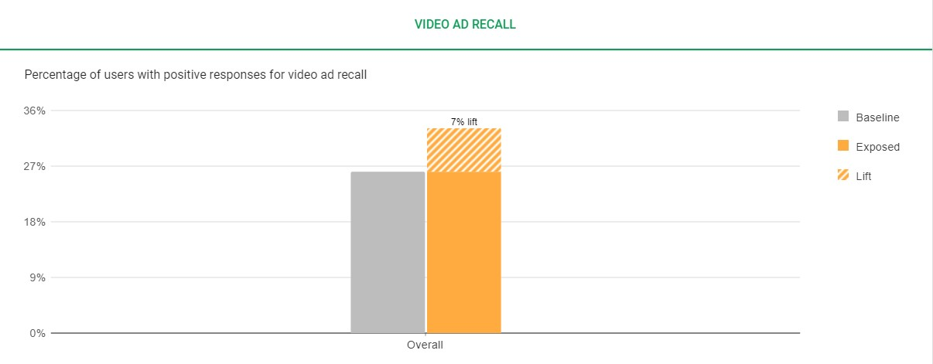
BLS for Gifting Brand
7%
Brand Lift
Survey Responses | Baseline Users | Exposed users
4,112 | 329,749 | 418,180

Slide 15
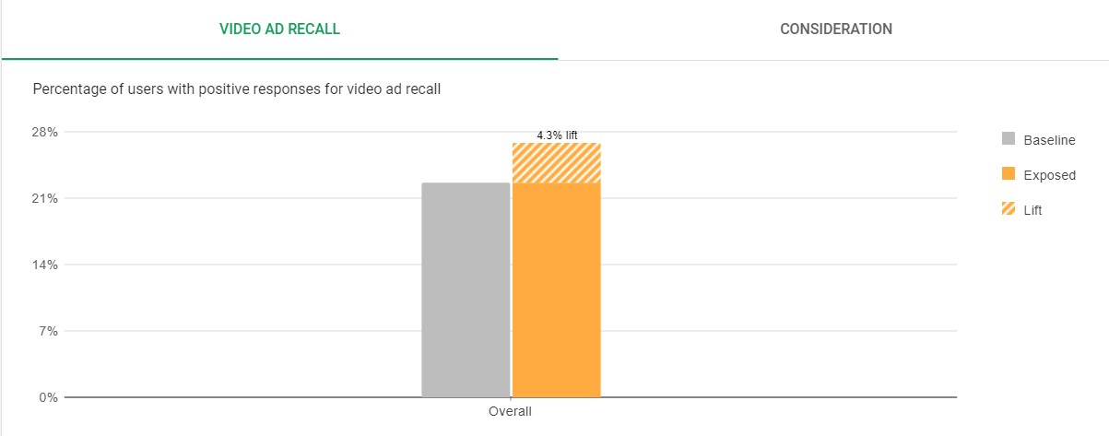
BLS for Health Brand
4.3%
Brand Lift
Survey Responses | Baseline Users | Exposed users
4,155 | 243,438 | 289,452

Slide 16
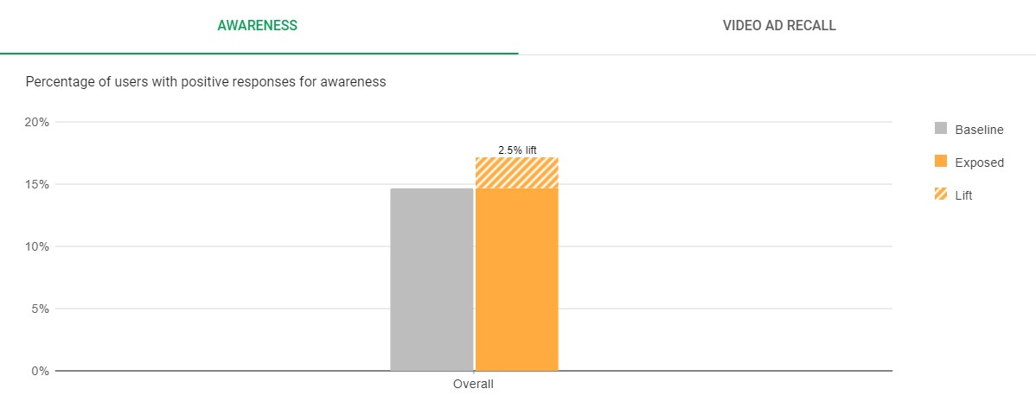
BLS for Pets Brand
2.5%
Brand Lift
Survey Responses | Baseline Users | Exposed users
8,734 | 386,382 | 452,912

Slide 17
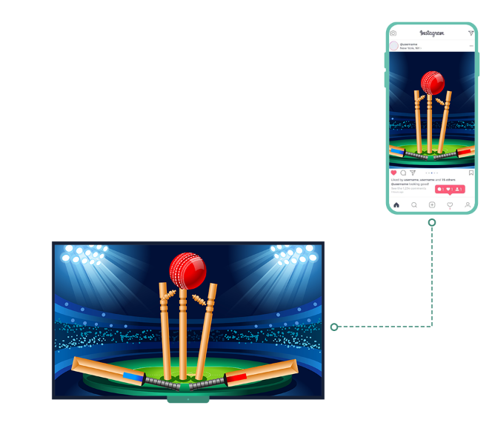
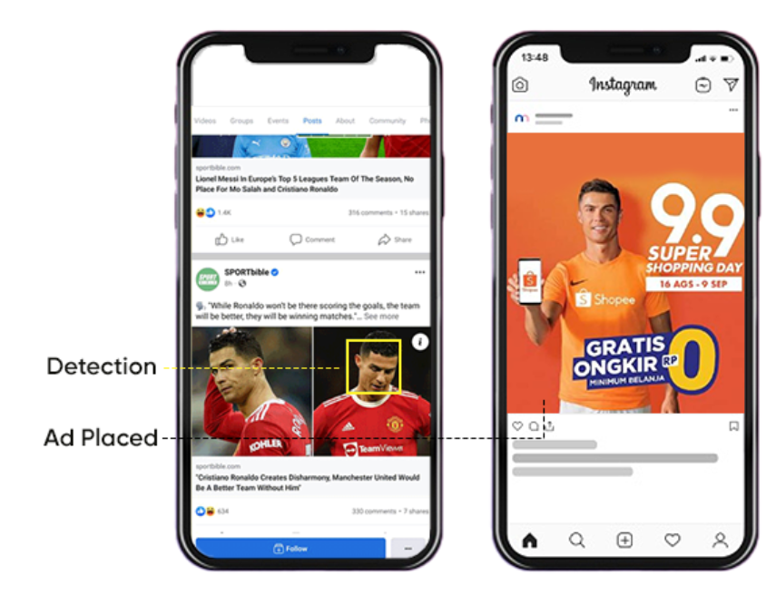
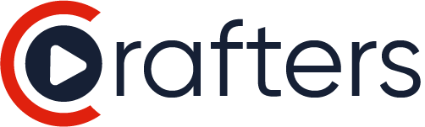
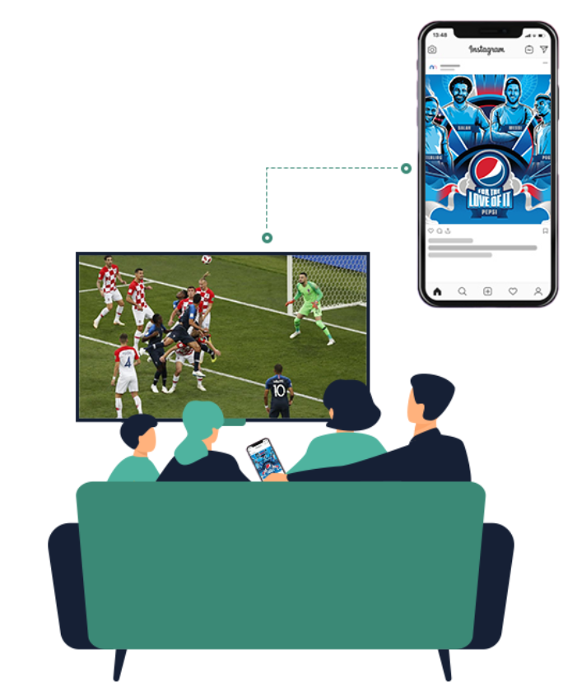
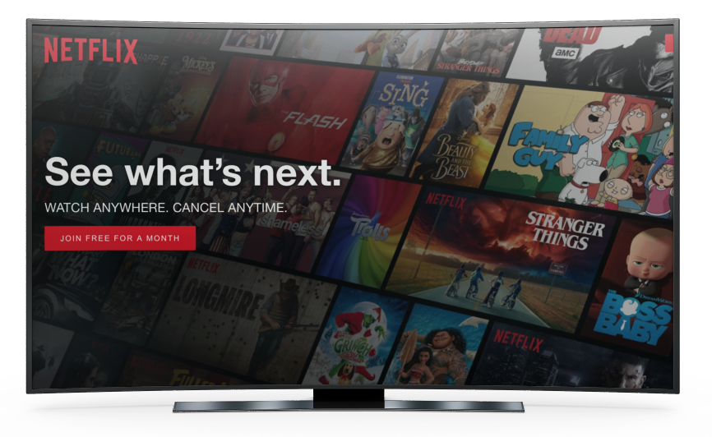
Consumers Evolved, So did Our Technology
Launch of Parallels
Weather & Sports Sync
Launch of Mirrors YouTube
Mirrors on OTT
Mirrors on CTV
Mirrors on Premium Sites
2012
2018
2020
2022
2024
TV Sync
Mirrors FB
& Insta
Crafters:
Creative Personalisation

Slide 18
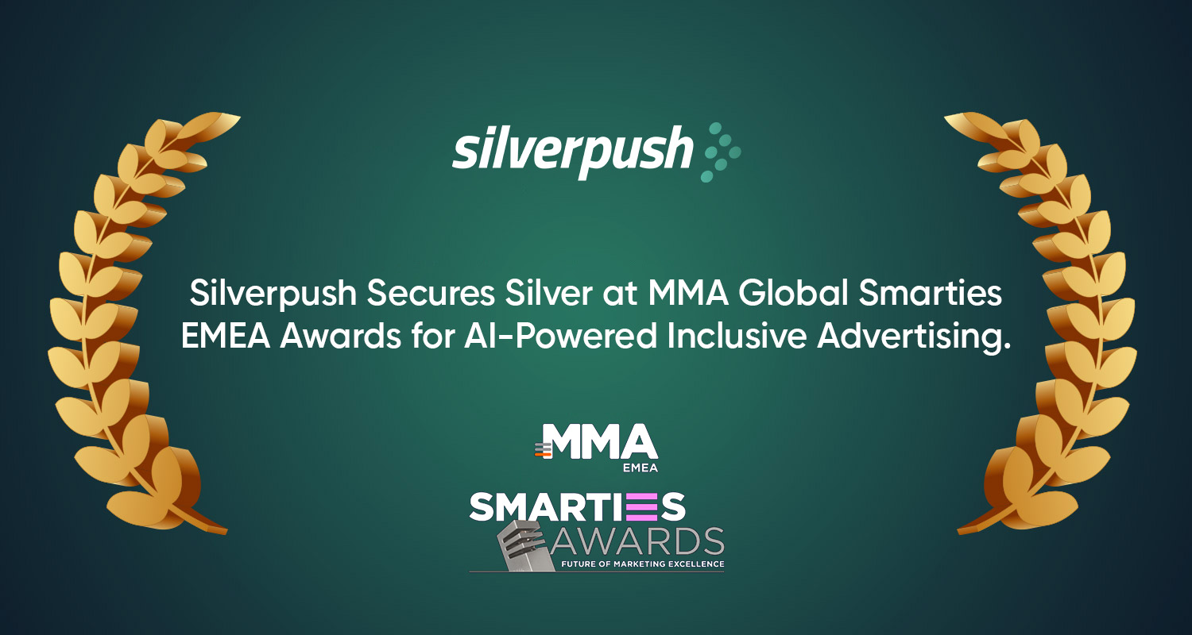
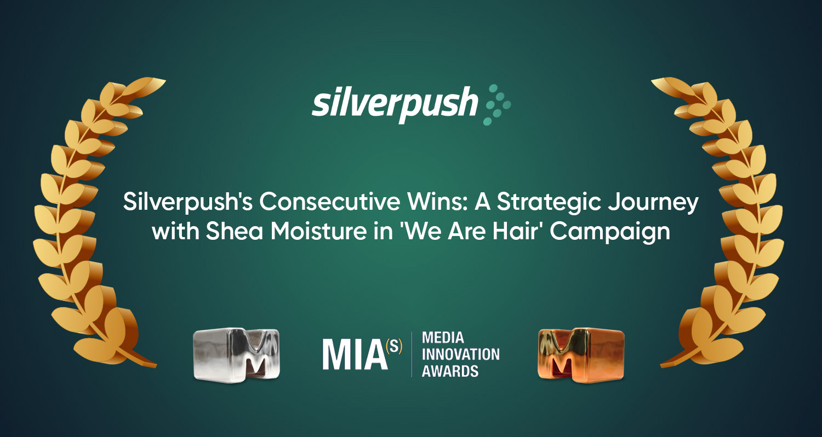
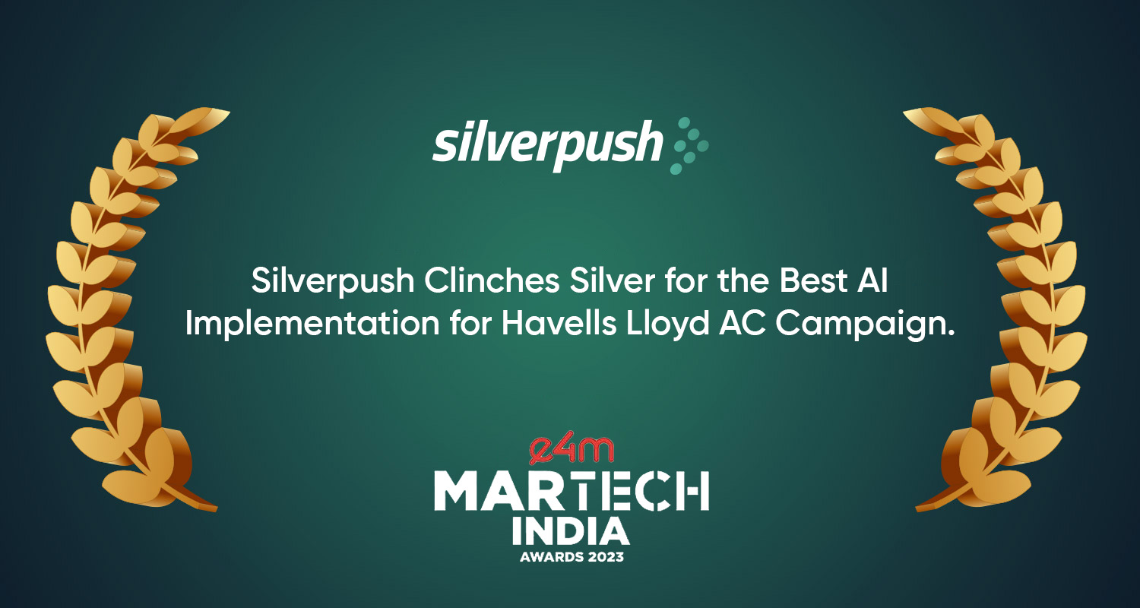
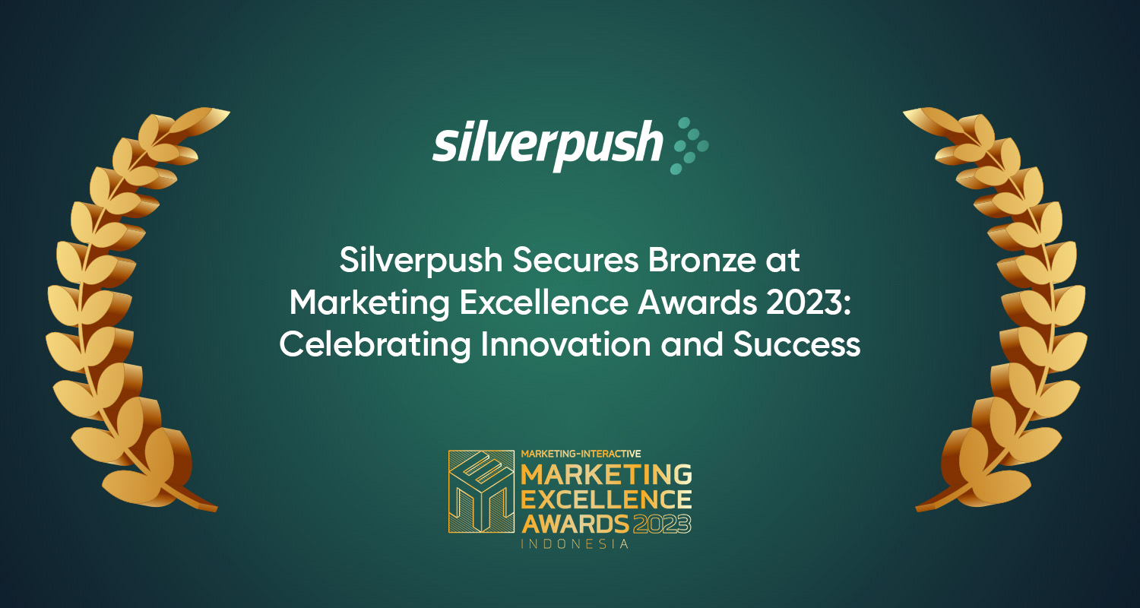
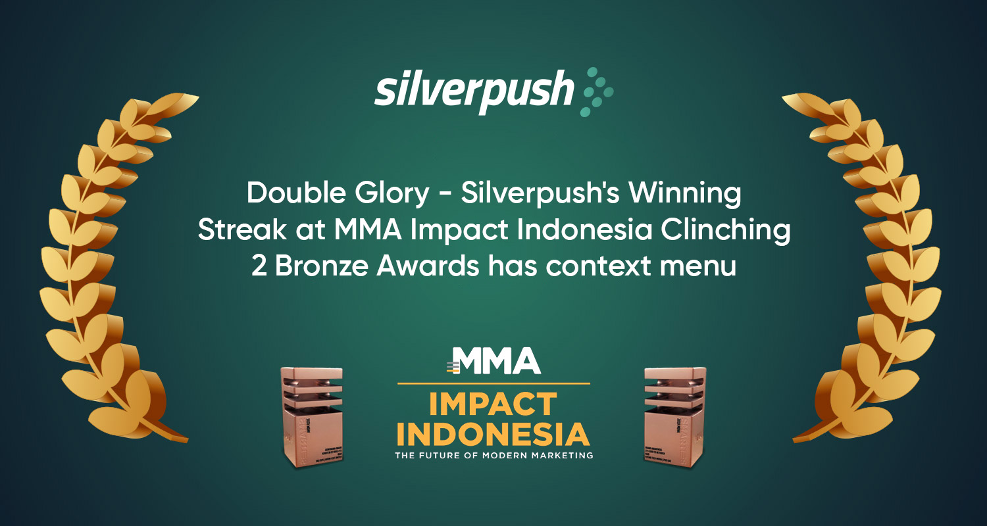
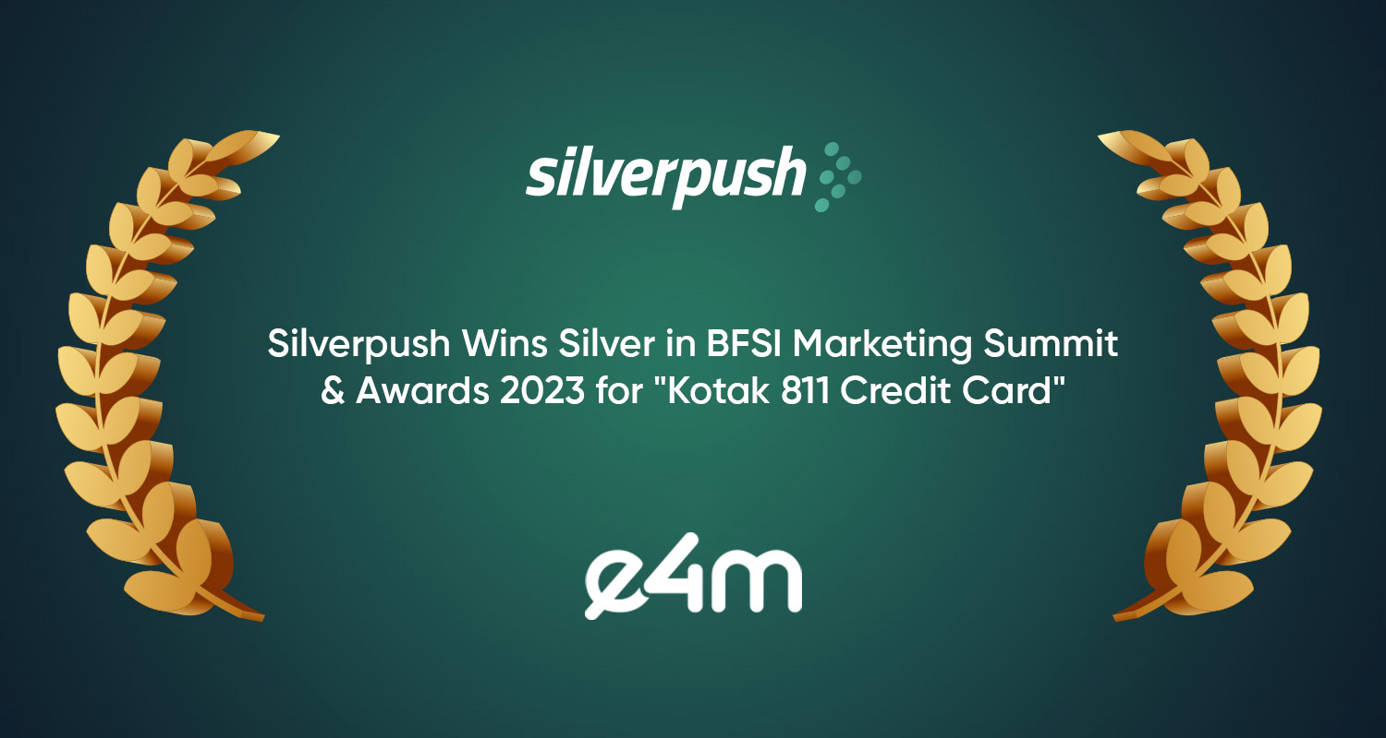
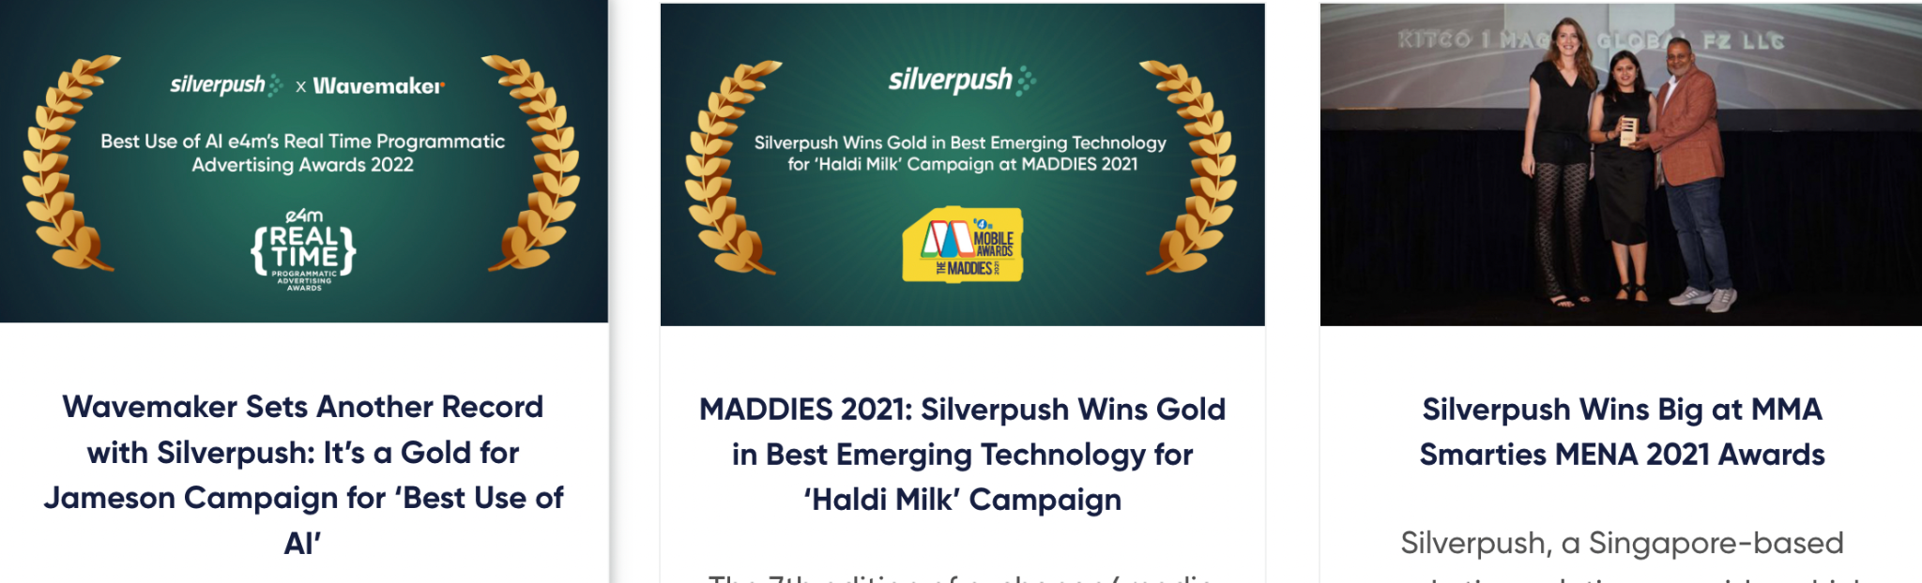
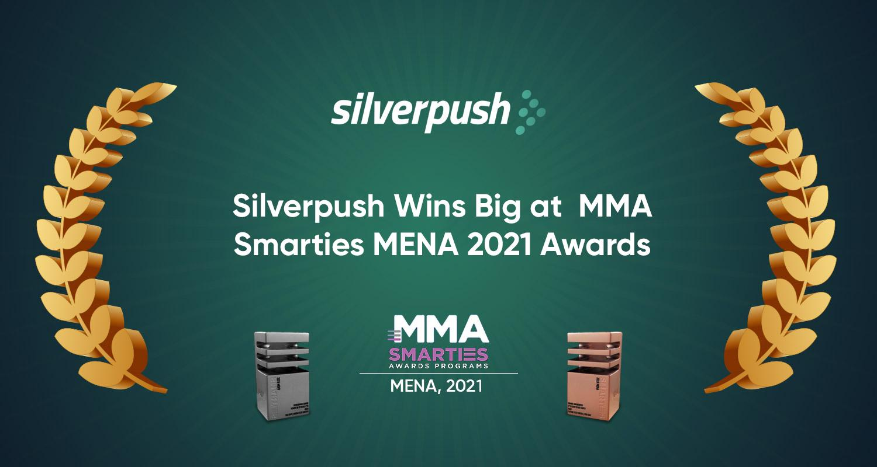
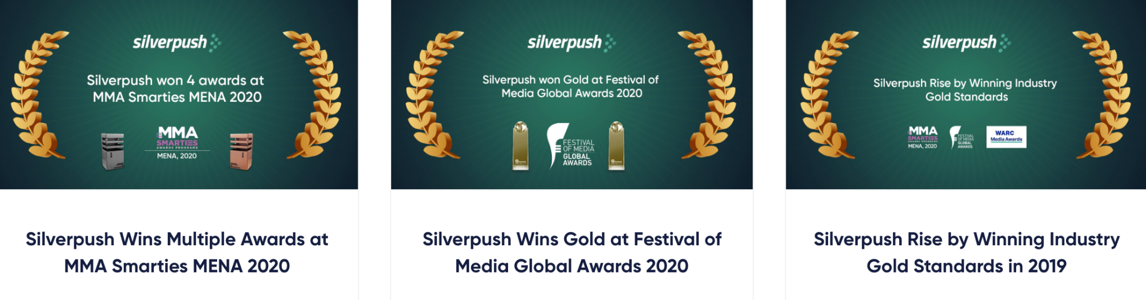
Award Winning Technology

Slide 19
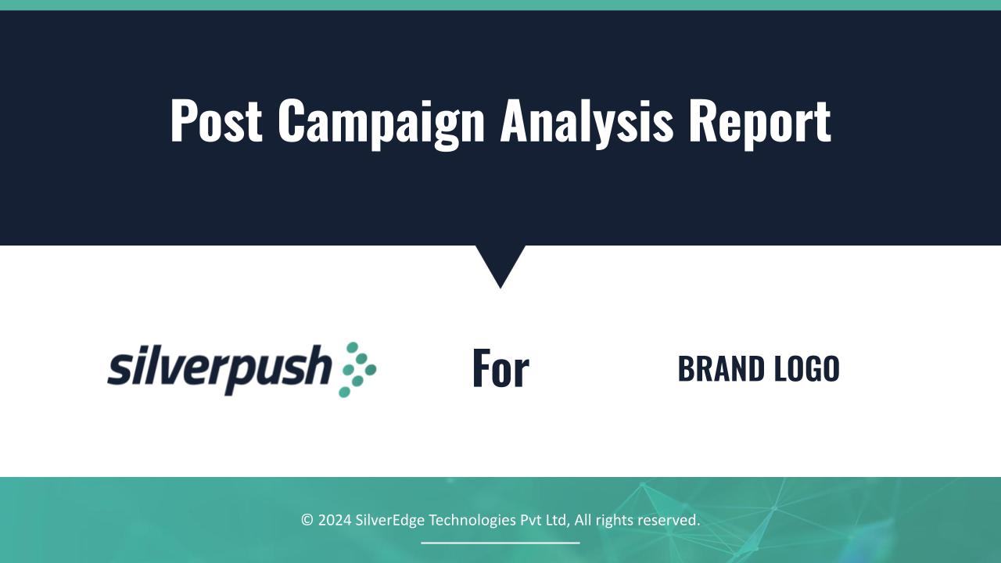
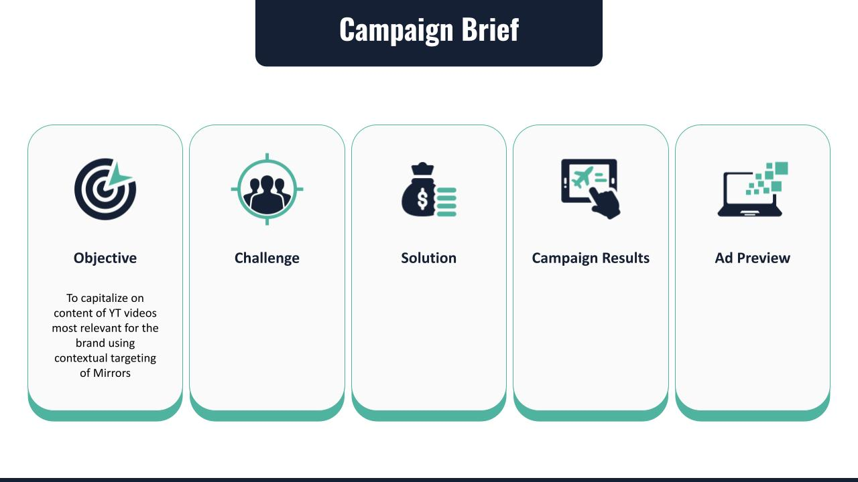
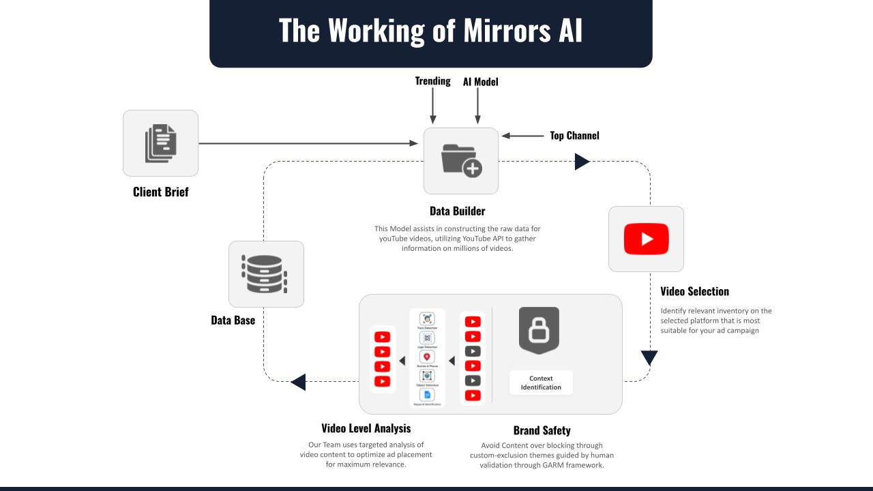
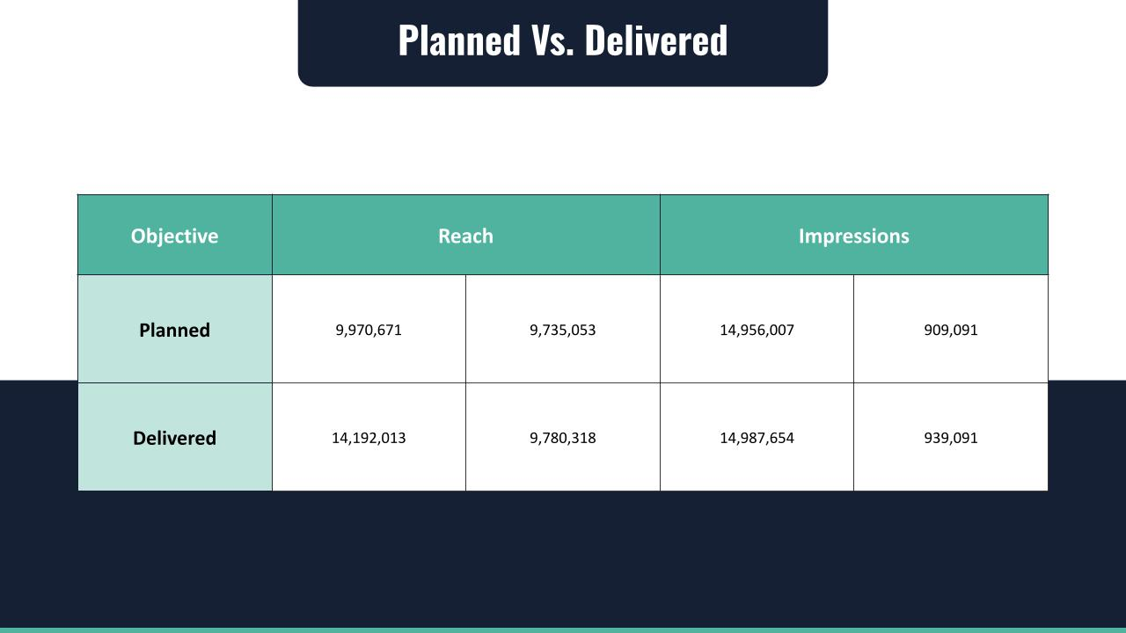
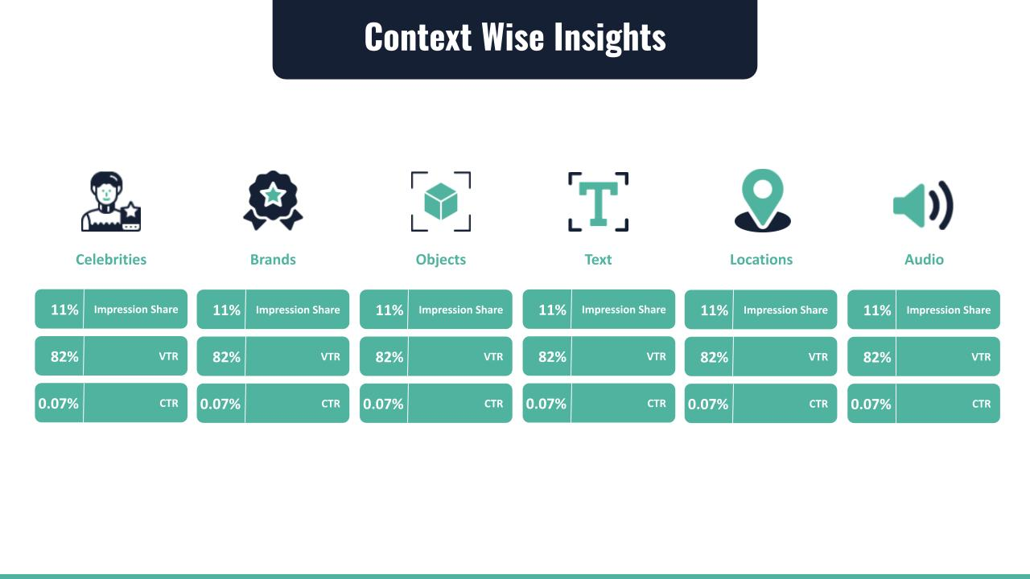
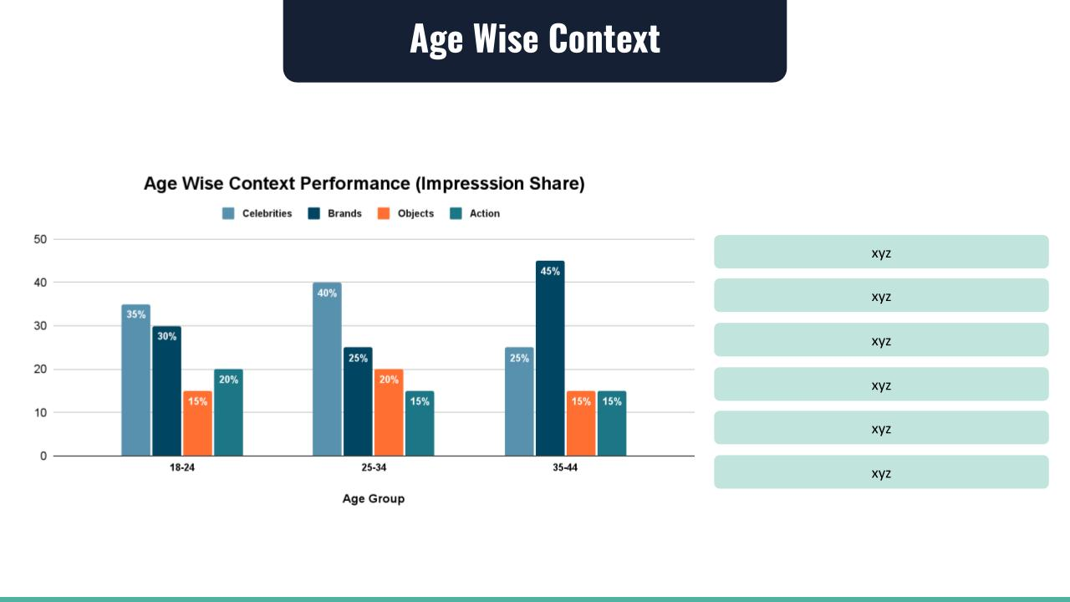
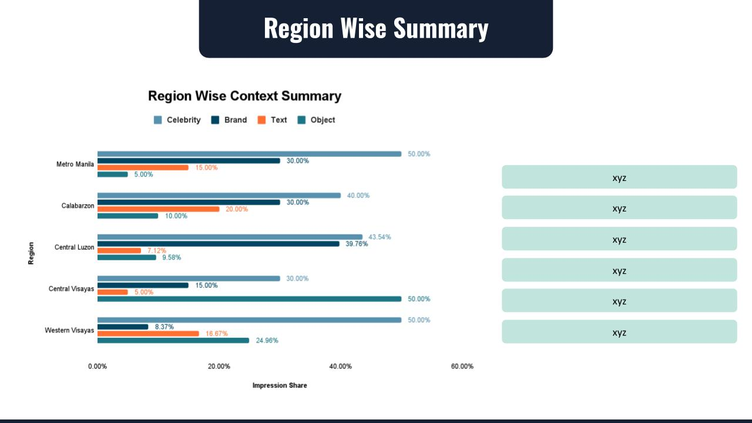
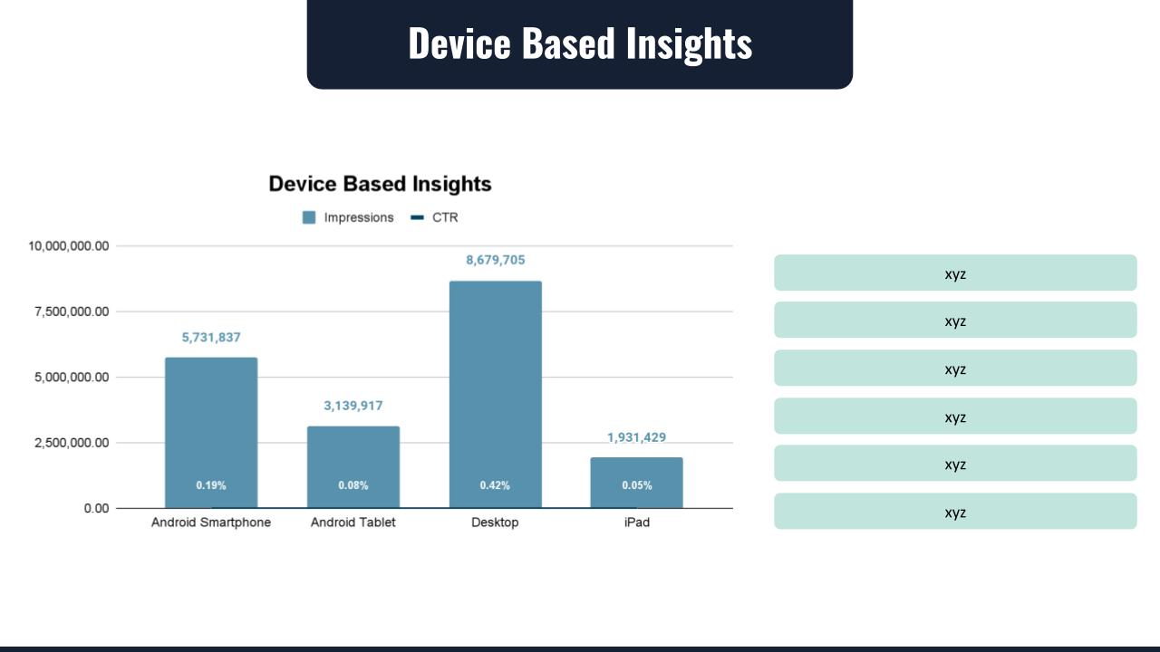
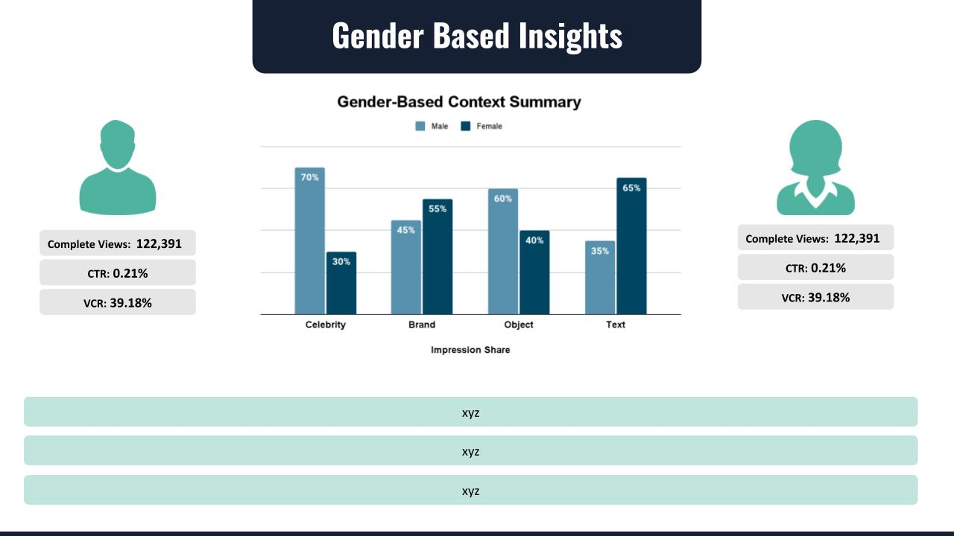
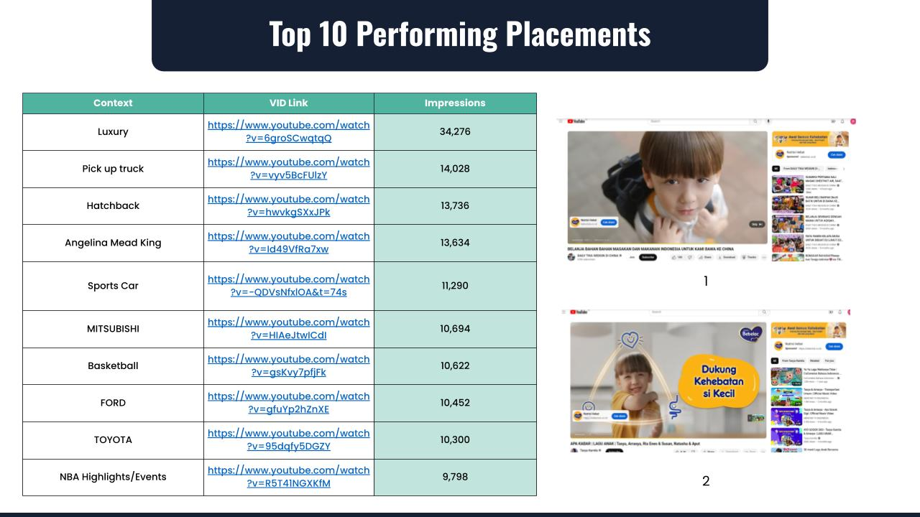
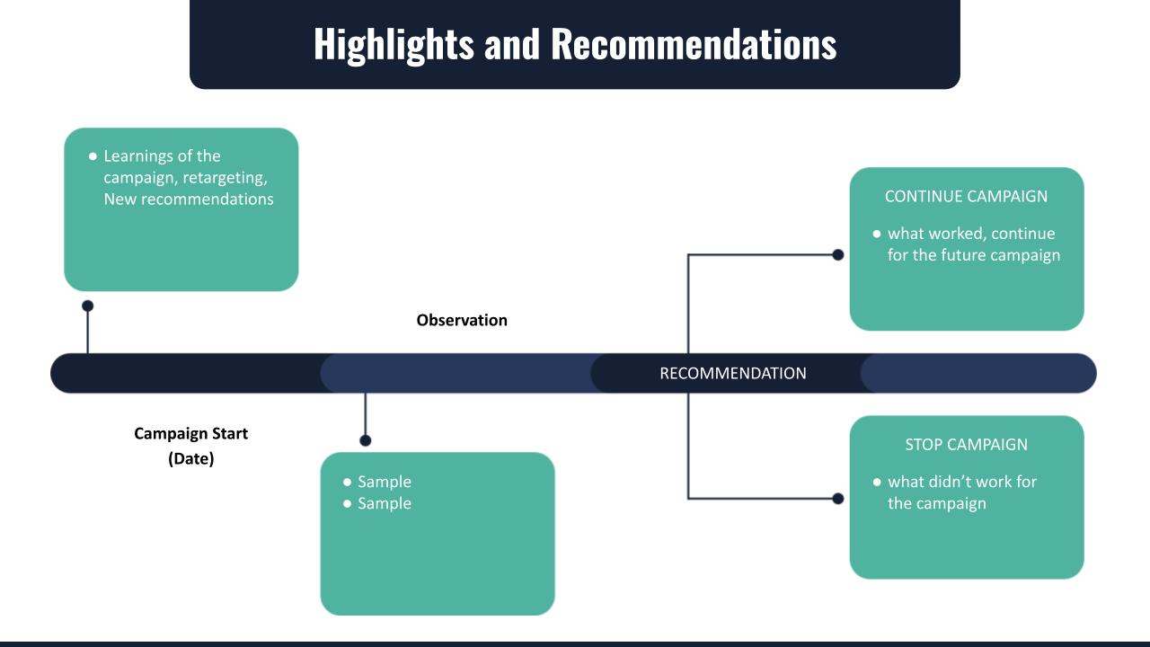
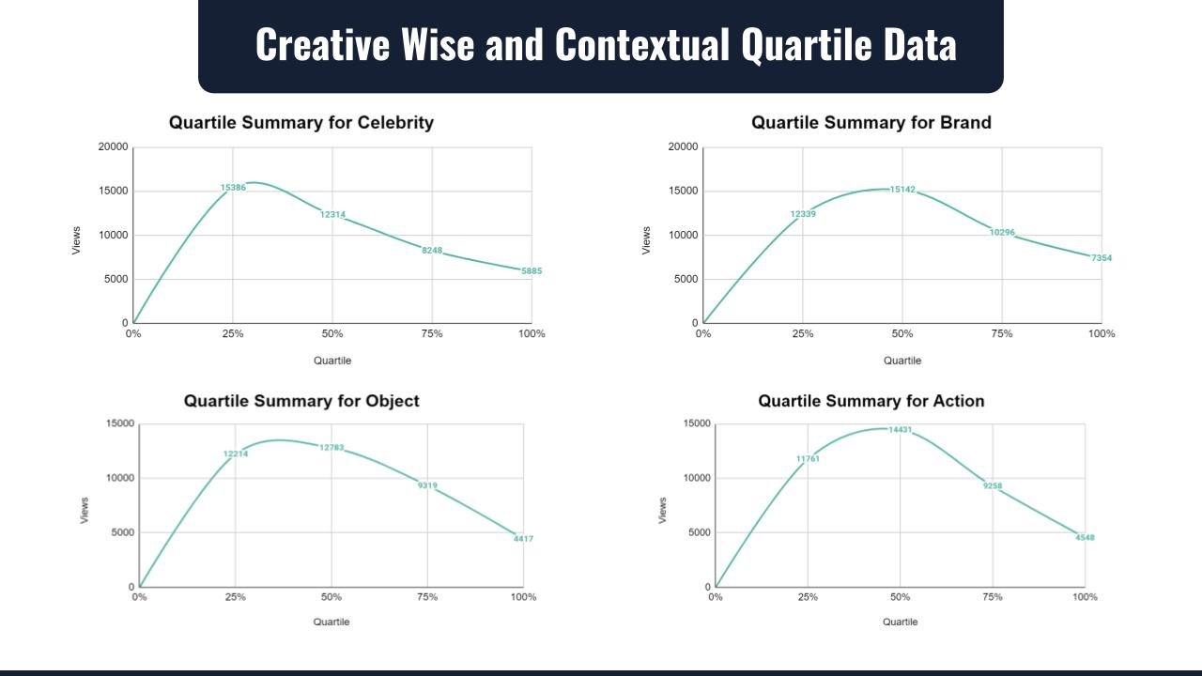
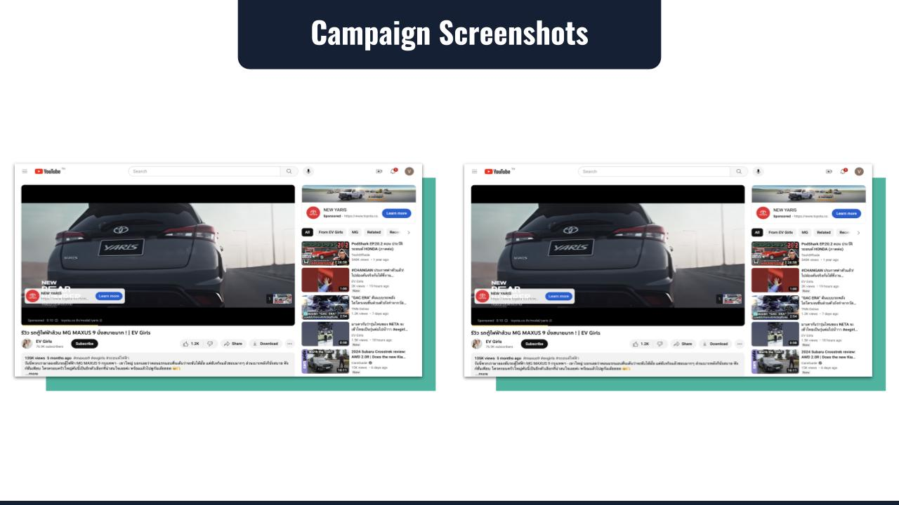
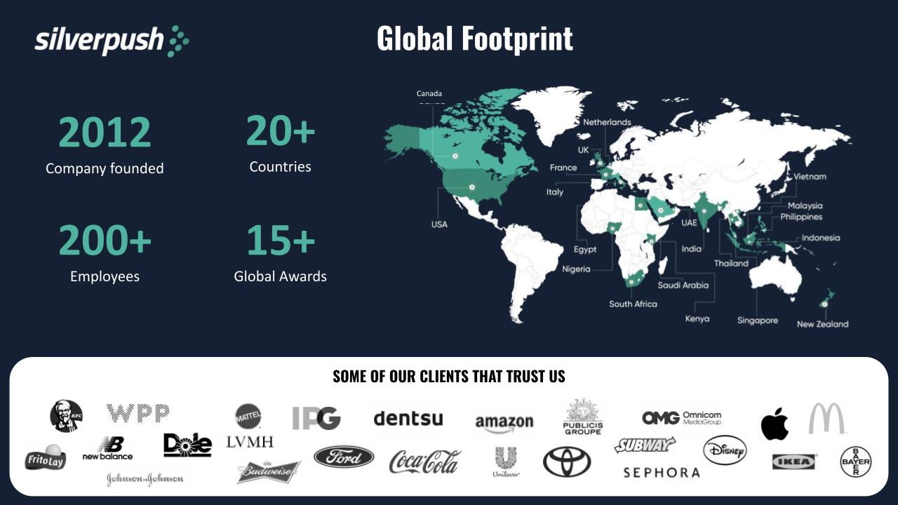
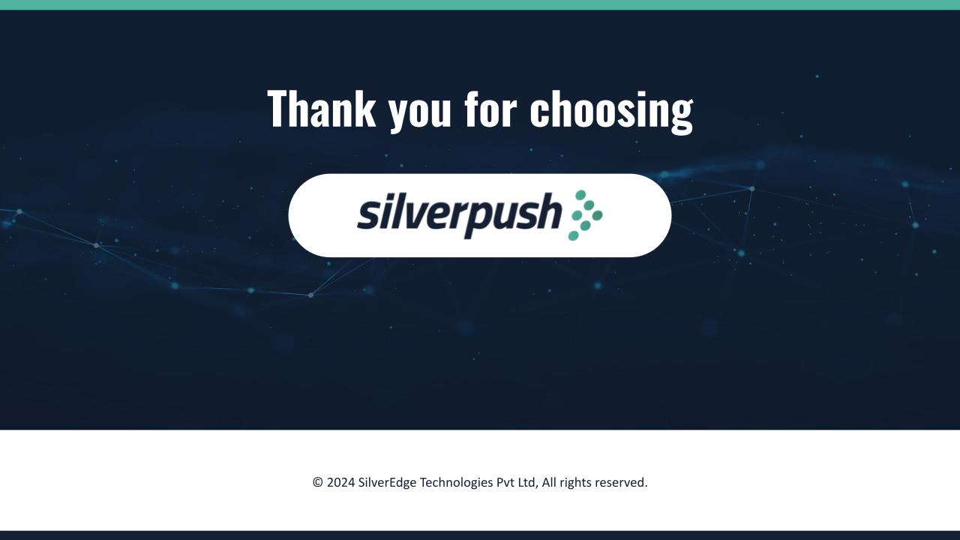
Comprehensive Post Campaign Analysis

Slide 20
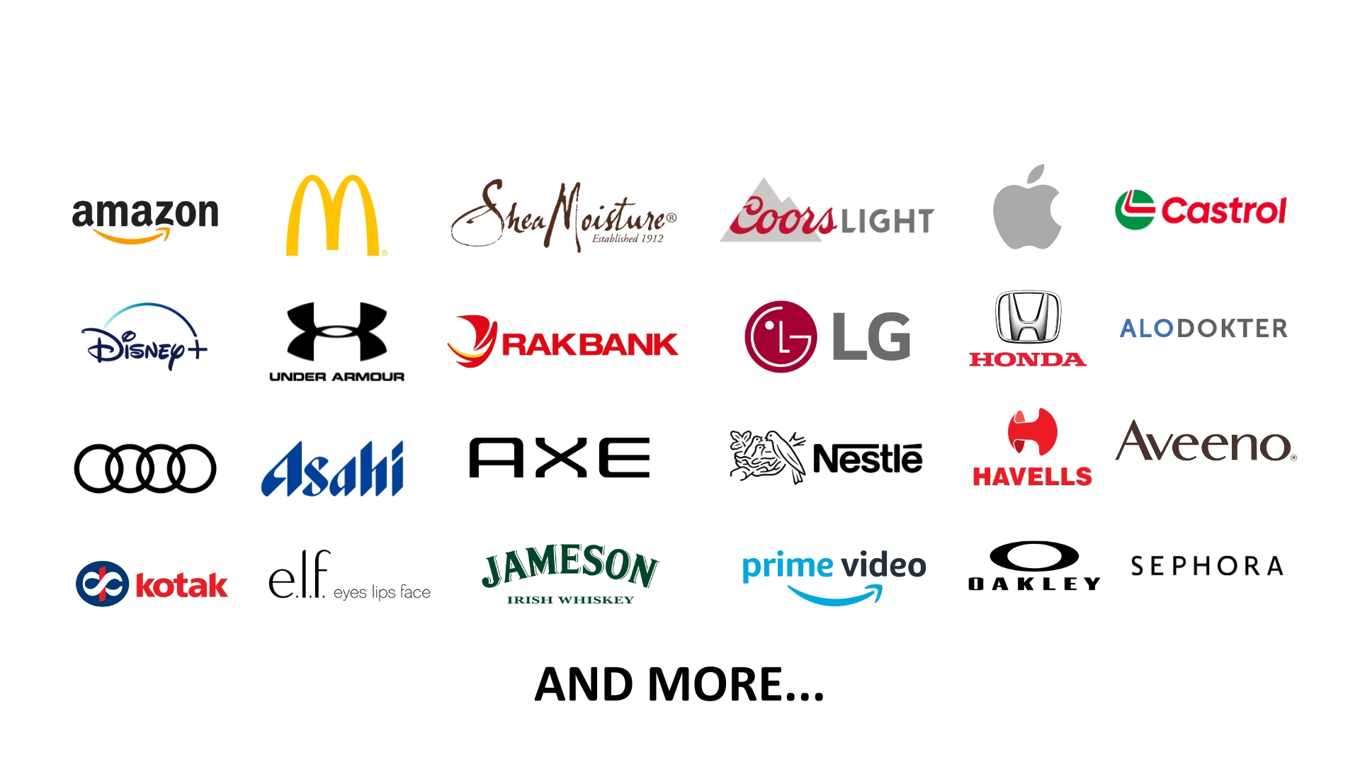
Clients Who Have Won With Us
Notes:
Our AI + human intelligence powered solutions are redefining the limits of contextual brand suitability for YouTube advertising with Mirrors.
20

Slide 21
Thank You!
© 2024 SilverEdge Technologies Pvt Ltd, All rights reserved.
Notes:
21

