Slide 1

Crypto Assets Related Investigation
OECD INTERNATIONAL ACADEMY FOR TAX AND FINANCIAL CRIME INVESTIGATION
Conducting Financial Investigations (Foundation) Virtual Programme
Ostia, Italy
Indonesia Case Study
EKA PUPY JUMANTARA
JULY 2024
Notes:
Hello, Good Morning..
Today I’m gonna share something from my experience conducting Tax Investigation in Indonesia
This case I’ll presenting is a crypto asset related investigation, so I hope my presentation is interesting to you and I can give some insight to you as well
Because after yesterday group discussion, I learned that some countries have no regulation about crypto assets and its trading and even considered crypto assets trading as illegal transaction. Hence, I believe that these countries have no government revenue derived from crypto assets transactions
Before we started, I’m gonna highlight some disclaimer on my presentation
This is a Tax Investigation, so I will share and presenting from a Tax Investigator perspective
This investigation is an on-going investigation and has not concluded yet, so I can not share some details of the investigation process
The purpose I joined this course is to gain more perspective from other countries regarding to this case I handle, so any input or recommendation is welcomed

Slide 2
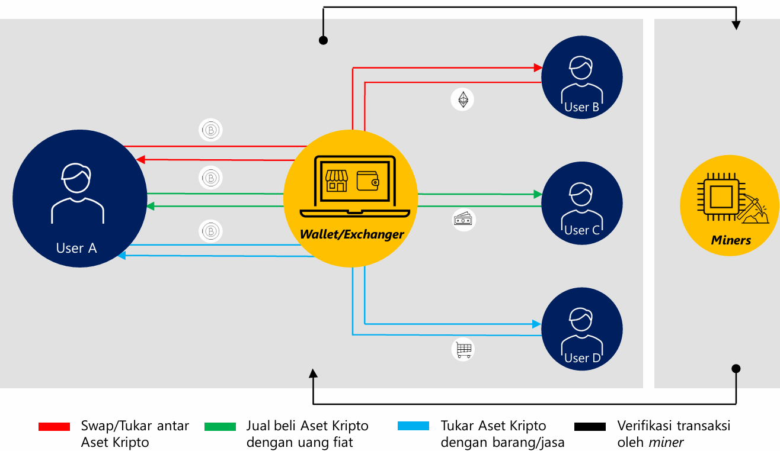

Crypto Assets Trading Overview
Crypto Assets Swaps
Crypto Assets Trade with Fiat Money
Crypto Assets Trade with Goods/Service
Transaction verification by miner
Notes:
Before I start my presentation, let me talk about crypto assets trading overview in general.
First type of crypto assets trading is trading crypto assets with fiat money. As you can see in green line, when User C wants to buy crypto assets, such as Bitcoin, He will trade his fiat money through a wallet or exchanger and User A will sell his Bitcoin via wallet or exchanger too.
Second type of crypto assets trading is crypto assets swap, So you can see in red line, if User A have a bitcoin and He wants to buy Ethereum from User B, He will swap it through the wallet or exchanger and get the crypto assets he desired.
The other type of crypto assets trading is crypto assets trade with goods/service. So you can see in blue line, if User A wants to buy something or use some services, He can trade his Bitcoin with the goods/services provided by User D via a wallet/exchanger too.
All this crypto asset transaction is verified by the crypto miners as you can see in black line.
And all this transactions have tax implications.

Slide 3

Income Tax Treatment – Indonesia Overview
Sale of crypto-assets 0.1% of the transaction value if the crypto-asset transaction is carried out through an electronic facility provided by an e-commerce trading operator that is a crypto-asset physical trader 0.2% of the transaction value if the e-commerce trading operator is not a crypto-asset physical trader. Income received or obtained from crypto-asset transactions conducted through electronic facilities provided by e-commerce trading operators 0.1% of the transaction value, where the e-commerce trading operator has obtained approval from BAPPEBTI 0.2% of the transaction value, where the e-commerce trading operator does not have approval from BAPPEBTI The income of crypto-asset miners 0.1% of the transaction value The income of e-commerce trading operators for the provision of electronic facilities used for crypto-asset transactions is subject to the prevailing tax rate under the Income Tax Law.
Income Tax
VAT
Notes:
These are the income tax treatment of crypto assets from Indonesian perspective.
Bappebti is a government agencies under the Indonesian ministry of trading that one of its duty is to oversee the crypto assets transaction. But in 2025 this duty will be transferred to Indonesia Financial Services Authority (OJK)

Slide 4
VAT Tax Treatment – Indonesia Overview
The delivery of the following goods/services are subject to VAT: Crypto-assets, by crypto-asset sellers This includes the purchase/sale of crypto-assets with fiat money, exchanging one crypto-asset for another and exchanging crypto-assets for other goods/services Provision of electronic facilities used for crypto-asset trading transactions, by e-commerce trading operators; Crypto-asset transaction verification services and/or crypto-asset miner group management services (mining pool), by crypto-asset miners Relevant VAT rates: 1% of the VAT rate multiplied by the transaction value of the crypto-assets, where the e-commerce trading operator is a crypto-asset physical trader 2% of the VAT rate multiplied by the transaction value of the crypto-assets, where the e-commerce trading operator is not a crypto-asset physical trader For crypto-asset mining services, 10% of the VAT rate multiplied by the monetary value of the crypto-assets received by crypto-assets miners, including crypto-assets received from the crypto-asset system e.g., block rewards.
Income Tax
VAT
Notes:
These are the regulation related to crypto assets transactions. By this regulations we can see that the wallet/exchanger act as a tax collector. The tax authority appoint the wallet/exchanger to collect the tax, either it’s an income tax or VAT.
If the wallet/exchanger is a local corporation, there is no difficulties, however if the wallet/exchanger is an international-based corporation, Tax authority will first have to appoint that corporation to be a Permanent Establishment and registered in Indonesia so that the PE can report and submit their tax return in Indonesia and also report the tax withheld by them via tax report

Slide 5

How The Case Initiated
Informations
Indonesia Financial Intelligence Unit
Indonesia Tax Authority (DGT)
Informations delivered by Indonesia Financial Intelligence Unit (PPATK) and enriched by Tax Intelligence : Suspect has international and domestic bank accounts Money outflow to China, Germany, Italy, Singapore, United Kingdom, and United States There is total of US$ 14,000,000 inflow and outflow money Suspect has multiple corporations Overseas banking transactions is not proportionate with the business activities Suspicion : Suspect not reporting all his income
Notes:
OK, now I will explain about our main discussion.
How the case initiated.
Indonesian tax authority get the informations from the Indonesian Financial Intelligence Unit, who already analyse international transactions whether it’s a transaction in to Indonesia or transaction out from Indonesia.
These informations then being enriched by our Tax Intelligence in order to see if the suspect’s transaction is proportionate with his business activities.
From the FIU informations, we know that the suspect has international and domestic bank accounts.
The money from that bank accounts outflow to many other countries such as China, Germany, Italy, Singapore, United Kingdom, and United States.
The total of money inflow and outflow from the bank accounts is about US$14,000,000.
With the information provided from Tax Intelligence we know that the suspect also has multiple corporations and business in Indonesia.
And that overseas banking transactions is not proportionate with the business activities.
The suspicion is : suspect not reporting all of his income and transaction to tax authority.

Slide 6
The Investigation
The Investigations carried out to Suspect and his related corporations Digital Forensic Techniques and Procedures to Suspect’s gadget and PC Crypto Assets Wallet Applications found in Suspect’s Gadget Investigator get Crypto Asset History Transactions Detailed Bank Transactions from Financial Institutions obtained Suspect cooperate and admit there are various income that are not reported to Tax Authority Some income is from Crypto Assets Trading Investigator ask opinion from internal expert to calculate the unpaid taxes Investigator already submit an EOI exchange request to our competent authority and still waiting for the responses from corresponding tax jurisdictions
Notes:
With the information provided by FIU and Tax Intelligence, Tax Investigators is assigned to do the investigation to the suspect.
The investigation is carried out to the suspect and all of his related corporations.
The investigator conducting a digital forensic techniques and procedures to the suspect’s gadget and PC/Laptop.
After a comprehensive search and inspection inside suspect’s house, the investigator found a crypto assets wallet applications in suspect’s handphone
And with a grit efforts the investigator finally can get the passcode and open the suspect’s crypto assets wallet application.
Inside the wallet, investigator can see the crypto assets transactions history.
The investigator also ask for the detailed bank transactions and obtained that data from the financial institutions that related .
After a thorough interview and examination, the suspect finally cooperate and admit there are various income that the suspect get and he failed to report that income to Tax Authority.
The suspect also admit that some income is gained from crypto assets trading.
With the data and information gained from the investigation carried out, Investigator still have to ask for an opinion from our internal expert to help calculate the unpaid taxes by the suspect and his related corporations.
Investigator also already submit an EOI exchange request the our competent authority and now still waiting for the responses from corresponding tax jurisdictions

Slide 7




Inter-Agencies Cooperation
FIU
Intelligence
Investigator
Digital Forensic
Financial Institutions
Notes:
This investigation is helped by the inter-agencies cooperation where the tax authority get the data feed from the FIU, these data and information then being collaborated with the Tax Intelligence and with the help of our Tax Digital Forensic Experts, the digital data obtained from suspect’s gadget and PC/laptop is analyzed.
The investigator also did some meetings with the FIU to get a better and deep understanding about the data provided by FIU.
The Financial Institutions also helped much with providing detailed bank account transactions that the suspect have

Slide 8
Case Results
The case is still an on-going investigation : Suspect admit not reporting all his income to Tax Authority Suspect will be given the opportunity to pay the taxes unpaid and the penalty of 100% to get the case closed in pre-investigation level If the case going up to investigation level and the investigator already coordinated with prosecutor, the penalty will be increased to 3 times If the suspect failed to pay the unpaid taxes and penalty, he will be charged with 6 months to 6 years of imprisonment, and have to pay 2 to 4 times of the taxes unpaid penalty depends on the judge
Notes:
The case results
This case is still an on-going investigation and not yet concluded.
The suspect already admit that he is not reporting all of his income gained to the tax authority.
According to our regulations, the suspect will be given the opportunity to pay the taxes unpaid and the penalty of 100% to get the case closed in preliminary investigation level, because in Indonesian tax regulations we have the ultimum remedium principle, which says that criminal law should be made a final effort in the case of tax law enforcement. The suspect then be given the opportunity to recover the government financial loss that happened because of the act of suspect not reporting all of his tax obligations. (I believe this regulation more or less is similar to UK Deferred Prosecution Agreements)
If the case is going up to investigation level and the investigator already coordinated with the prosecutor, the penalty will be increased to 3 times of the taxes unpaid.
However, if the suspect failed to pay the unpaid taxes and penalties, he then will be charged with 6 months to 6 years of imprisonment and also have to pay 2 to 4 times of the taxes unpaid penalty depends on the judge decisions.

Slide 9


Thank You!!
Questions?
Eka Pupy Jumantara
eka.pupyjumantara@pajak.go.id
+62-857-586-35303
Notes:
Thank you. That’s all my presentation.
I will happy to receive some opinion and insight from you all.
And If there is another input from you after this course finish, you can email or whatsapp me on this contact.
Any question??

