Slide 1
7th International Conference on Geological Repositories
Overview of NEA & Opportunities for Younger Generation
Morgan Packer
Specialist, Radioactive Waste Management
Nuclear Energy Agency (NEA)
ICGR-7, 27 May 2024 – Busan, Korea

Slide 2
What is the Nuclear Energy Agency?

Slide 3
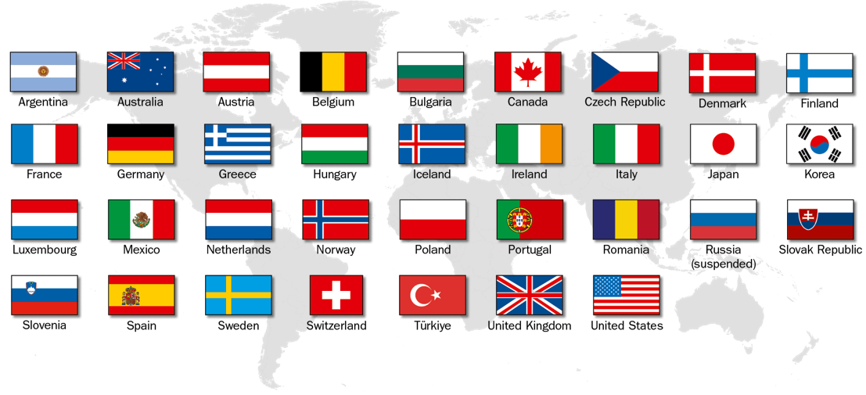
Overview of the Nuclear Energy Agency (NEA)
34 Member Countries
8 standing committees
80 working parties and expert groups
NEA Data Bank - providing nuclear data, code, and verification services
23 international joint projects
Growing global relationships with industry and universities
Together these 34 countries account for 82%
of the world's installed nuclear capacity

Slide 7







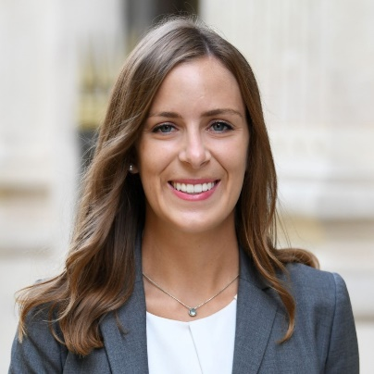
NEA Radioactive Waste Management Division (RWMD)
Young Generation

Slide 8
How does the NEA support the younger generation in the nuclear sector / radioactive waste
management?

Slide 9
Human Capacity Building for New Nuclear
The 2035 Project: Building a Diverse, Inclusive, and Gender-Balanced Nuclear Workforce
Aligns with NEA’s strategic goal to build human capacity in the nuclear sector.
Designed to enhance, accelerate and build upon existing NEA initiatives.
Will apply innovative approaches and platforms to support members efforts to build the needed nuclear workforce by no later than 2035.

Slide 10
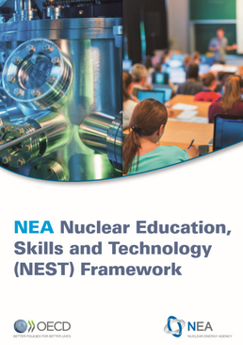
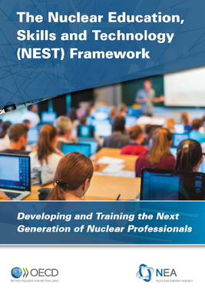
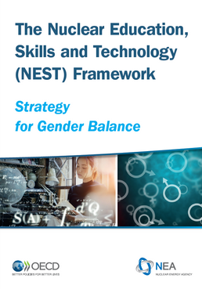
Nuclear Education, Skills and Technology (NEST) Framework
  Launched in February 2019
  A multinational framework designed to develop skills and nurture the next generation of nuclear subject matter experts through transfer of practical experience and knowledge.
Added-values and benefits
Fast track to leadership.
Multidisciplinary skills and competencies through hands-on training.
Access to state-of-the-art facilities.
Opportunity to develop a network through multinational co-operation.
Participation in challenging and innovative activities.
www.oecd-nea.org/NEST

Slide 11
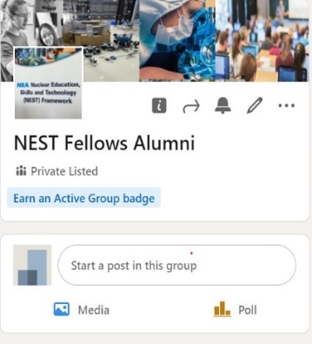
Ongoing NEST Projects
Hydrogen containment experiments for reactor safety (HYMERES).
Small modular reactors (SMRs).
Advanced remote technology and robotics for decommissioning (ARTERD).
Radioactive waste management of i‑graphite (I-GRAPHITE).
Medical applications, nuclear technologies, radioprotection and safety (MANTRAS).
Building competence, expert knowledge, applied techniques, safe decommissioning, train fellows (BEAST).
Training Radiological and International Nuclear Security (TRAINS).
Improving Cross-disciplinary and Transversal Skills for the Severe Accidents Community (TCOFF-II).
NEST Fellows speak:
  “The exposure to a wide-range of nuclear technologies and applications broadened my understanding of the complexity of the nuclear field...”.
  “I come from a social science background but the training increased my horizon regarding nuclear education, which I never thought I was ever going to have throughout my life...”.
  “This project has leaved a
  prominent hallmark on my future
  plans...”.
  “I am really grateful to NEST to
  make it fun, make it team, make
  it nuclear...”
NEST Fellows: Master and PhD students, postdocs, and young professionals
200+ Fellows (30% women) in 2019-2023
50+participating organisations
NEST Mentors: experts in hosting organisations
Fellowship duration:
1-12 months

Slide 12
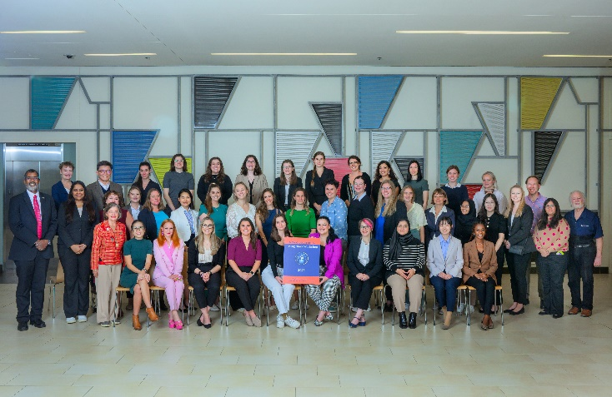
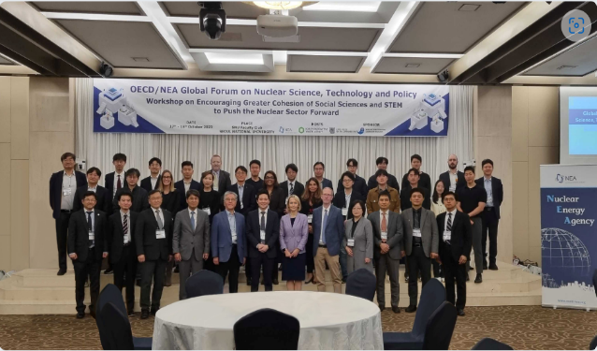
The NEA Global Forum on Nuclear Education, Science, Technology and Policy
  Launched in January 2021
  Engages with academic institutions which are responsible for developing the next generation of nuclear science and technology experts.
  Brings long-term, creative thinking to address international policy challenges that nuclear energy faces today as input to NEA processes.
  Provides academic institutions around the world with a framework for interaction, co-operation, and collective action.
  Holds occasional symposia to highlight the Forum’s work and serve as a venue for academic experts, as well as other stakeholders, to identify emerging issues and creative solutions related to the strategic areas identified.
  1st Rising Stars Workshop at MIT, USA, September 2023
  Country-specific workshop in Korea, October 2023
www.oecd-nea.org/globalforum

Slide 13

The NEA Global Forum: Areas of work
Council of Advisors (35 members from 20 academic institutions)
Governs the Global Forum and defines its programme of work
Working Group 1 Gender balance in nuclear technology and academic workforces
Working Group 2 Future of Nuclear Engineering Education
Working Group 3 Relationship between nuclear energy and society
Working Group 4 Innovations in the nuclear sector
Working Group 5 Re-Establishing Nuclear Law Education Programme
Working Group 6 Building the pipeline of STEM professionals

Slide 14
NEA Global Forum – Country Specific Workshop, Korea October 2023
NEA held a Global Forum – Country Specific Workshop at Seoul National University (SNU) last October 2023 with some key takeaways and recommendations for policy makers:
  Encourage clear communication on energy policy and the role of the nuclear sector at the national level;
  Continue joint efforts of government, nuclear stakeholders and academia to rebuild the attractiveness of nuclear education and careers to mobilise new talents through investments, innovation and inclusion in the nuclear sector;
  Through these joint efforts with key stakeholders, establish a comprehensive and innovative multidisciplinary curriculum;
  Expand training and education in an international context as a means of leveraging resources, including experimental infrastructure and supporting a connected workforce.

Slide 15
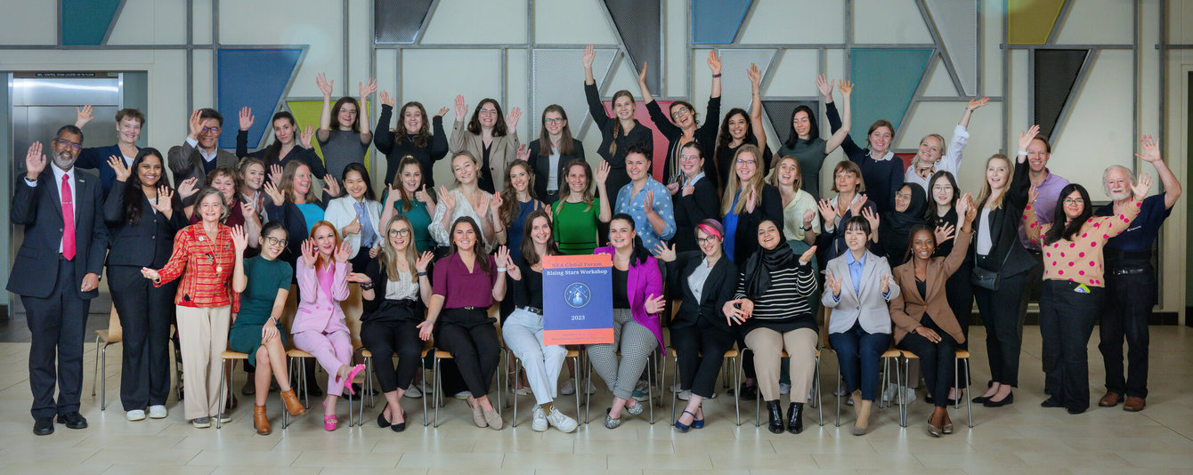
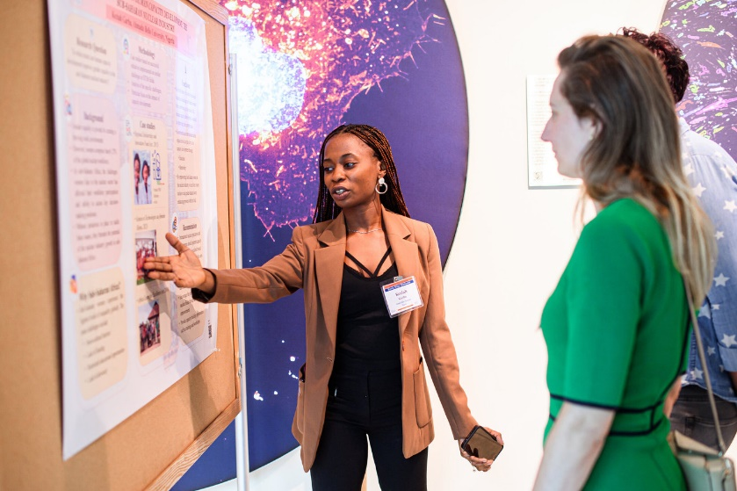
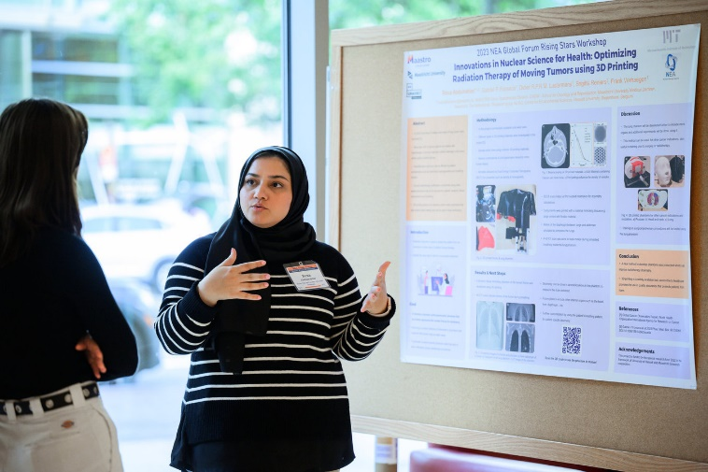
1st Global Rising Stars Workshop
Inaugural Annual Workshop at MIT:
  September 20–21, 2023 at MIT.
  40 Rising Stars: international graduate students and early career postdocs
  Participation of NEA Director General William D. Magwood, IV
  ~10 special guests, incl. NEA Global Forum members, provided mentoring.
  Planning underway for special issue of Nuclear Technology in Q1 2025 featuring Rising Stars articles.

Slide 16

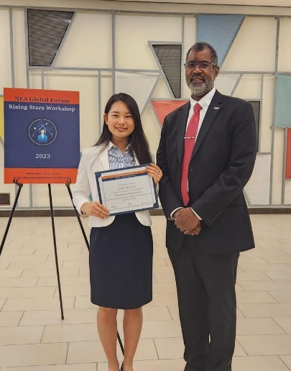
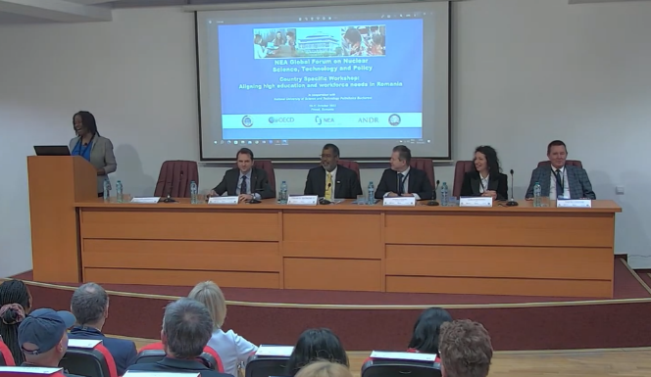
The NEA Global Forum: Recent and planned events
3rd Annual Global Nuclear Science and Engineering Commencement, theme “Nuclear technology in service to Society”, virtual, 29 June 2022.
1st Country-specific Workshop “Challenges of nuclear education”, co-organised with the University of Tokyo and Ministry of Education, Culture, Sports, Science and Technology (MEXT), 19-20 July 2022, Tokyo, Japan.
1st Rising Star Workshop, co-organised with Massachusetts Institute of Technology (MIT),
20-21 September 2023, Boston, US.
2nd Rising Star Workshop, being planned to take place in Fall 2024.
2nd Country-specific Workshop “Aligning high education and workforce needs in Romania”, co-organised with National University of Science and Technology Politehnica Bucharest, 10-11 October 2023, Pitesti, Romania
3rd Country-specific Workshop “Encouraging greater cohesion of social sciences and STEM to push the nuclear sector forward”, co-organised with SNU and the Korea Radioactive Waste Agency (KORAD), 16-17 October 2023, SNU, Korea.
1st Global Forum Symposium, planned for 2025.
Bill Gates keynote speech at the Third Global Nuclear Science and Engineering Commencement, June 2022
1st Rising Stars Workshop at MIT, USA, September 2023
Country-specific workshop in Romania, October 2023

Slide 17
How can you get involved with the NEA / OECD?

Slide 18
Courses & networking opportunities offered by the NEA
International School on Radiological Protection (IRPS)
  12-16 August 2024 at Stockholm University in Sweden
  Registration: Nuclear Energy Agency (NEA) - International Radiological Protection School (IRPS) at Stockholm University – 2024 edition (oecd-nea.org)
International Nuclear Law Essentials (INLE)
  3-7 March 2025 in Paris, France at the OECD
  Applications will open September 2024: Nuclear Energy Agency (NEA) - International Nuclear Law Essentials (INLE) (oecd-nea.org)
International Nuclear Law School (ISNL)
  2024 application period is now closed (will be held from 26 August – 6 September), but will take place ~August 2025 in Montpellier, France
  Information: Nuclear Energy Agency (NEA) - International School of Nuclear Law (ISNL) (oecd-nea.org)

Slide 19
Participate in NEA Expert Groups
While the NEA Secretariat remains separate from the official nomination process to serve on an Expert Group in order to ensure independence, Member Country Delegations to the OECD nominate on a formal basis experts to participate in NEA Expert Groups.
If you are interested in representing your country / organisation in a specific NEA Expert Group, reach out to your OECD national delegation directly for more information on the nomination process.

Slide 20
Applying to positions at the OECD / NEA
All vacancies and internships are through the OECD platform – Smart Recruiters
  Apply here: Careers at OECD (smartrecruiters.com)
  Two modes of recruitment at the OECD/NEA:
    Staff on loan – appointment by your current employer to the OECD
    OECD official – formal interview process (video interviews, written exam and panel interview)
Internships require a Memorandum of Understanding (MOU) and a valid certificate of current enrolment in a higher education institution.

Slide 21
What can you do this week
at ICGR-7 to push forward
your career in the nuclear
sector / RWM?

Slide 22
Thank you!
Questions?
Please email: morgan.packer@oecd-nea.org
Title page photo: zffoto, ShutterStock

