Slide 1


ASSET RECOVERY IN BRUNEI DARUSSALAM
Azmeena Mohiddin
Legal Counsel & Deputy Public Prosecutor
Financial Crime and Narcotics Unit
Criminal Justice Division

Slide 2
Table of contents
01
Governing Laws
03
Case Examples
02
Criminal Asset Recovery Order 2012
Main laws on Asset Recovery in Brunei Darussalam
Asset recovery cases in Brunei Darussalam
Overview of CARO and Orders pertaining to Asset Recovery

Slide 3

01.
Governing Laws

Slide 4

Governing Laws
Criminal Asset Recovery Orders, 2012
Misuse of Drugs Act
Criminal Procedure Code
Provisions to forfeit proceed of crime to the state
Provisions to forfeit ship, hovercraft, aircraft or vehicle connected with offence
Prevention of Corruption Act
Provisions to investigate accounts, to furnish Statutory Declaration (upon authorization by PP) and restriction on disposal of property

Slide 5
WHY CARO 2012?
Provides various orders to be applied for property suspected to be proceeds of crimes
Criminalizes money laundering as a stand alone offences
Provides various investigative powers to authorized officers
Applies to proceeds of serious offences:
Framework to make and accede to request for enforcement of foreign restraining, confiscation and benefit recovery order by a foreign country
punishable of at least 6 months imprisonment, fine not less than $1000 or more severe penalty

Slide 6

02.
Orders under CARO 2012

Slide 7
Orders under CARO 2012
Restriction Notice by PP
Confiscation Order
Non- conviction based forfeiture
Unexplained wealth declaration
Restraining Order
Benefit recovery order
Forfeiture where no prosecution

Slide 8
Orders under CARO 2012 – Interim Orders
Restriction Notice by PP
Restraining Order
By written notice issued by PP
Anyone who is investigated for an alleged offence under CARO or ML offence or any serious offence
By Court Order
Only when there is reasonable ground to suspect the property to be tainted property AND a conviction – based forfeiture order OR benefit recovery Order may be applied on the property

Slide 9
Orders Under CARO 2012 – Forfeiture Order
Confiscation Order
Non Conviction based Forfeiture Order
Court Order if satisfied that the property is tainted property
After conviction (time limit of 2 years)
By way of Originating Summons supported by Affidavit of Investigating Officer
Court Order if satisfied that the property is tainted property
Regardless of acquittal or withdrawal of charges
By way of Originating Summons supported by Affidavit of Investigating Officer

Slide 10
Orders Under CARO 2012 – Tainted Property
Property used in connection or used in the commission of offence
A
Property obtained as a result of the commission of an offence
Tainted Property
B
Income from sources unrelated to criminal activity of that person cannot reasonably account for the acquisition of that property
C
Proceeds of Crime
D

Slide 11
$2,169,693.01
≈USD$1,616,906.65
Since implementation of CARO 2012, as of 31/1/2022

Slide 12
03.
Case Examples

Slide 13

“DINAR DIRHAM” CASE
A global cryptocurrency trading company that offered a platform to digitally invest in gold crypto coins globally.
4 individuals took deposits from public to “invest” in gold/cryptocurrency scheme “Dinar Dirham”.
Entitled “investor” to monthly returns of between 8% -15 % for 6 months.
One individual removed money that was proceed of crime from Brunei and deposit it into his Malaysian account.
Minimum purchase of 1 Dinar Coin (DNC) (Equivalent to 4.25g of 999.9 gold) is valued at B$260-B$280 and amount would be paid to the Investment Banker for registration.

Slide 14
DINAR DIRHAM CASE
Alerted by FIU and found monies are deposited by the so called “investors” into the local bank accounts of these 4 individuals.
None of the individuals nor Dinar Dirham possess a license to carry out a banking business (which include receiving deposits) in Brunei Darussalam.
Application for non conviction based forfeiture by consent applied for and granted by the Court.
In total: BND$55,004.30 (≈USD$40,990.51) found in their respective accounts in a local bank.
BND$557,720.00 (≈USD$415,626.16) cash were found in one of the individual’s house.
Asset recovered: BND$612,724.30 (≈USD$456,616.67)

Slide 15
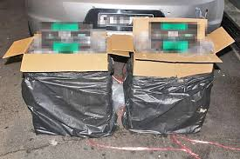
MOHASIN CASE
A foreign male convicted for possession of unexcisable goods i.e. 100 cartons of cigarettes under the Excise Order.
When arrested, he was also found with BND$1,070 (≈USD$797.39) cash which he admitted to be from sale of contraband cigarettes and his salary as a labourer.
He was also discovered to have a local bank account containing over BND$100,000.00 (≈USD$74,000) which he opened in 2016. Thus, CARO investigation was carried out.

Slide 16
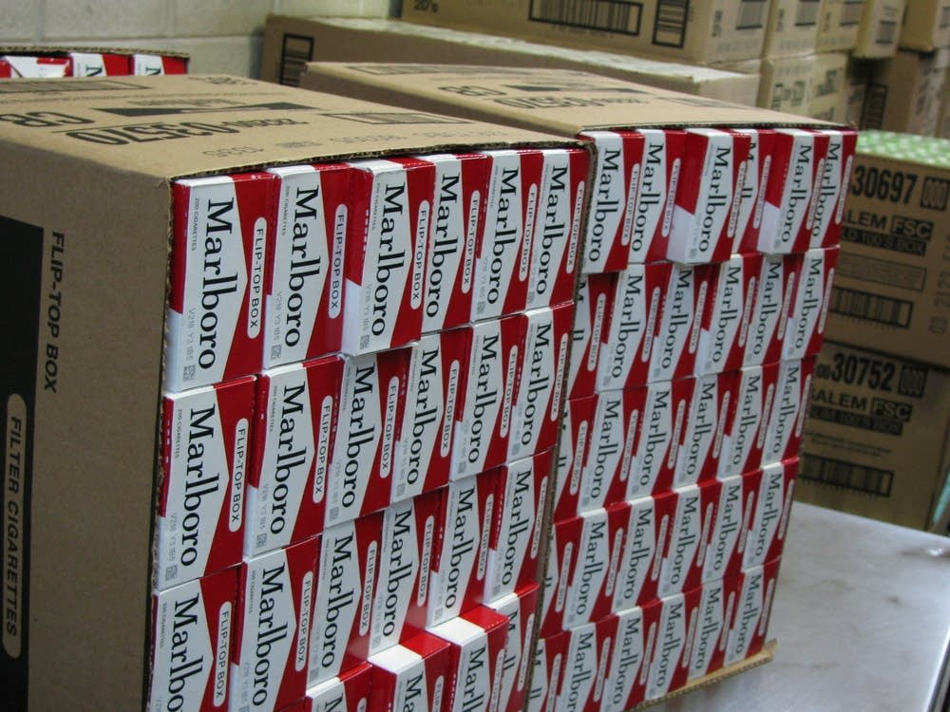
MOHASIN CASE
Investigation:
Restriction notice under CARO issued to restrict disposal of monies in the account.
FIU analysis shows that he frequently made ATM deposits that reached the daily cap of BND$10,000 and made 3 ATM deposits through multiple transaction totaling to $30,000 (≈USD$22,356.71) at odd hours. He also made large withdrawals at the ATM through multiple transactions.
Statement from employer revealed that he has not been working as a laborer for the said company for over a year

Slide 17
MOHASIN CASE
His explanations: Money were from his salary and sales of cars and lorry which he have saved up, and from family and friends who have asked him to keep their money in his account. He also claimed that he has been working as a freelance laborer for about 5 years.
Admitted: Only $40,000 (≈USD$29,808.95) deposited in 2020 were from illegal sale of cigarettes.
Asset Recovered: BND$40,000 (≈USD$29,808.95) under Conviction – based Confiscation Order by consent under CARO.

Slide 18
R & N CASE – ONGOING
R was a Deputy Official Receiver and held Official Receiver’s (OR) bank accounts on trust for repayment of Judgment Debtor’s debt
Both were senior judicial officers
Have 2 children, one who was studying in the UK at the time
R & N are husband and wife
They all led VERY lavish lifestyle

Slide 19
R & N CASE – ONGOING
15 January 2020, R was convicted for criminal breach of trust for misappropriating BND$15,750,292 (≈USD$11,737,490.88) from OR accounts over a period of 14 years.
R and N were also charged individually and convicted for money laundering under CARO for:
1. Cash that was deposited in their joint bank accounts (N acquitted of 2 charges pertaining to two deposits)
2. Monies that were transferred to their UK bank accounts
3. Cash used to buy luxury cars and handbags
During the start of investigation, ACB applied for PP’s power to freeze their bank accounts including their daughter and son (under the PCA).

Slide 20
R & N CASE– Seized Exhibits
19
7
14
456
Bank Accounts
Vehicles
Vehicles
Luxury Items
R, N and their children
Registered under R and daughter
Porshe, Mercedes, Jaguar, Range Roger
Registered under N
Porshe, Mercedes, Jaguar, Range roger
Handbags (mostly Chanel), wallets, watches (Rolex, Breitling)

Slide 21
R & N CASE – Financial Analysis
Disproportionate Wealth
Deposits
Vehicles
Legitimate income between 2003-2017 was about BND$1.3 Million (≈USD$968,790.81).
Cash used (based on cash deposits, cash payments for cars and credit card payments only) about BND$9.7 Million (≈USD$7,228,669.89).
Luxury items about BND$1 Million (≈ USD$745,223.70).
Large amount of cash deposits made into their joint accounts made a day or few days after withdrawal from the OR account.
$10K notes withdrawn from OR account subsequently deposited into joint account.
About BND$5.9 Million (≈USD$4.3Million) deposited.
Between 2008 and 2017, they have paid a total of over BND$2 Million (≈USD$1.4 million) in cash for purchase of 25 luxury cars which was acquired soon after R withdrew large amounts of cash from the OR account which was under her control.

Slide 22
R & N CASE – Restraining Order
After conviction, Prosecution applied for a restraining order under CARO to retrain cars, monies in bank accounts, handbags and watches.
Application was granted by the Court as it was satisfied that there is reasonable grounds to suspect the properties are tainted properties and confiscation order MAY be made.
Notice of Motion filed for Confiscation Order on 13 January 2022.
Next Step:
If Court is satisfied that it is tainted property, Confiscation Order will be made
Trial if the application is contested
Property subject to CO may be sold off and proceeds deposited into CARO fund

Slide 23
Thanks!
Do you have any questions?
azmeena.mohiddin@agc.gov.bn
www.agc.gov.bn

