Slide 1
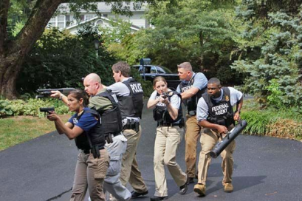
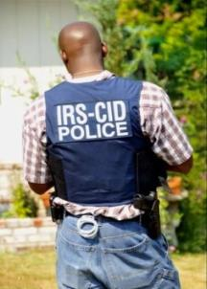
Measuring the Threat of Professional Enablers
CASE STUDY
|

Slide 2

How do you find Professional Enablers?
General Investigations
Informants/Sources
Other Agencies/Referrals
Data Analysis
FINCEN
Undercover Activity
Spin-offs
Notes:
Target general investigations of Attorneys, tax accountants, financial advisors; pick an industry
Find data sources to run anomalies (companies registered to professional, companies registered to a particular address)
Develop sources, attend seminars, perform an undercover at a seminar
Outreach to other agencies, make them aware of the situation.
Follow-up on spin-offs, use target to develop other targets
FINCEN will have database of UBOs

Slide 3

How do you Measure the Threat?
Understand the scope
Understand the problem
Analyze data sets
Share information among agencies
Focus on a goal

Slide 4


It all started with an informant…
And a thumb drive.

Slide 5



No list of members
No annual report
No identity check for Registered Agent
Registered Agent opens bank account
Who are these people????

Slide 6
P.O. Box Address
Several different investigative techniques
Day of Action
PATIENCE

Slide 7
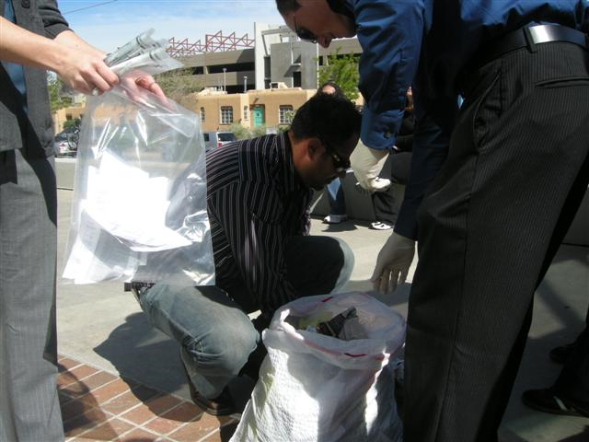
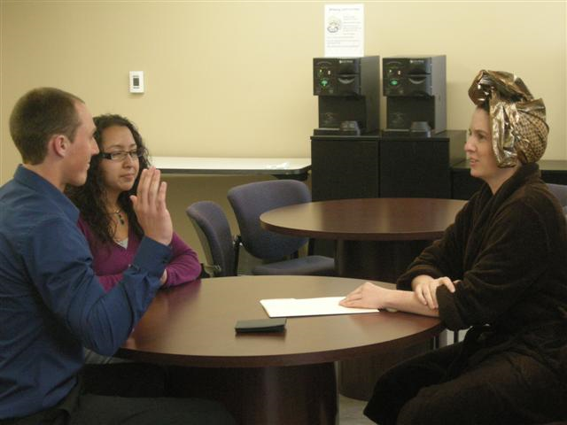
30+ Interviews of clients around the country
3 physical search warrants of professional enablers
Parallel tax audits from IRS Civil
5 Subject Interviews
RESULTS

Slide 8

Puerto Peñasco

Slide 9

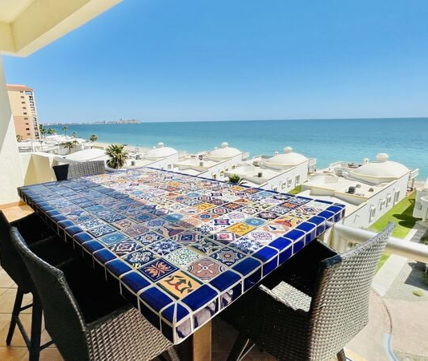


Why not spend your tax savings here??

Slide 10
Purchase NM LLC - $5,000
Anonymity = tax-free living
Move retirement $$ out of tax system
Purchase fractional shares in Mexican Property
Minimum $100k investment
Live happy in Mexico

Slide 11

PROBLEM
All a Ponzi Scheme

Slide 12

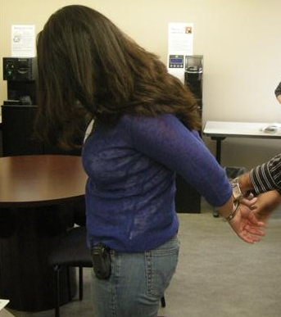

Wire Fraud/Mail Fraud/Aiding and Abetting/Tax Charges
Prison Sentences
Everyone lost at the end

Slide 13


Spin-off Cases
Lessons Learned
Challenges
Notes:
Bank Education on Know-your-customer rules/BSA Regulations
Stricter regulations on NM LLCs
Holding clients accountable for their part
Requiring a physical address for a registrant
Identifying Registered Agent/Proof of identity

Slide 14


